Slide 1
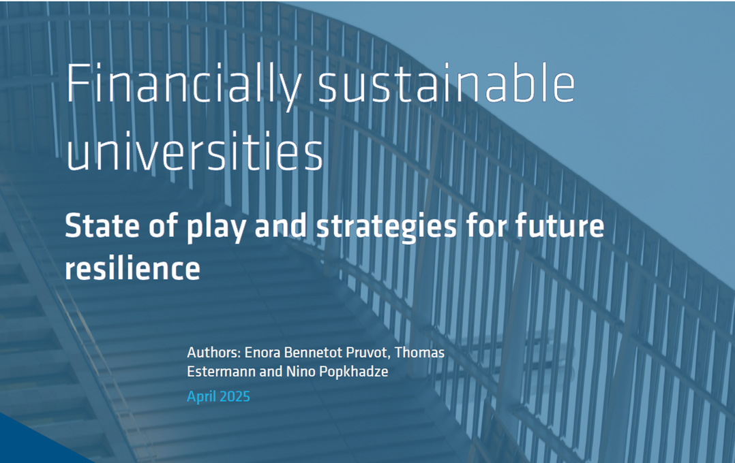

Compostela Group of Universities
September 2026
Nino Popkhadze
Policy Analyst
European University Association
Governance, Funding and Public Policy

Slide 2
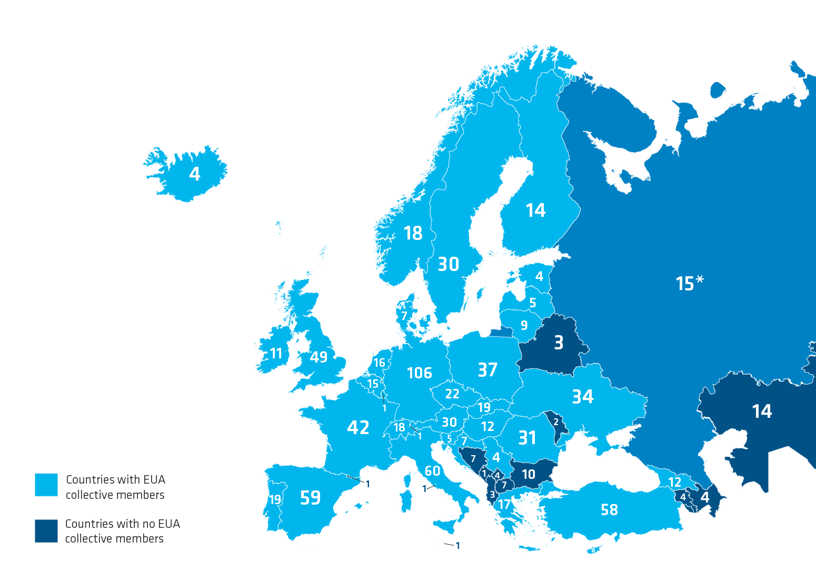

European University Association
“Supporting our members to excel in service to society”
Established in 2001
Representing 900 members across 49 countries
      Facilitates dialogue on higher education & research
      Represents the interests of the higher education sector
      Supports the sector with a range of services (strategy development, thematic peer groups & focus groups, events, and publications)
      Data powerhouse
      Shares good practice
      Supports reform processes across Europe and beyond
      Connects members with EU policy

Slide 3
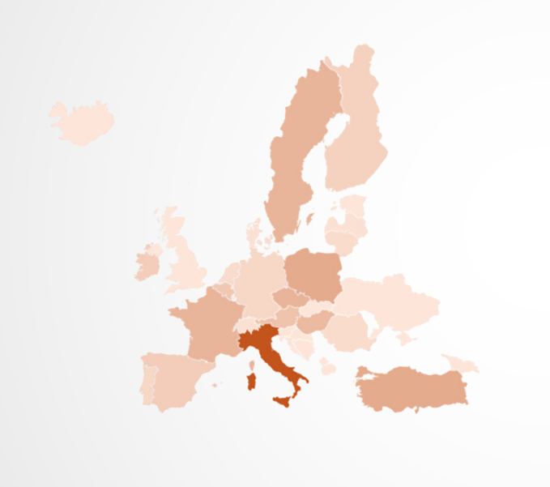
Survey data
Data collection May -June 2024
168 HEIs from 34 countries
Top contributors
Italy 31
Poland - 13 Türkiye - 13
Sweden - 11 France - 11 Czechia - 11

Slide 4
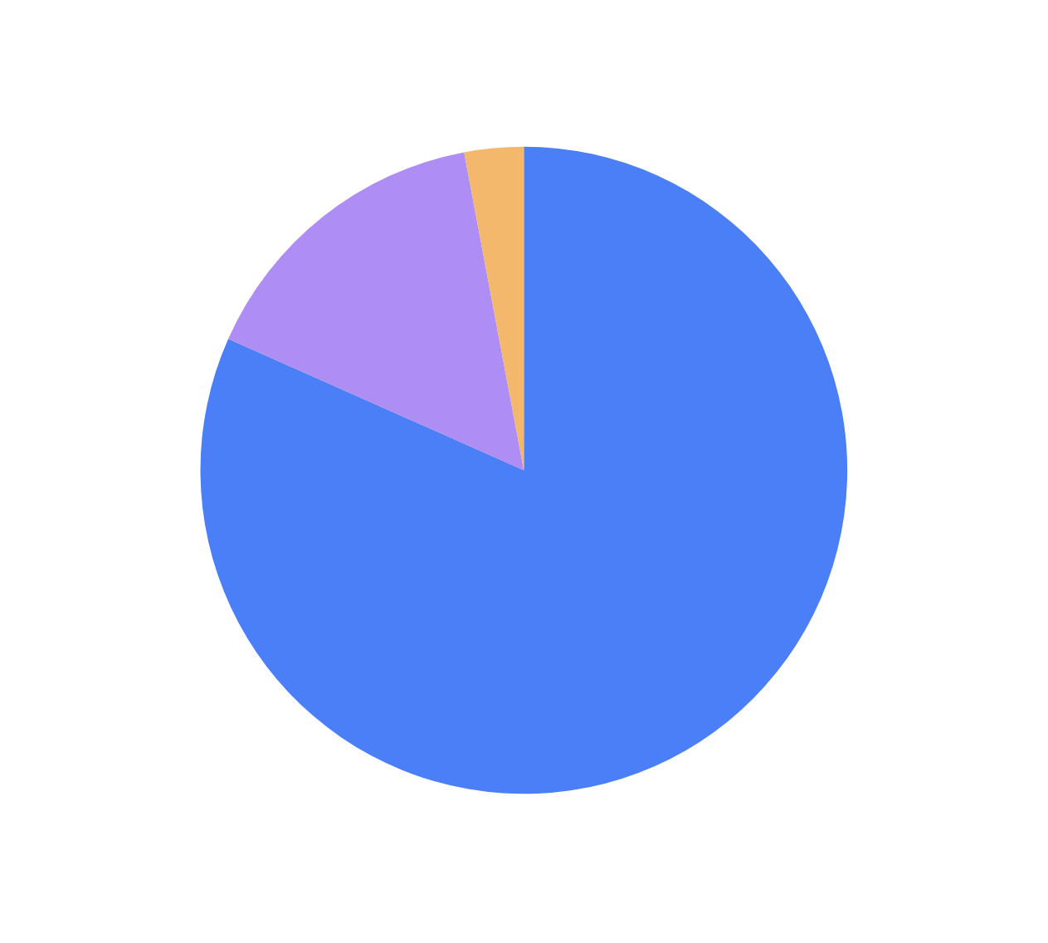
Survey data
Institutional profile

Slide 5
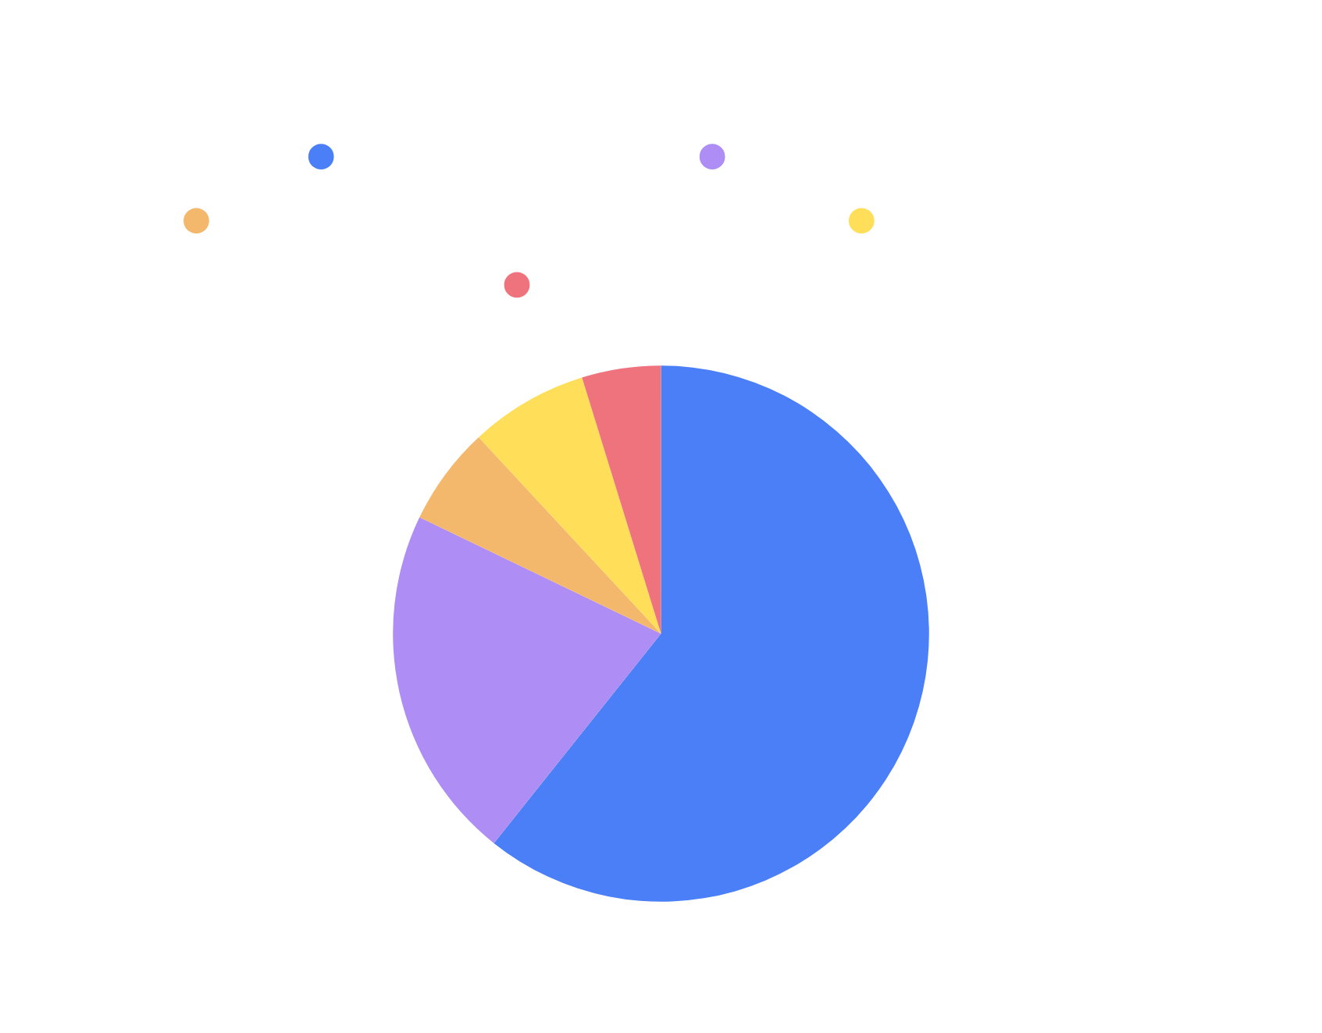
Survey data
Institutional profile

Slide 6
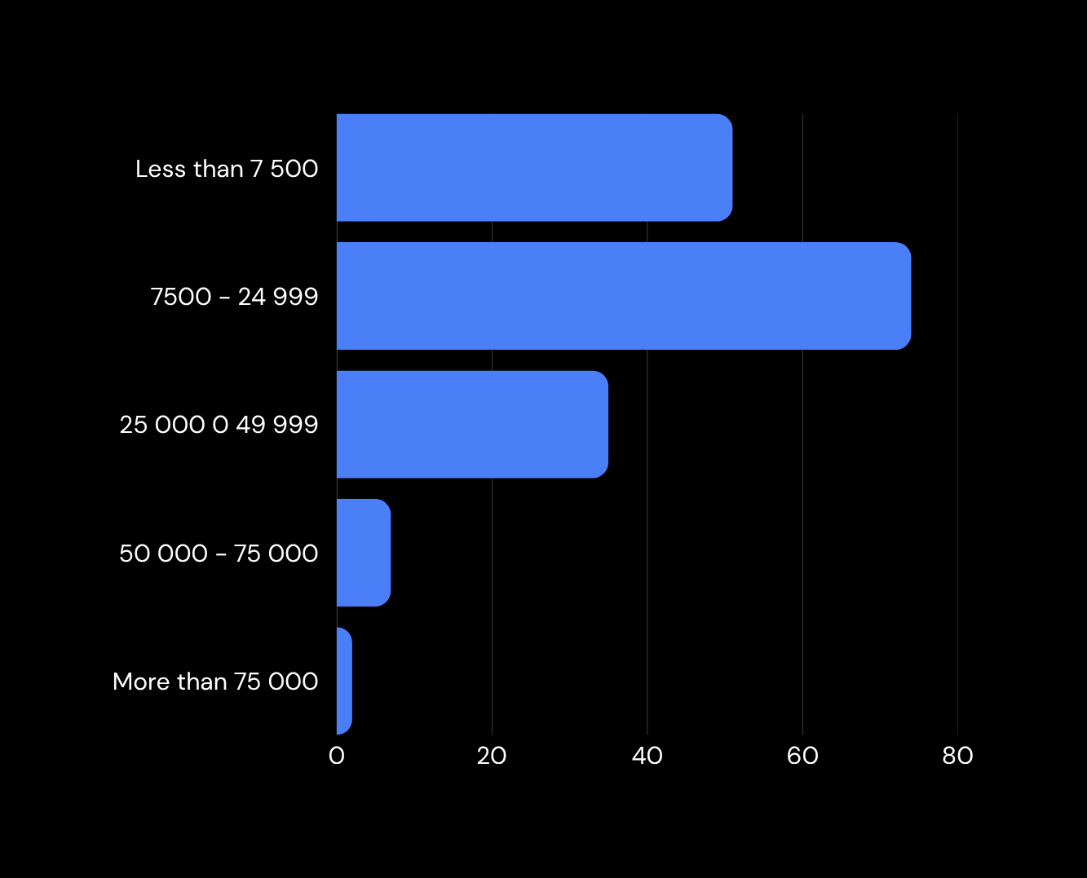
Survey data
Institutional profile
STUDENT FTE

Slide 7

Survey data
Institutional profile
STAFF FTE

Slide 8
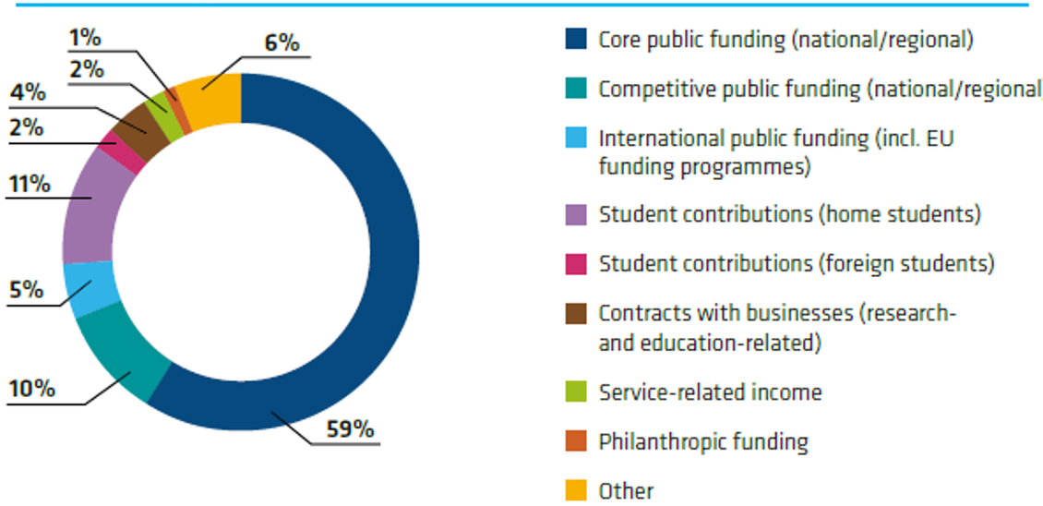
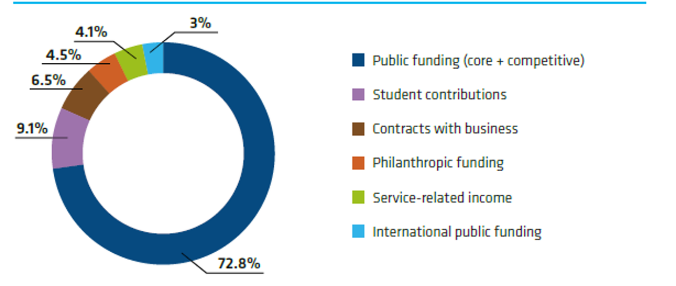
Average Income Structure
2024
2009

Slide 9
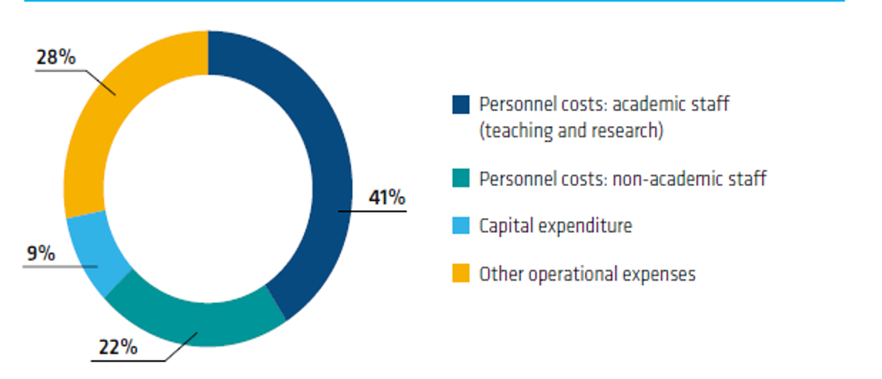
Average Expenditure

Slide 10
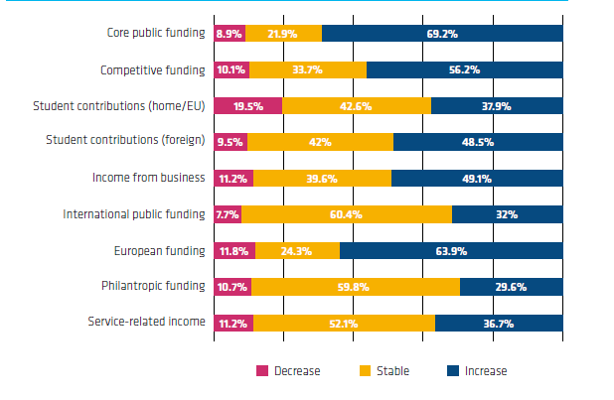
Income Evolution

Slide 11
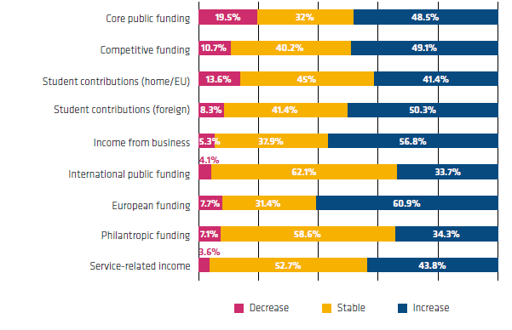
Income Expectation

Slide 12
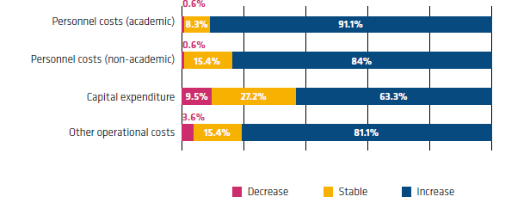
Expenditure Evolution

Slide 13
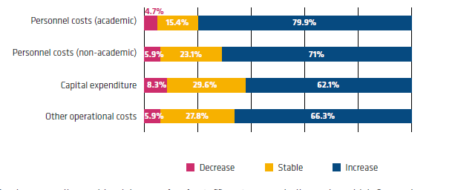
Expenditure Expectation

Slide 14
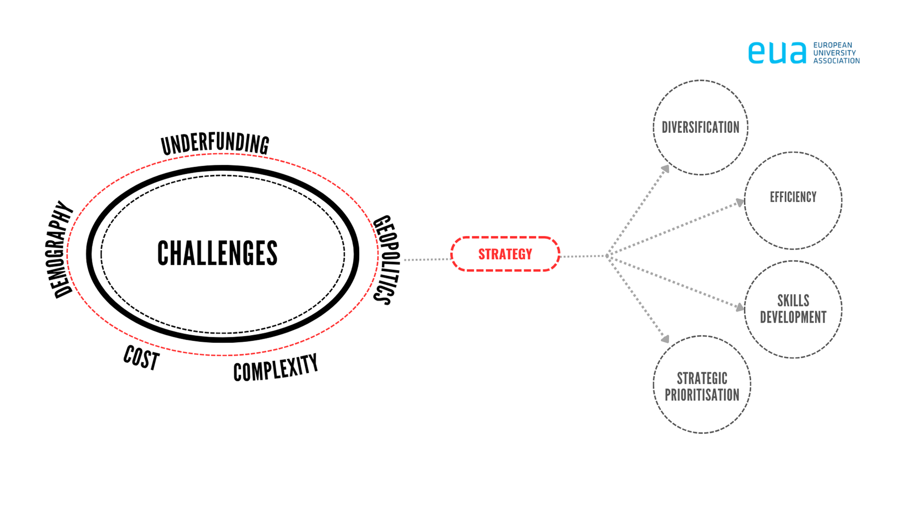
Challenges & Strategies

Slide 15
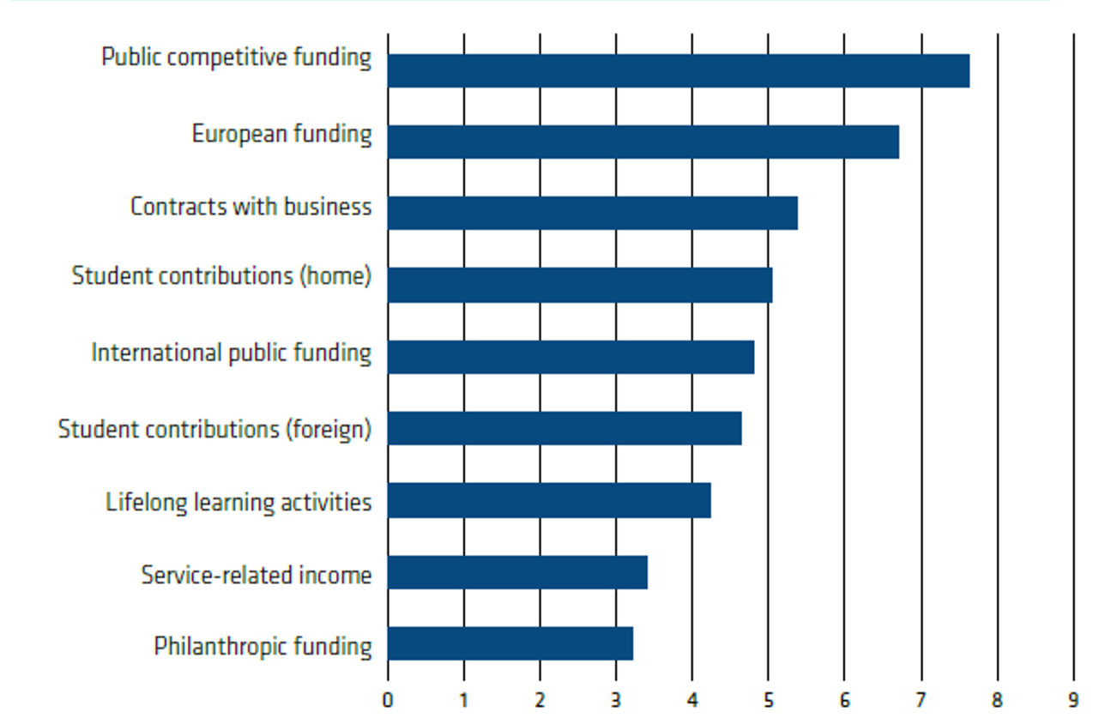
Ranking of priorities for diversification

Slide 16

European Funding: Great Expectations
European Council proposes:
167 bn - Horizon Europe
Erasmus + 39.1 bn
Based on the proposal of the Cypriot Presidency in June
EC proposal 175 bn
Erasmus+ 41 bn
Horizon Europe is part of the European Competitiveness Fund, total of 451 bn
Sector
Horizon Europe
200 bn
Erasmus + 60bn
Horizon Europe figure backed by the European Palriament

Slide 17
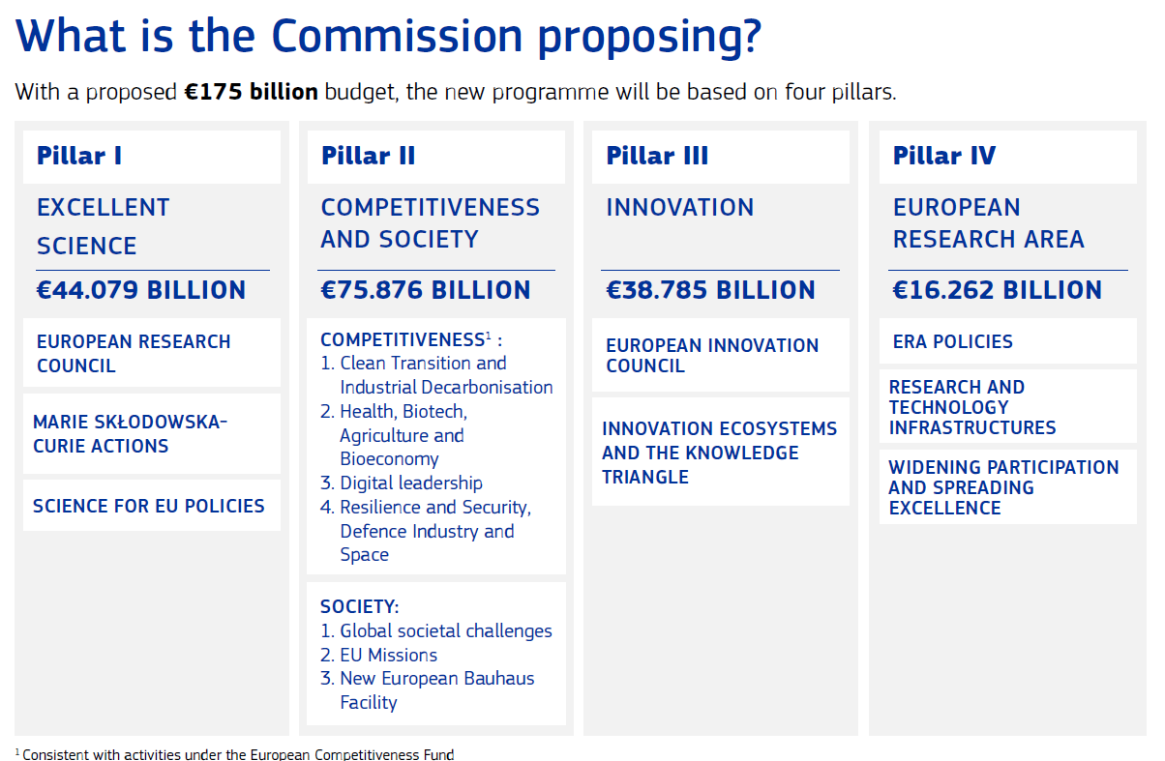
European Funding: Great Expectations

Slide 18
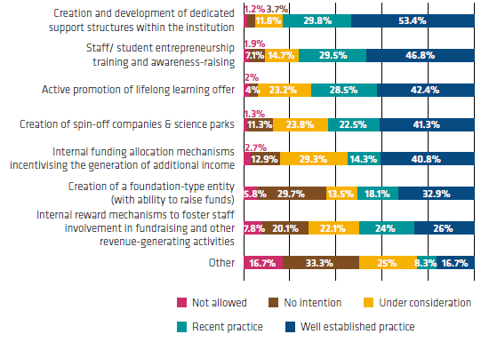
Tools to support income diversification

Slide 19
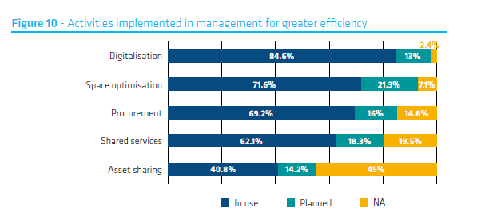
Efficiency

Slide 20
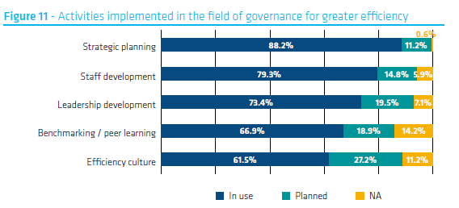
Efficiency

Slide 21
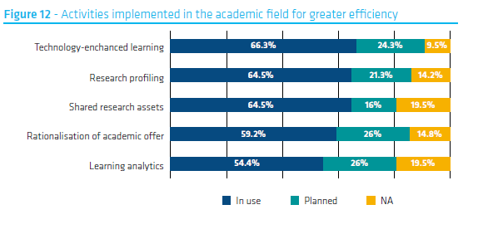
Efficiency

Slide 22
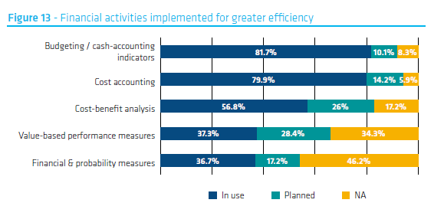
Efficiency

Slide 23
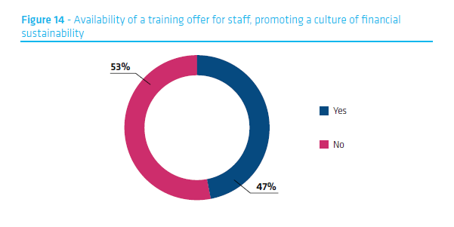
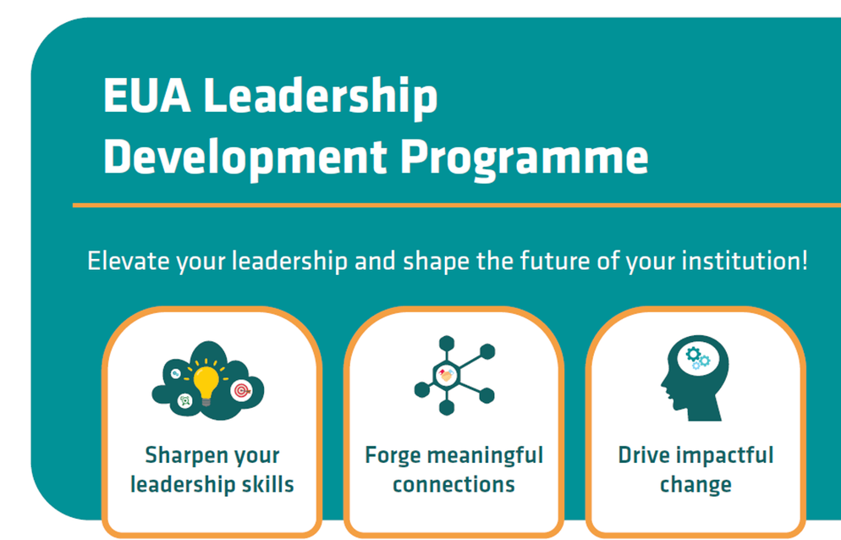
Training and Upskilling

Slide 24
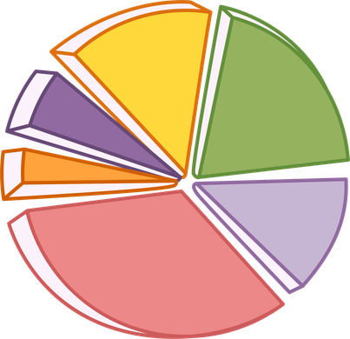
Building Future Financial Resilience
Diversify income sources
Implement efficiency measures
Upscale support and upskill staff
Sharpen strategic focus
Develop and implement comprehensive strategies according to the specific institutional ecosystem
Invest in support offices and expertise
Potential for service-related income and philanthropic funding
Align expectations on European funding
Potential in cooperation (sharing assets, services) and optimizing space
Benchmarking and peer learning to maximize effectiveness.
Develop strategic capacity in research support and fundraising; develop financial training to build capacity
Potential for specific Leadership development programmes with relevant content
Potential for using foresight tools, streamlining the educational offer, and focusing on research strengths
Strategic partnerships

Slide 25


EUA Funding Forum: 14-16 October 2026
Brno University of Technology
A place where all conversations revolve around funding

Slide 26
Thank you for your interest
nino.popkhadze@eua.eu

