Slide 1


Slide 2


Slide 3

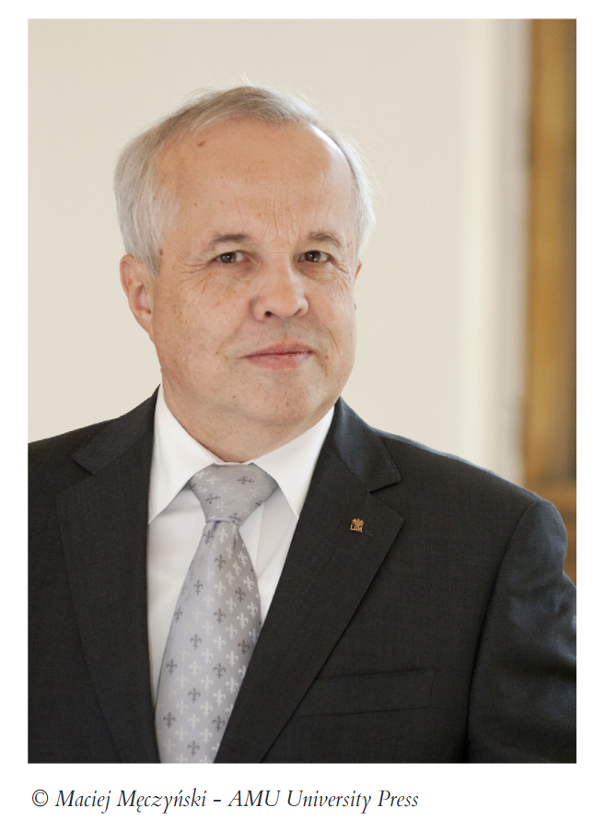

Marek Kręglewski
CGU Golden Pin
(Vila Real, 2025)

Slide 4
Marek Kręglewski
Professor at the Faculty of Chemistry
Adam Mickiewicz University in Poznan (Poland)

Slide 5
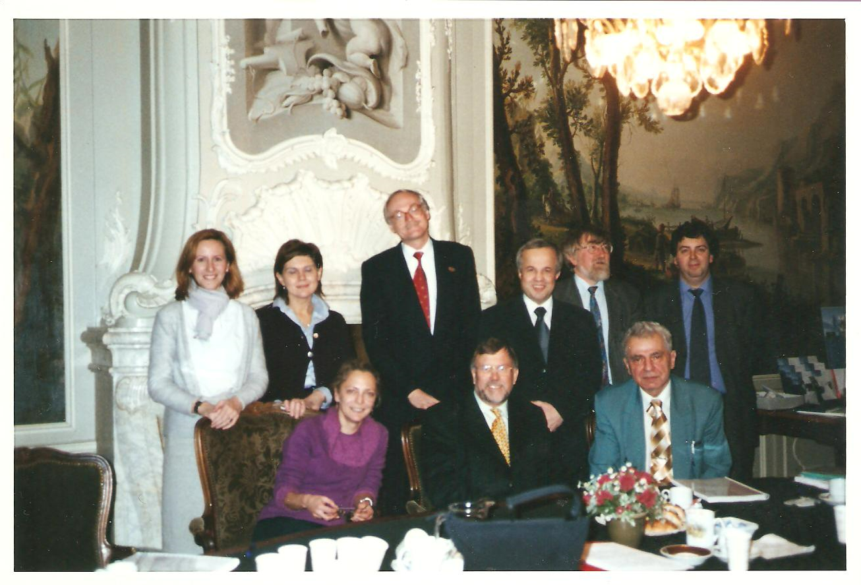
Marek Kręglewski
CGU Delegate at Adam Mickiewicz University in Poznan.

Slide 6
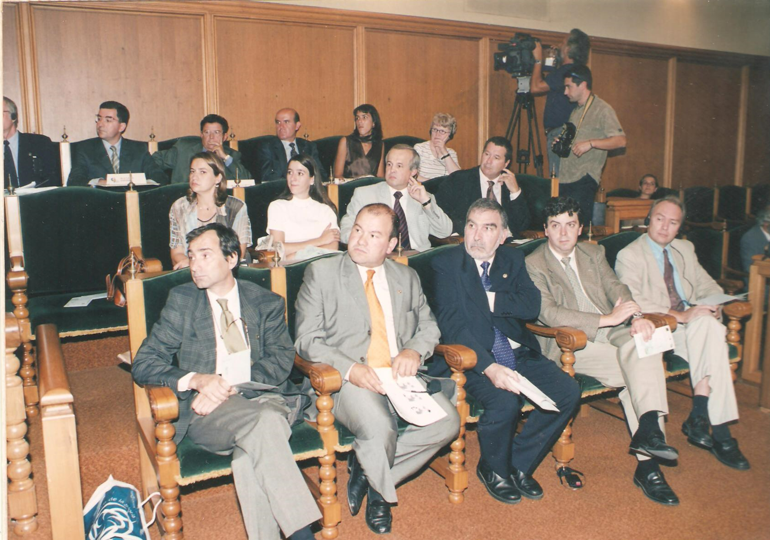
Marek Kręglewski
Representative of the University and the Group in numerous occasions since the inception of the CGU.

Slide 7
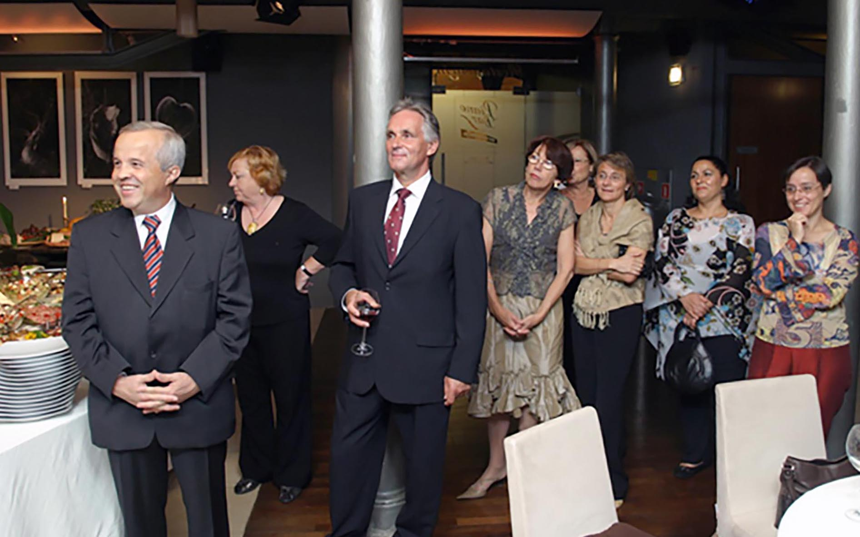
Marek Kręglewski
Host of various CGU events at AMU: presentation ceremonies, executive committees, academic sessions and general assemblies (2006 & 2014).

Slide 8
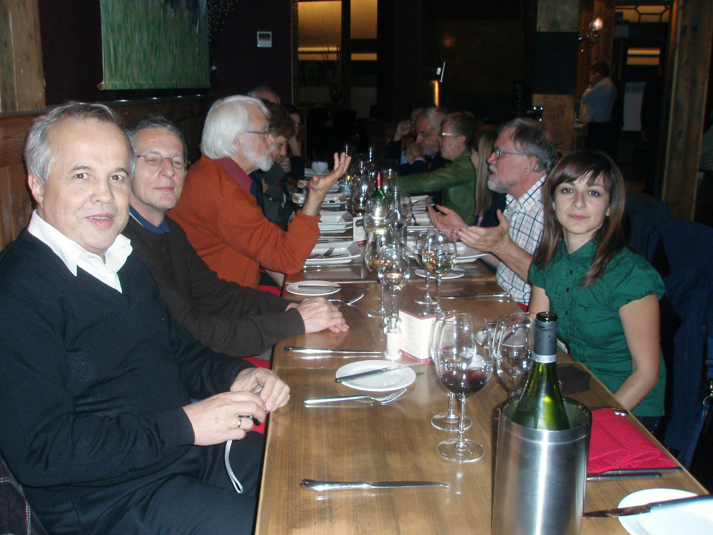
Marek Kręglewski
Host of various CGU events at AMU: presentation ceremonies, executive committees, academic sessions and general assemblies (2006 & 2014).

Slide 9
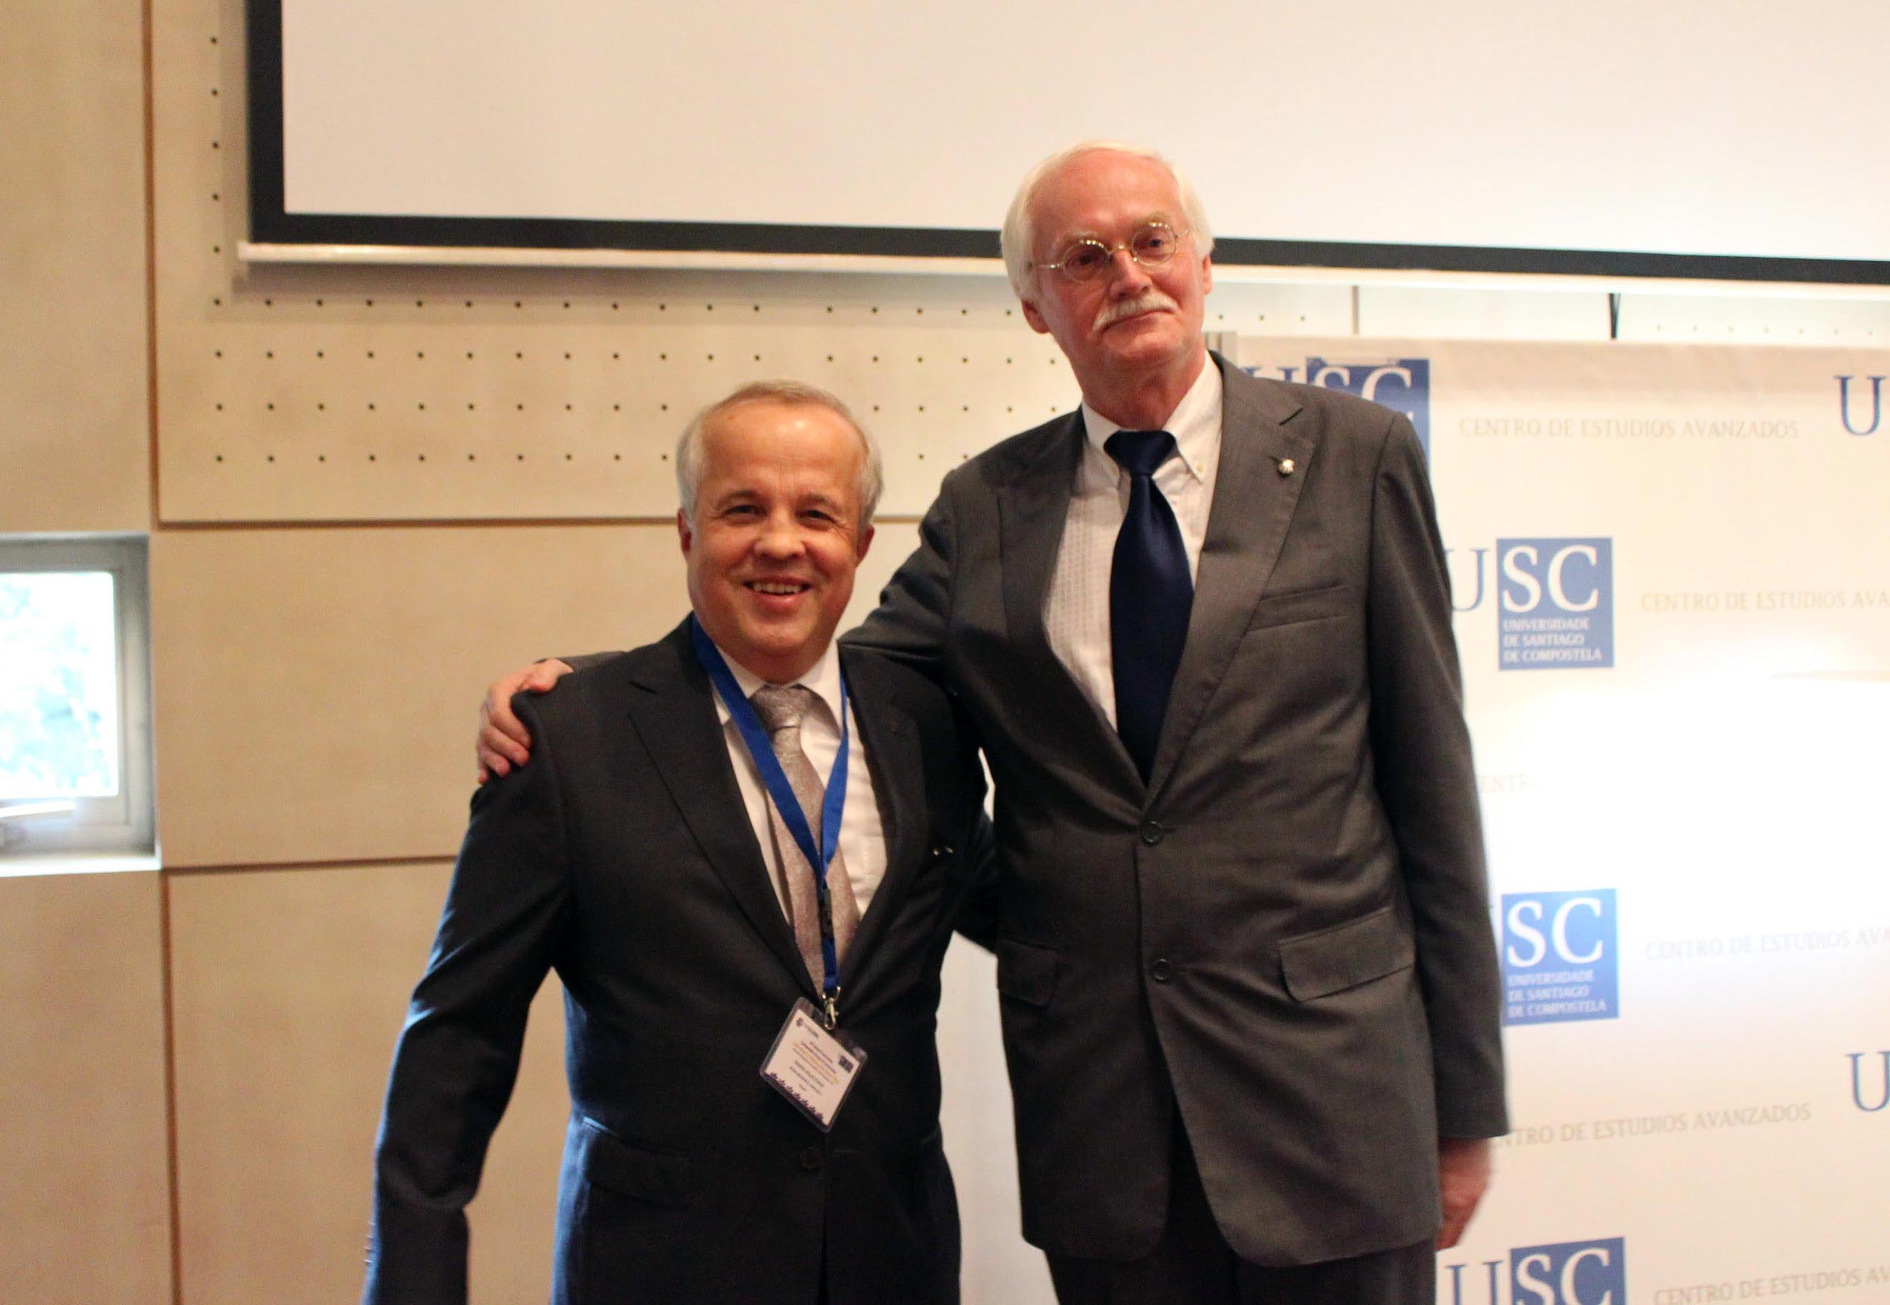
Marek Kręglewski
Host of various CGU events at AMU: presentation ceremonies, executive committees, academic sessions and general assemblies (2006 & 2014).

Slide 10
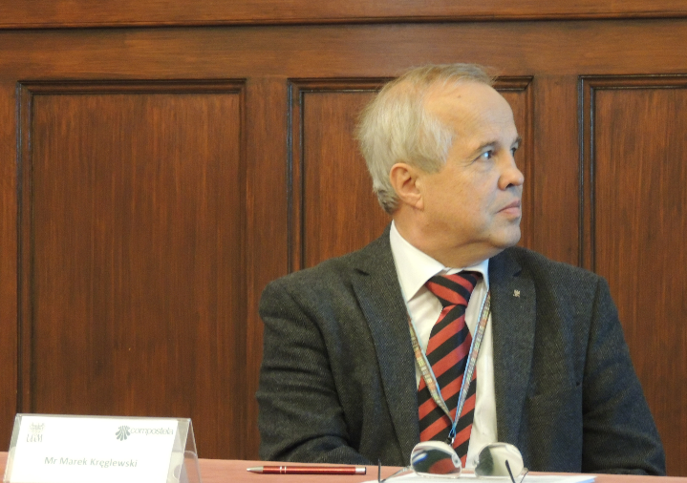
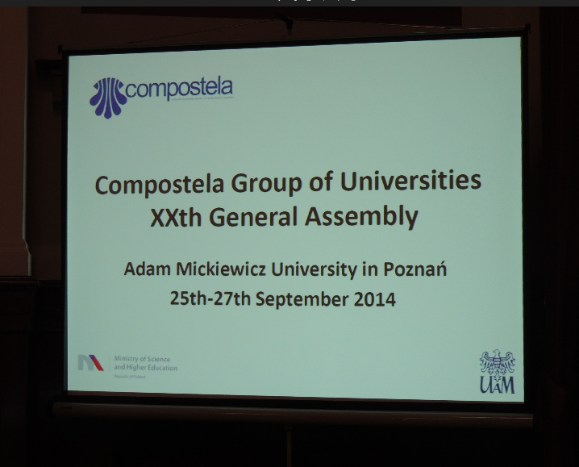
Marek Kręglewski
Host of various CGU events at AMU: presentation ceremonies, executive committees, academic sessions and general assemblies (2006 & 2014).

Slide 11
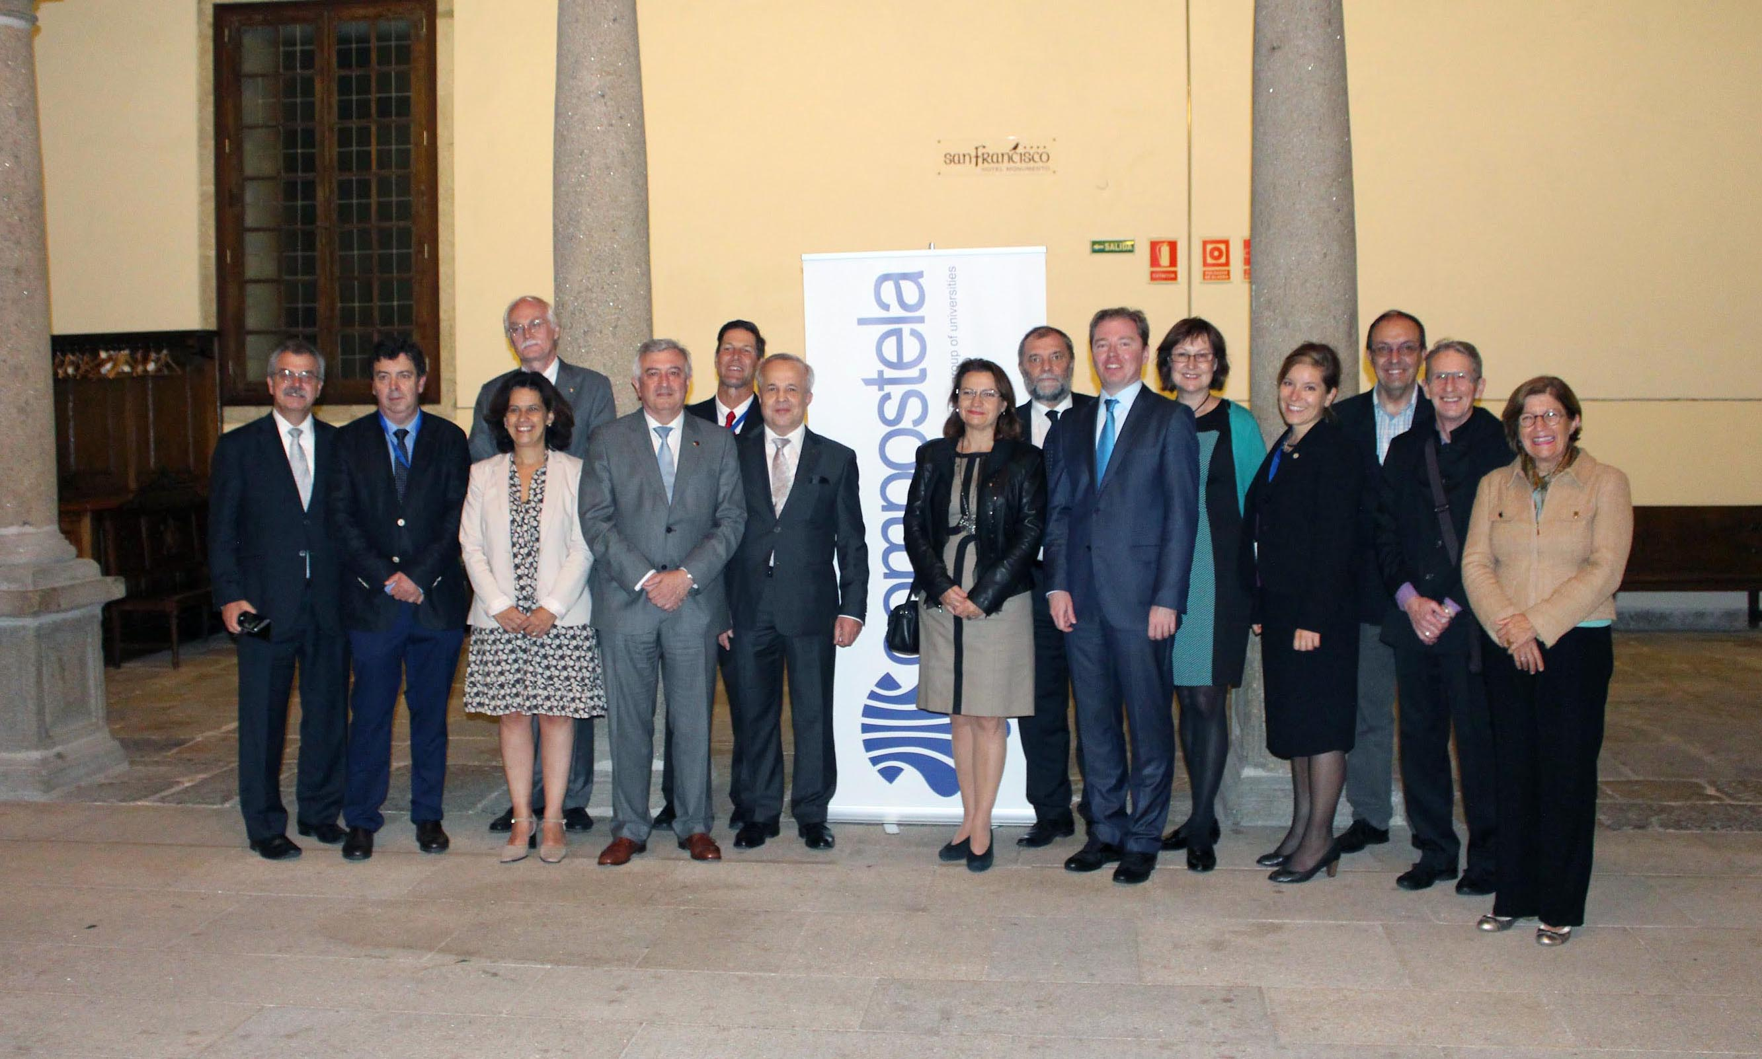
Marek Kręglewski
Host of various CGU events at AMU: presentation ceremonies, executive committees, academic sessions and general assemblies (2006 & 2014).

Slide 12
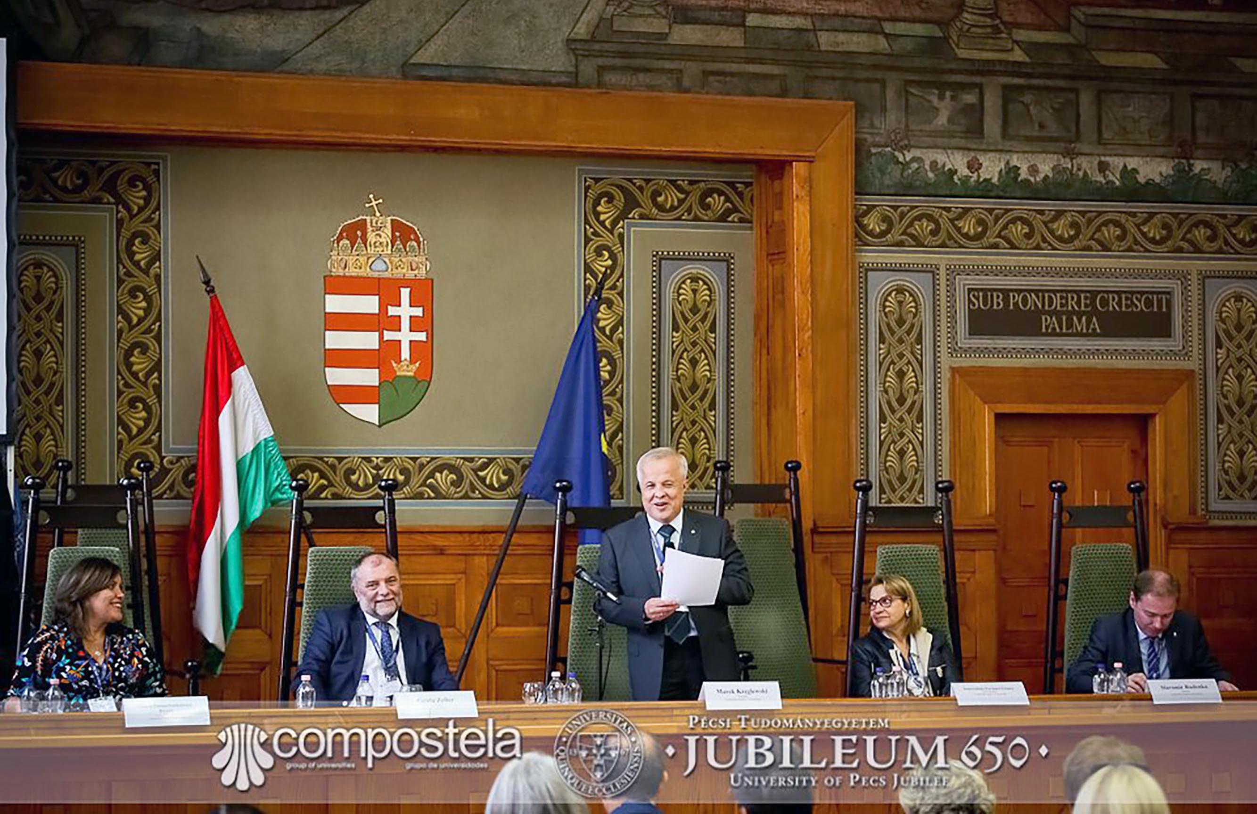
Marek Kręglewski
Taking active part of the CGU executive committee, as a member (1999-2007) and as a treasurer (2007-2015).

Slide 13
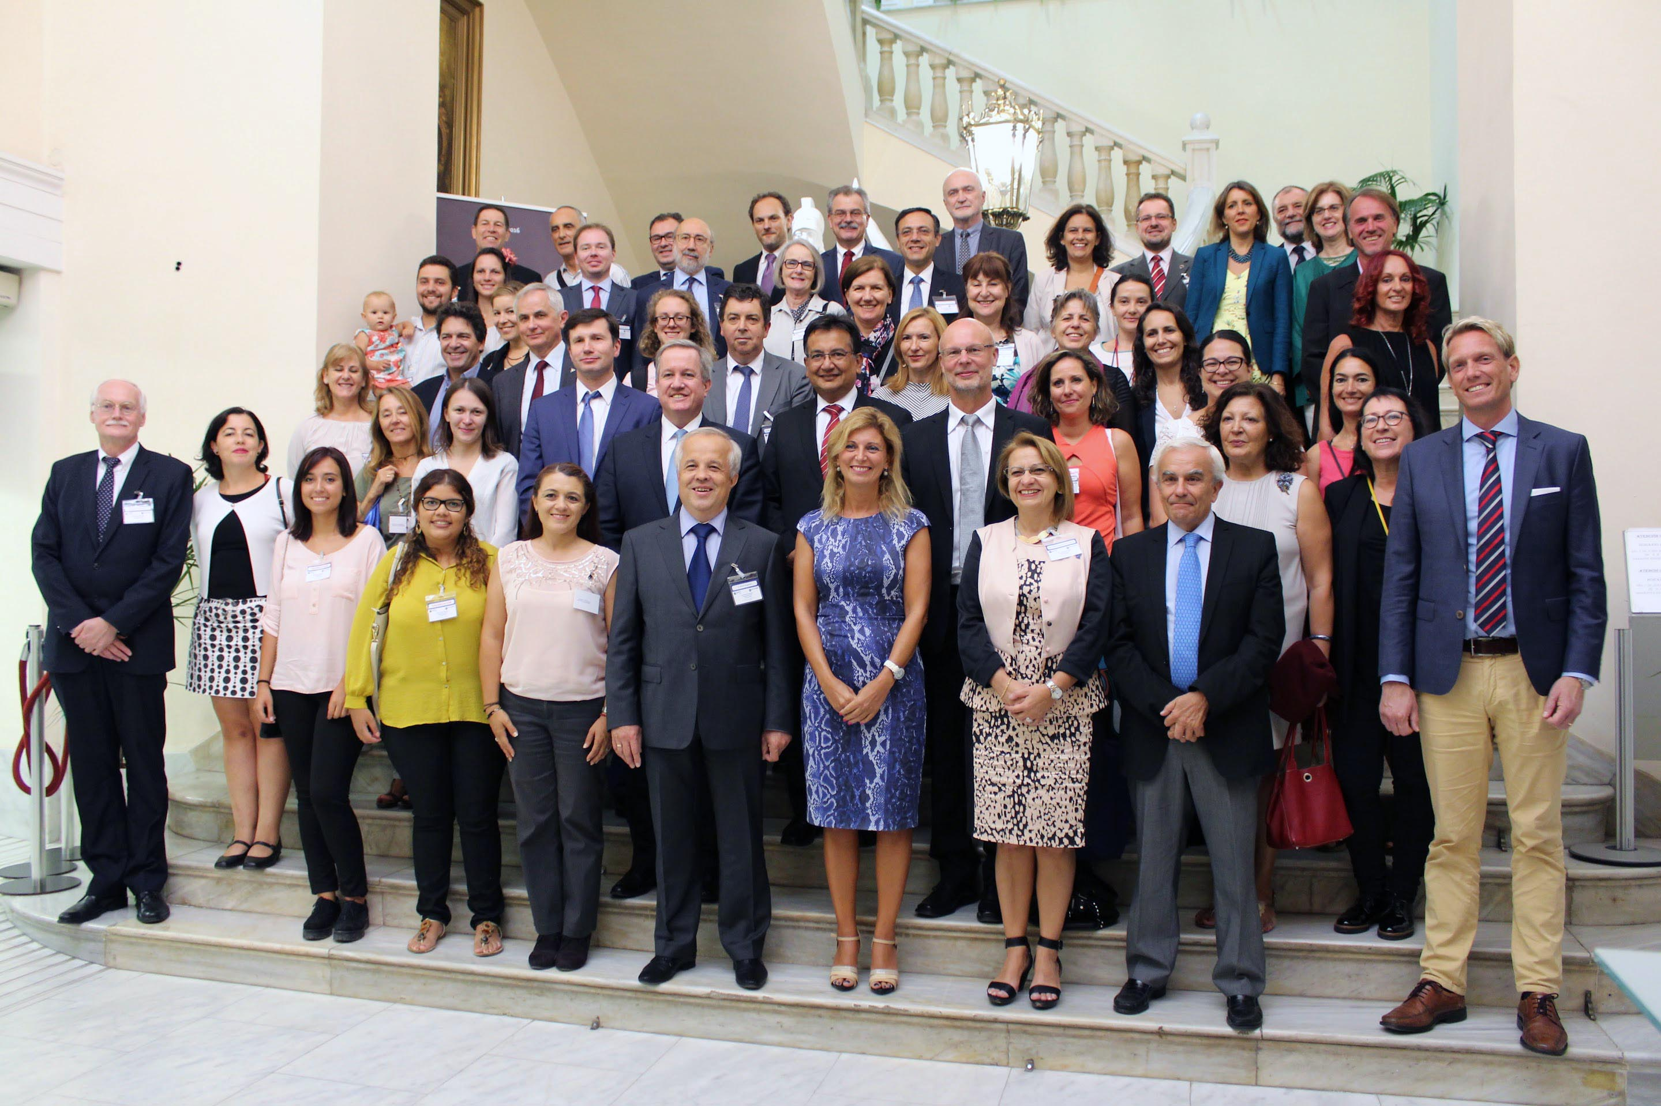
Marek Kręglewski
Taking active part of the CGU executive committee, as a member (1999-2007) and as a treasurer (2007-2015).

Slide 14
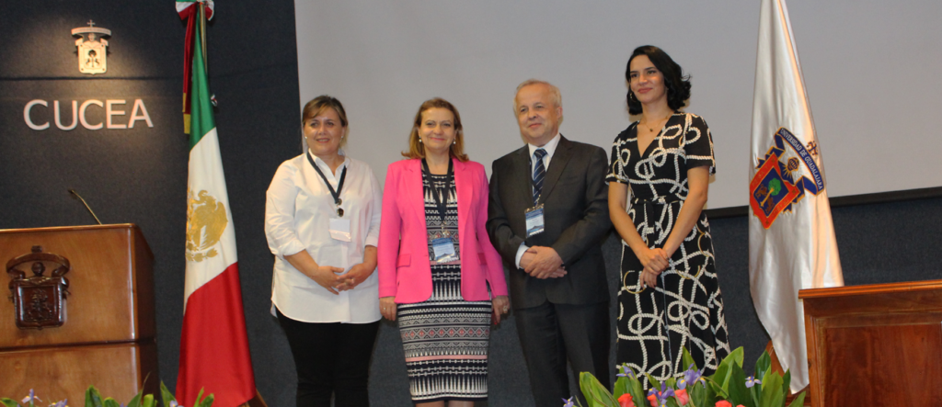
Marek Kręglewski
CGU President for two terms: 2015-2019, relected 2019-2025.

Slide 15
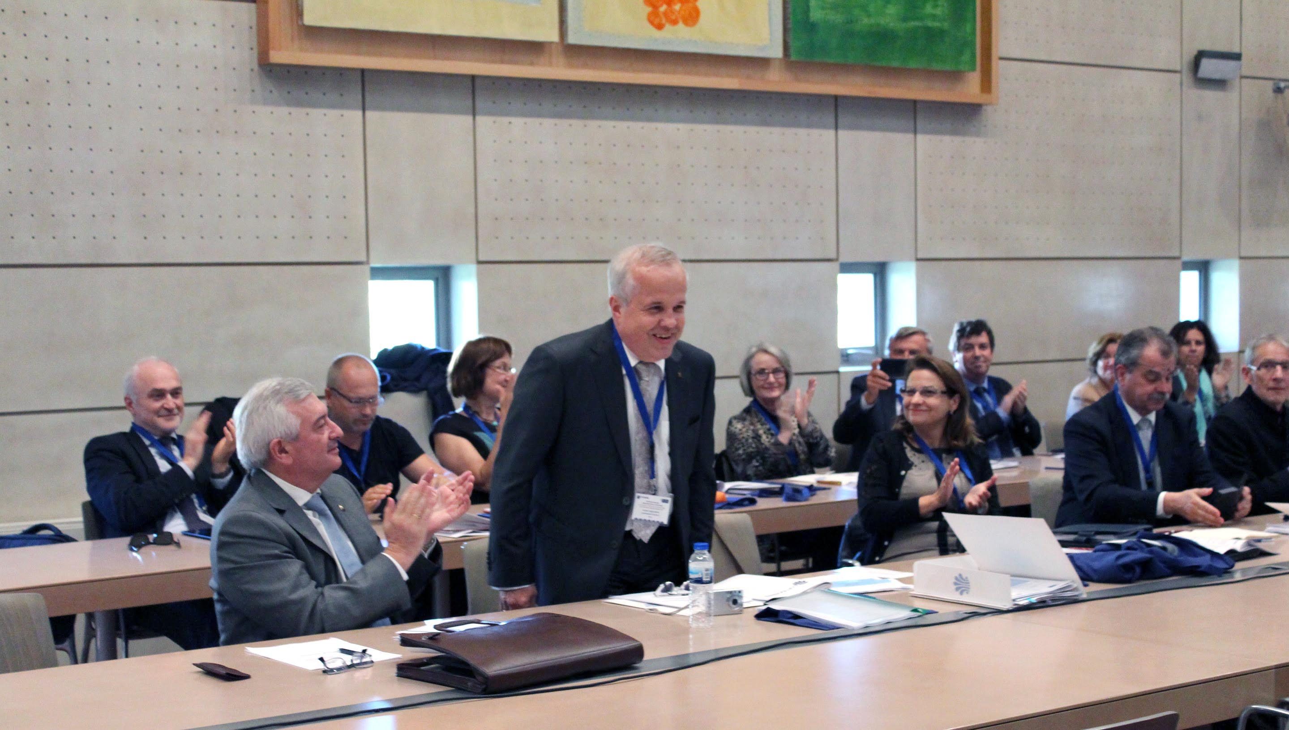
Marek Kręglewski
CGU President for two terms: 2015-2019, relected 2019-2025.

Slide 16
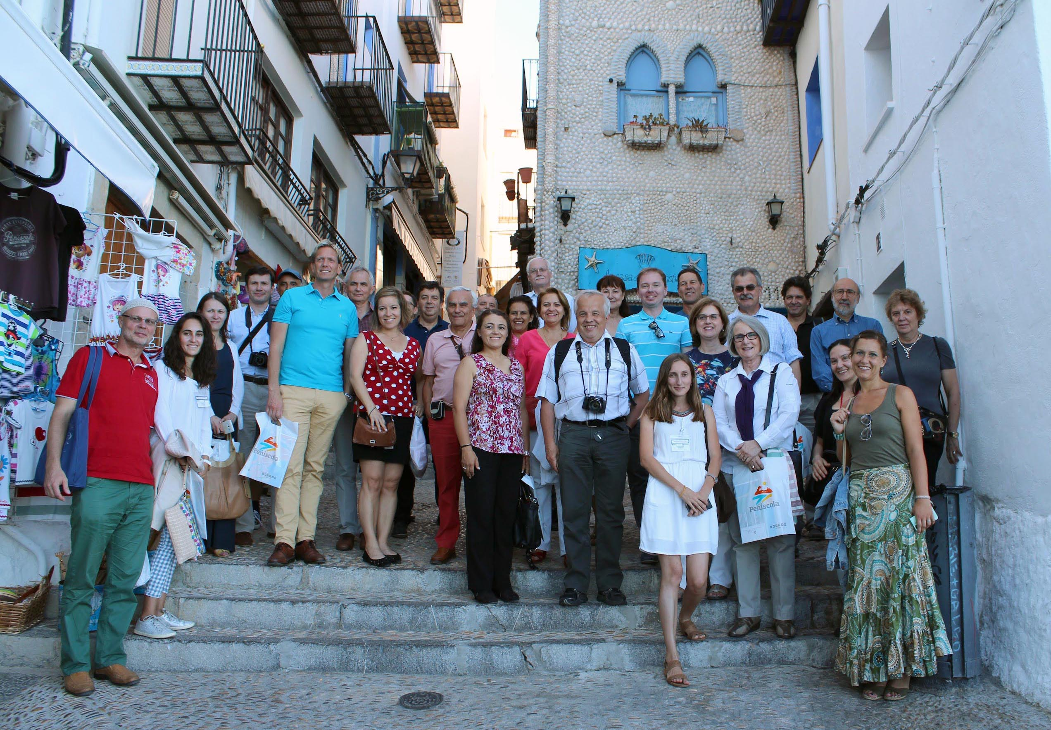
Marek Kręglewski
Passionate traveller and good travelling companion in every single event of our beloved network.

Slide 17
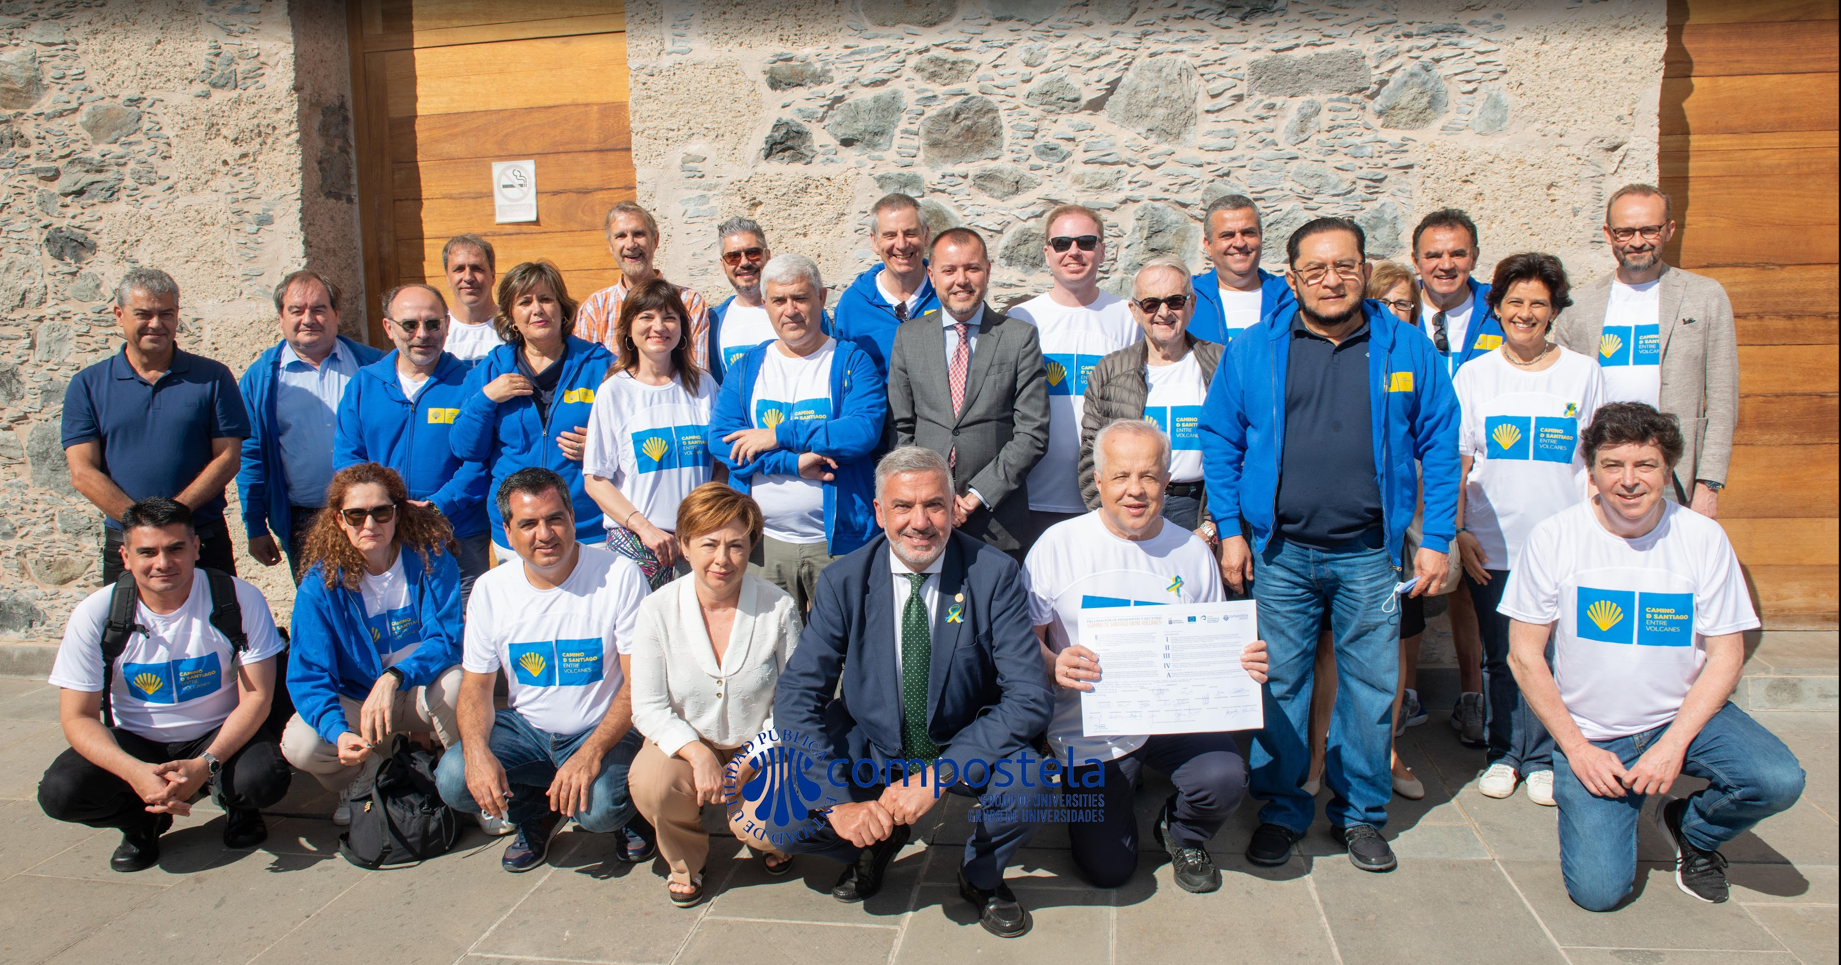
Marek Kręglewski
Passionate traveller and good travelling companion in every single event of our beloved network.

Slide 18
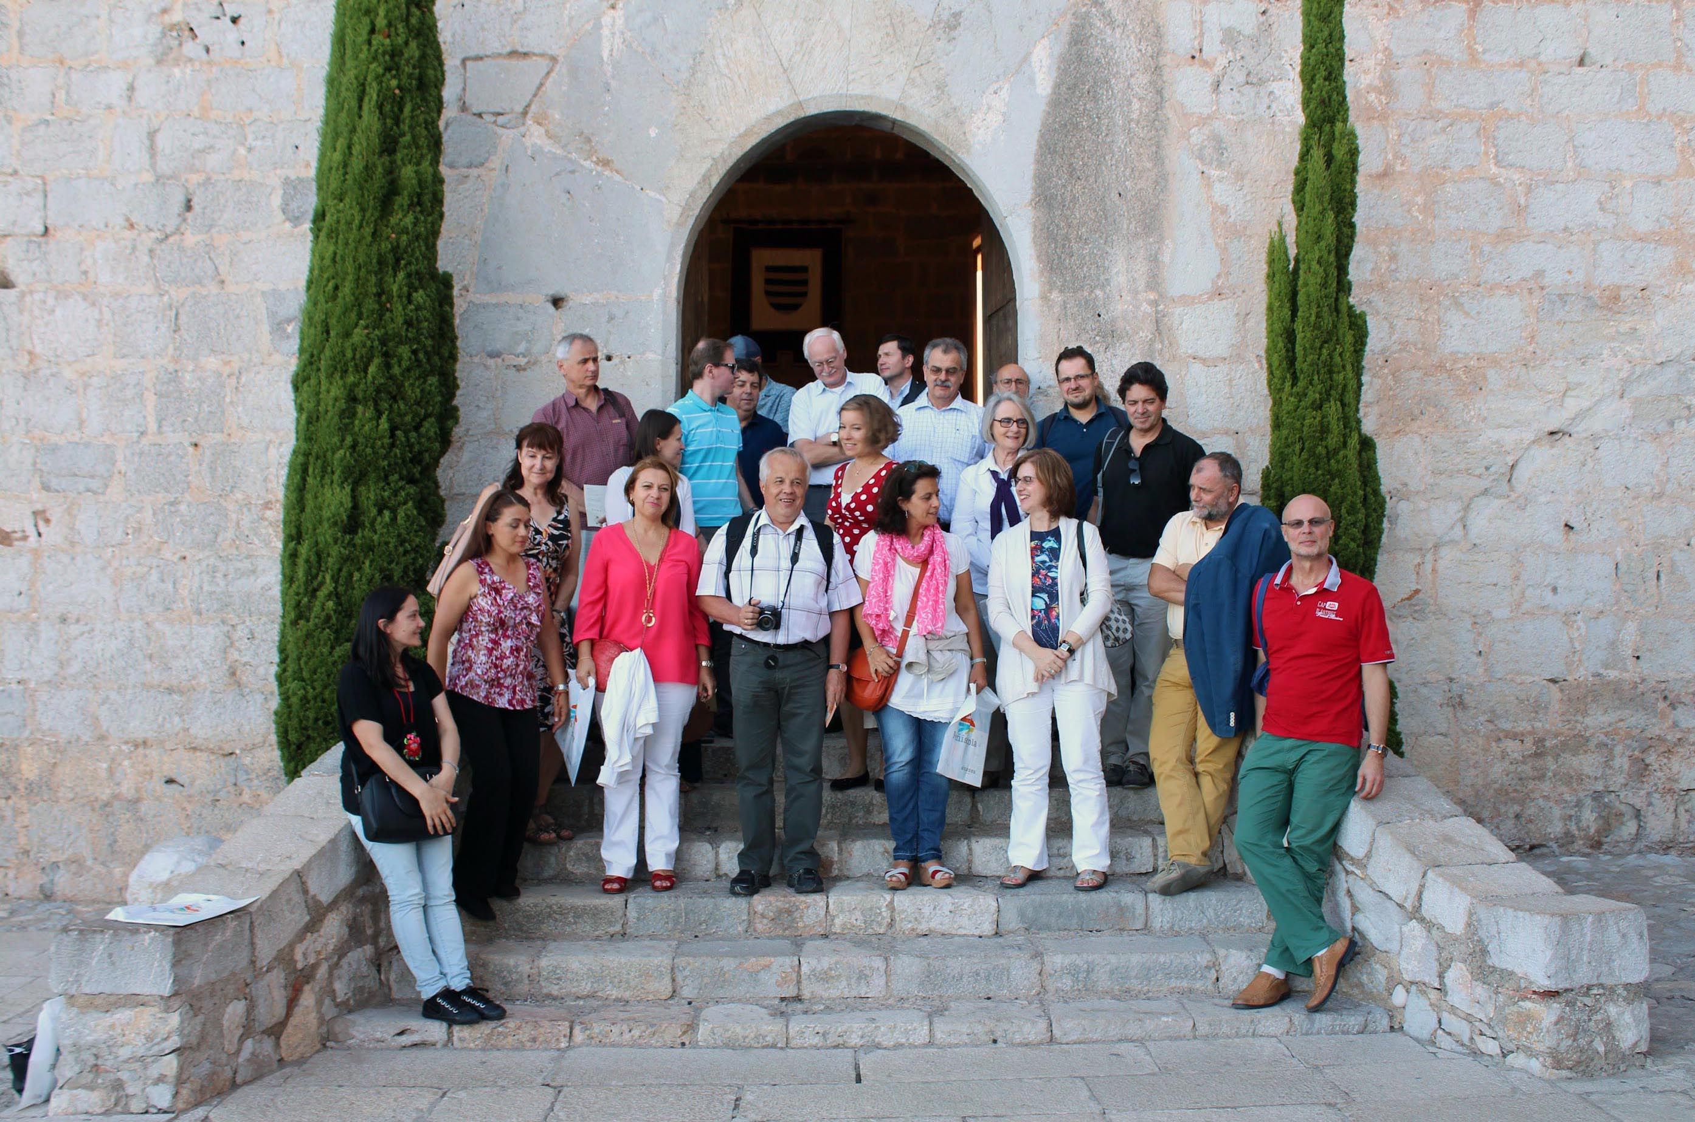
Marek Kręglewski
Passionate traveller and good travelling companion in every single event of our beloved network.

Slide 19
Marek Kręglewski
Marek Kreglewski, awarded GCU Golden Pin 2025 for his generous and unwavering dedication to the network and his valuable engagement and leadership, a reflection of a profound vocation for service and excellence that deserves recognition.

