Slide 1


Slide 2

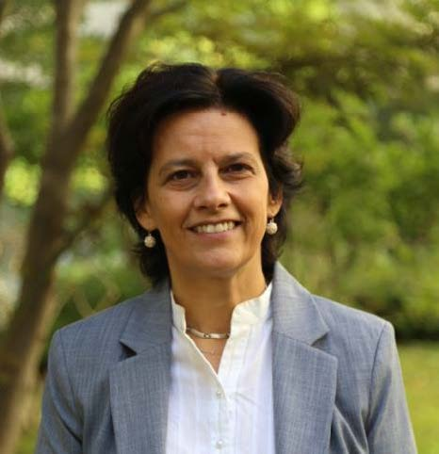
CHAIR
OF THE
SESSION
CGU
XXXI
GA

Slide 3
MINUTES OF FORMER GENERAL COUNCIL MEETING
CGU
XXXI
GA

Slide 4
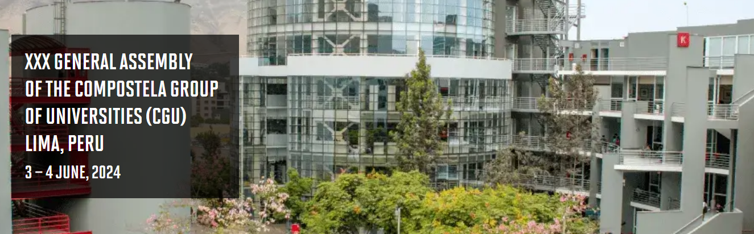
MINUTES
CGU
XXXI
GA
MINUTES OF FORMER GENERAL COUNCIL MEETING

Slide 5
REPORT OF THE PRESIDENT
CGU
XXXI
GA

Slide 6
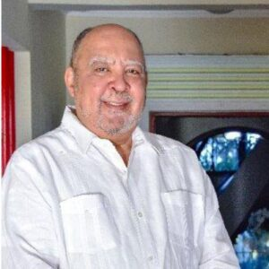
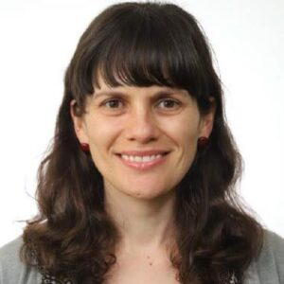
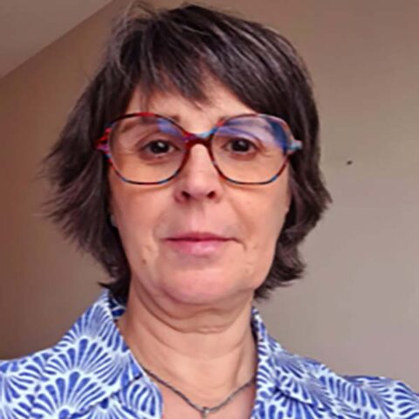
EXECUTIVE COMMITTEE WITHDRAWALS
Julio
Sánchez Maríñez
(INTEC)
María
Fdez. Flecha
(PUPC)
Virgina
Díaz
(UPM)
—MEMBER—
—TREASURER—
—MEMBER—
CGU
XXXI
GA
REPORT OF THE PRESIDENT

Slide 7
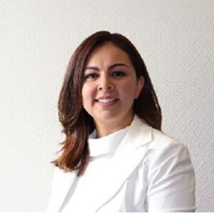
EXECUTIVE COMMITTEE WITHDRAWALS
Valeria
Padilla Navarro
(UDG)
—NEW TREASURER—
CGU
XXXI
GA
REPORT OF THE PRESIDENT

Slide 8




OBSERVERS OF THE XXXI GENERAL ASSEMBLY
International Affairs
Vice presidency
National and International Cooperation
CGU
XXXI
GA
REPORT OF THE PRESIDENT

Slide 9
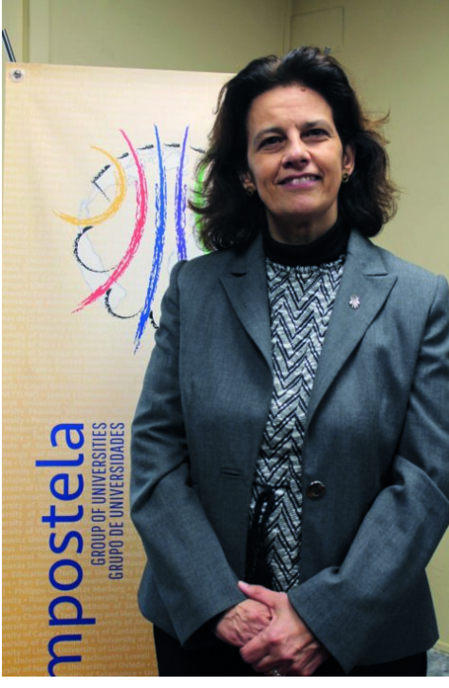

AGENDA
CGU
XXXI
GA
REPORT OF THE PRESIDENT

Slide 10

AGENDA ON SUSTAINABILITY
Compostela Connection on Sustainability
Compostela Sustainability Award
Environmental commitment
CGU
XXXI
GA
REPORT OF THE PRESIDENT

Slide 11
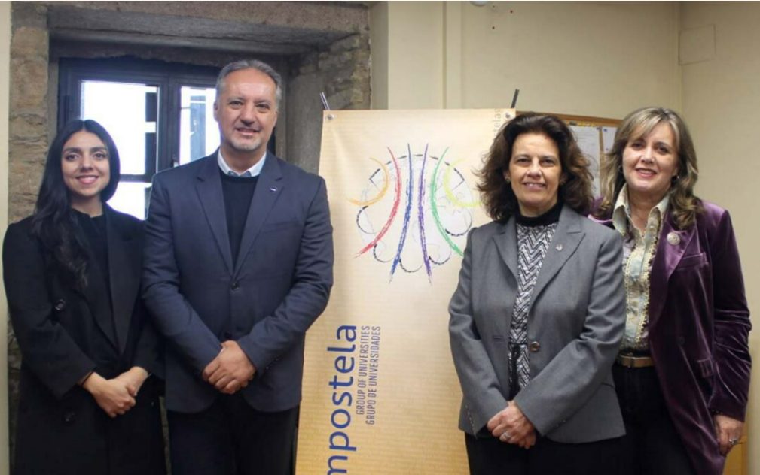
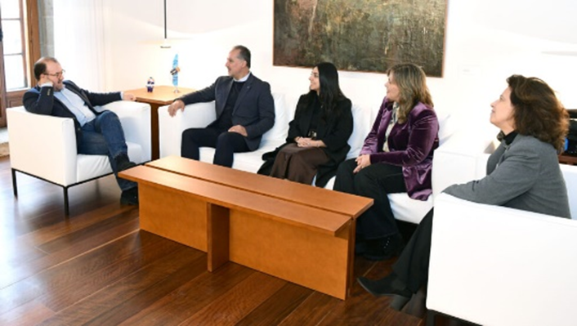
AGENDA ON COMMUNICATION & GROWTH
10/February/2025
CGU
XXXI
GA
REPORT OF THE PRESIDENT

Slide 12
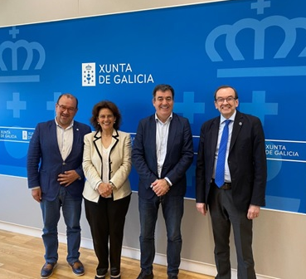
AGENDA ON COMMUNICATION & GROWTH
Impulsa programme
CGU
XXXI
GA
REPORT OF THE PRESIDENT

Slide 13
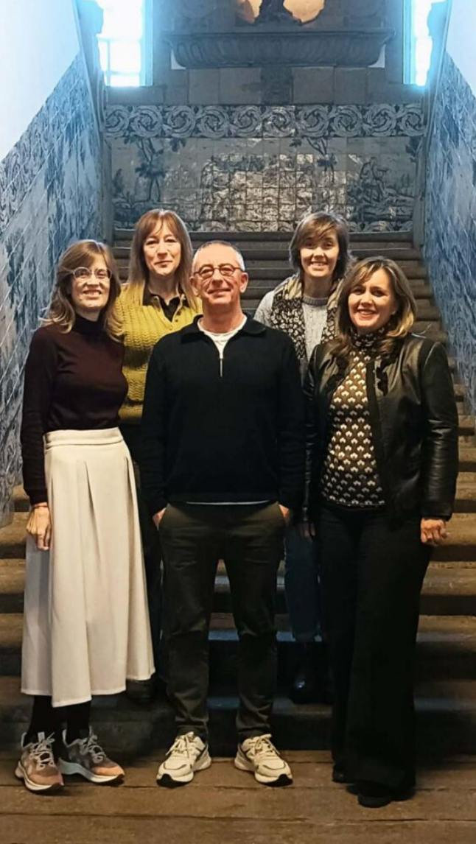

AGENDA ON COMMUNICATION & GROWTH
CGU
CGU Impulsa Programme
further links with members
CGU
XXXI
GA
REPORT OF THE PRESIDENT

Slide 14

CGU
XXXI
GA

Slide 15
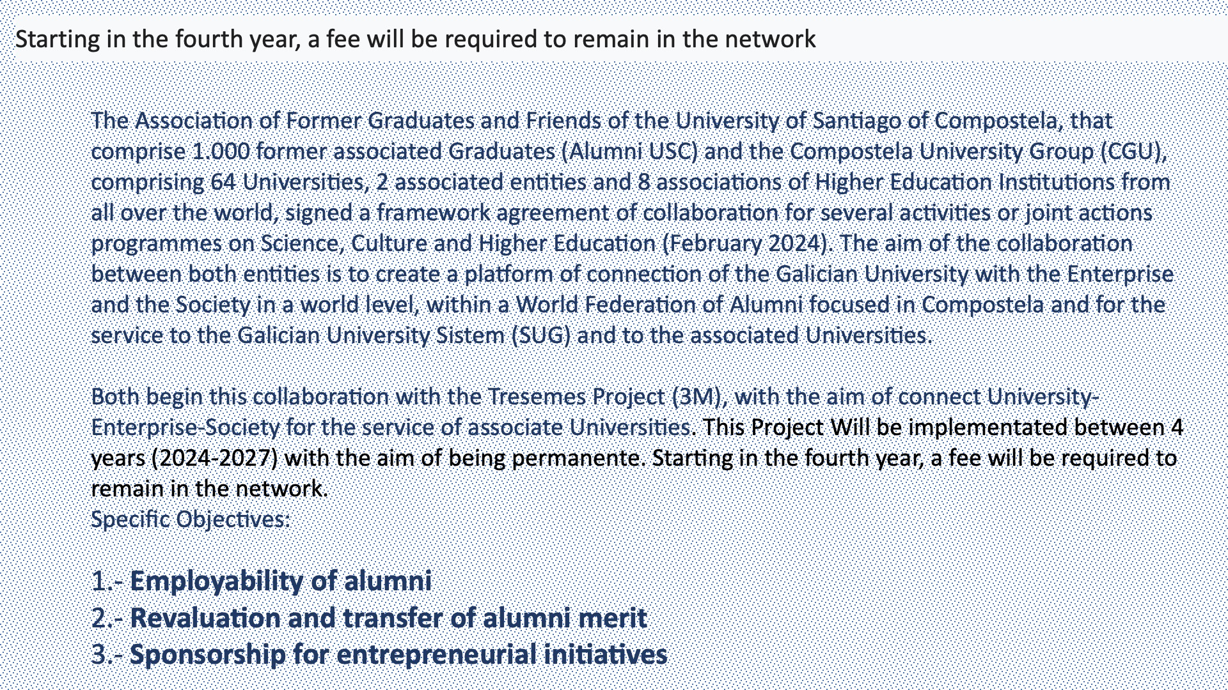
CGU
XXXI
GA

Slide 16

CGU
XXXI
GA

Slide 17

CGU
XXXI
GA

Slide 18
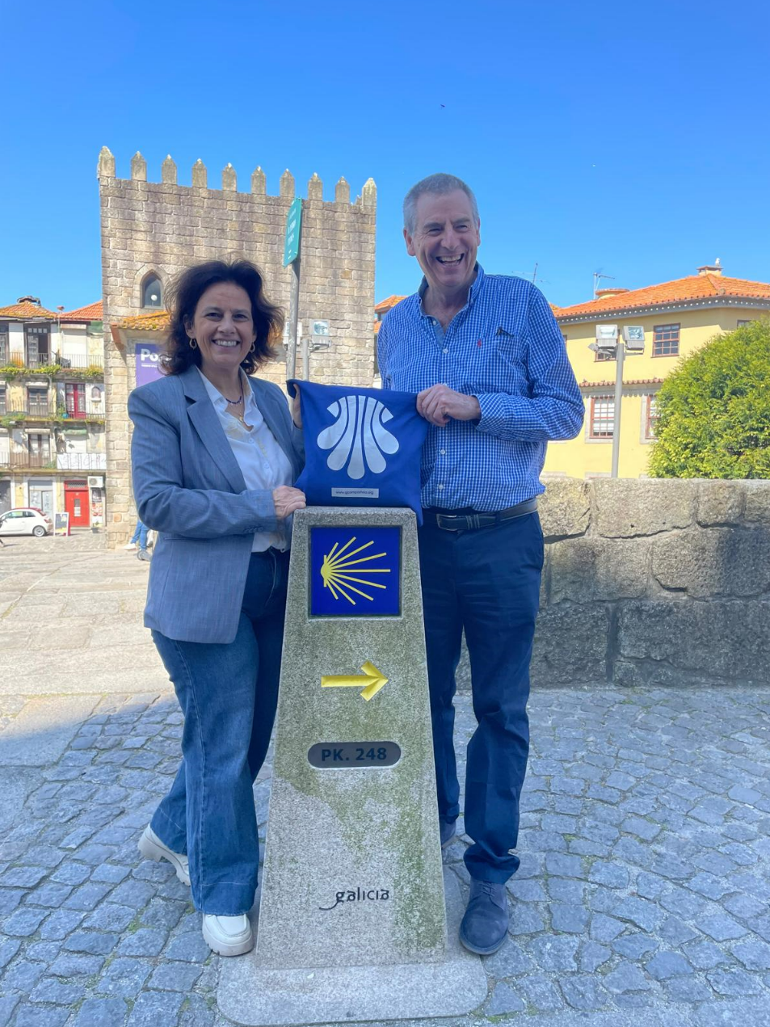
AGENDA ON CULTURAL HERITAGE AND UNIVERSITY
MEETINGS ON THE WAY
An University of Worcester initiative, supported by the CGU
Porto, 20/May/2025
CGU
XXXI
GA
REPORT OF THE PRESIDENT

Slide 19
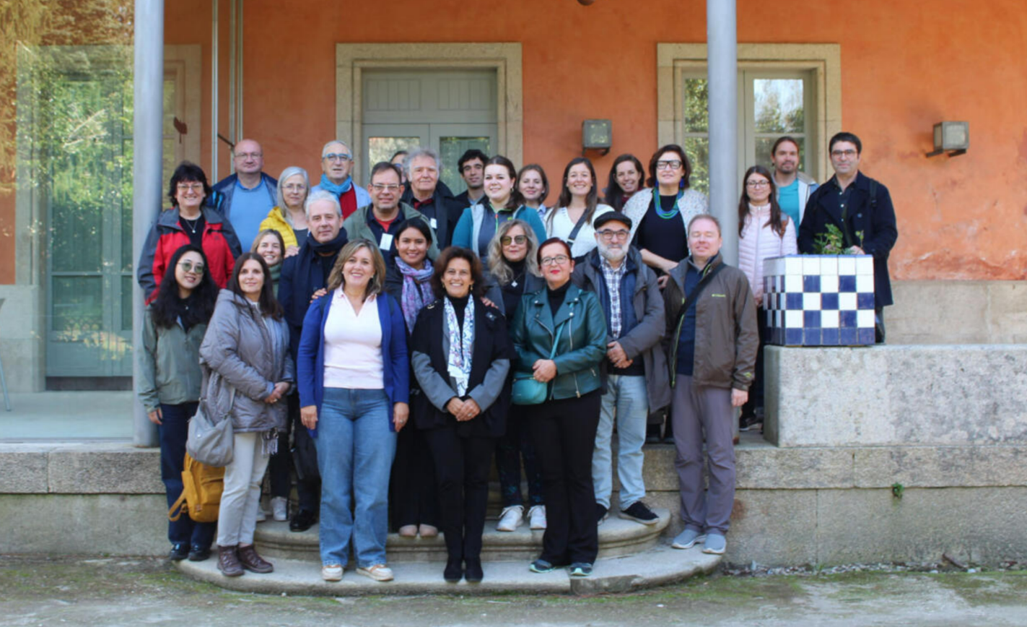
AGENDA ON CULTURAL HERITAGE AND UNIVERSITY
MEETINGS
ON THE WAY
CGU
XXXI
GA
REPORT OF THE PRESIDENT

Slide 20





AGENDA ON INTERNATIONAL PROJECTION
Erasmus+ mobility projects
(KA130, KA131, KA171)
CGU
XXXI
GA
REPORT OF THE PRESIDENT

Slide 21
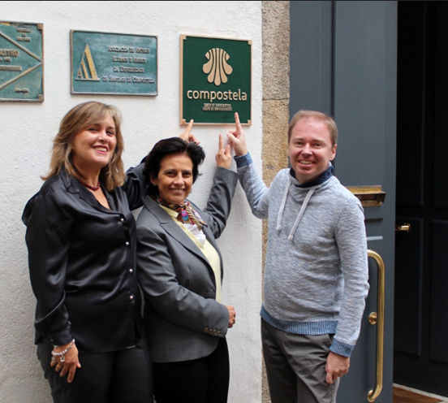
AGENDA ON HEADQUARTERS
FUTURE = staff + members commitment x perseverance
CGU
XXXI
GA
REPORT OF THE PRESIDENT

Slide 22
MEMBERSHIPS
CGU
XXXI
GA

Slide 23

FULL MEMBERSHIP
Universidad Popular Autónoma del Estado de Puebla (Mexico), represented by
Andrés Barba Vargas, vice president for Outreach and International Affairs
CGU
XXXI
GA
MEMBERSHIPS

Slide 24
COLLABORATIVE MEMBER
Ecuadorian Corporation for Development of Research and Academia (Ecuador)
Julio Pablo Carvalho, executive director
Carolina Bolaños, coordinator for Interinstitutional Relations
Gabriela Cáceres, coordinator of research and development
Andrea Pesantez, executive director assistant and travel management
CGU
XXXI
GA
MEMBERSHIPS

Slide 25
REPORT OF THE EXECUTIVE SECRETARY
CGU
XXXI
GA

Slide 26
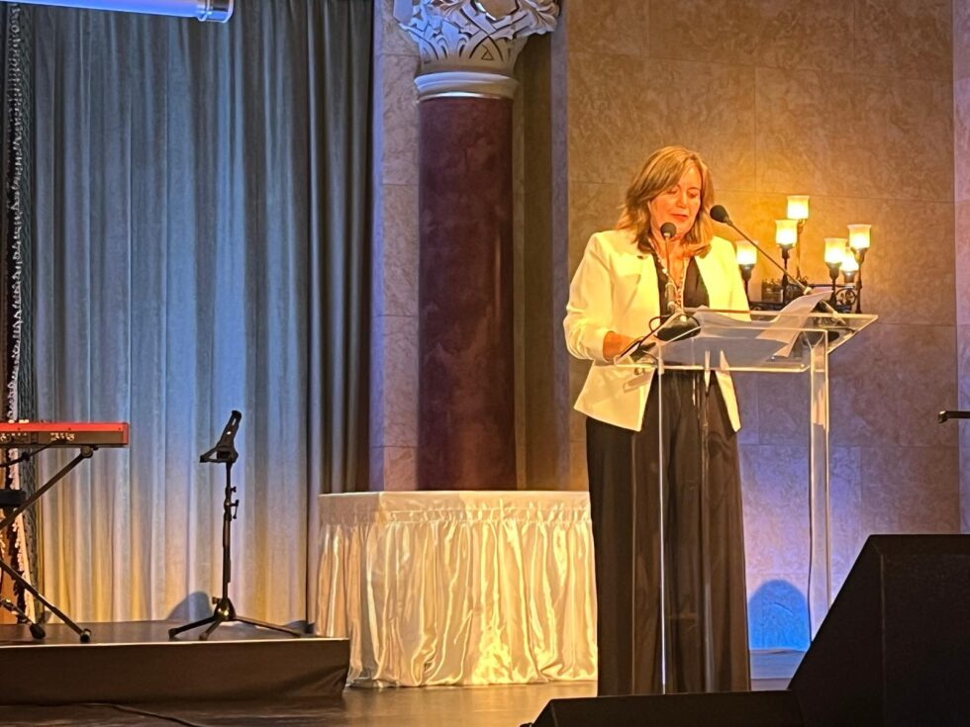
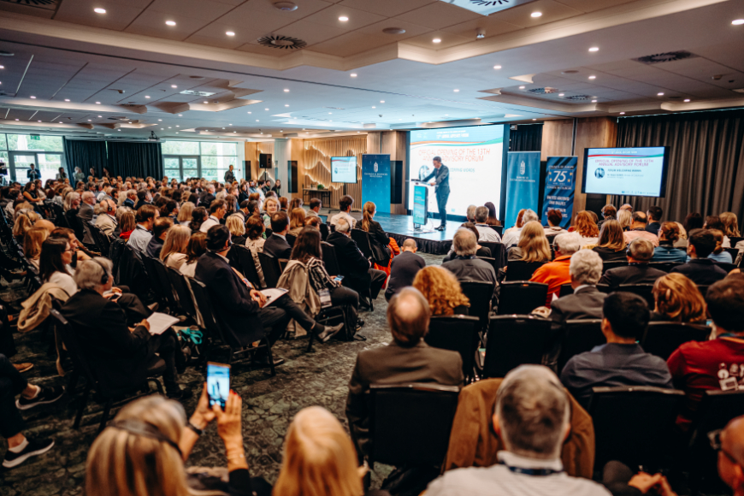
COLLABORATIONS AND AGREEMENTS
International Projection throughout the Camino
EICR, Budapest 2024
CGU
XXXI
GA
REPORT OF THE EXECUTIVE SECRETARY

Slide 27
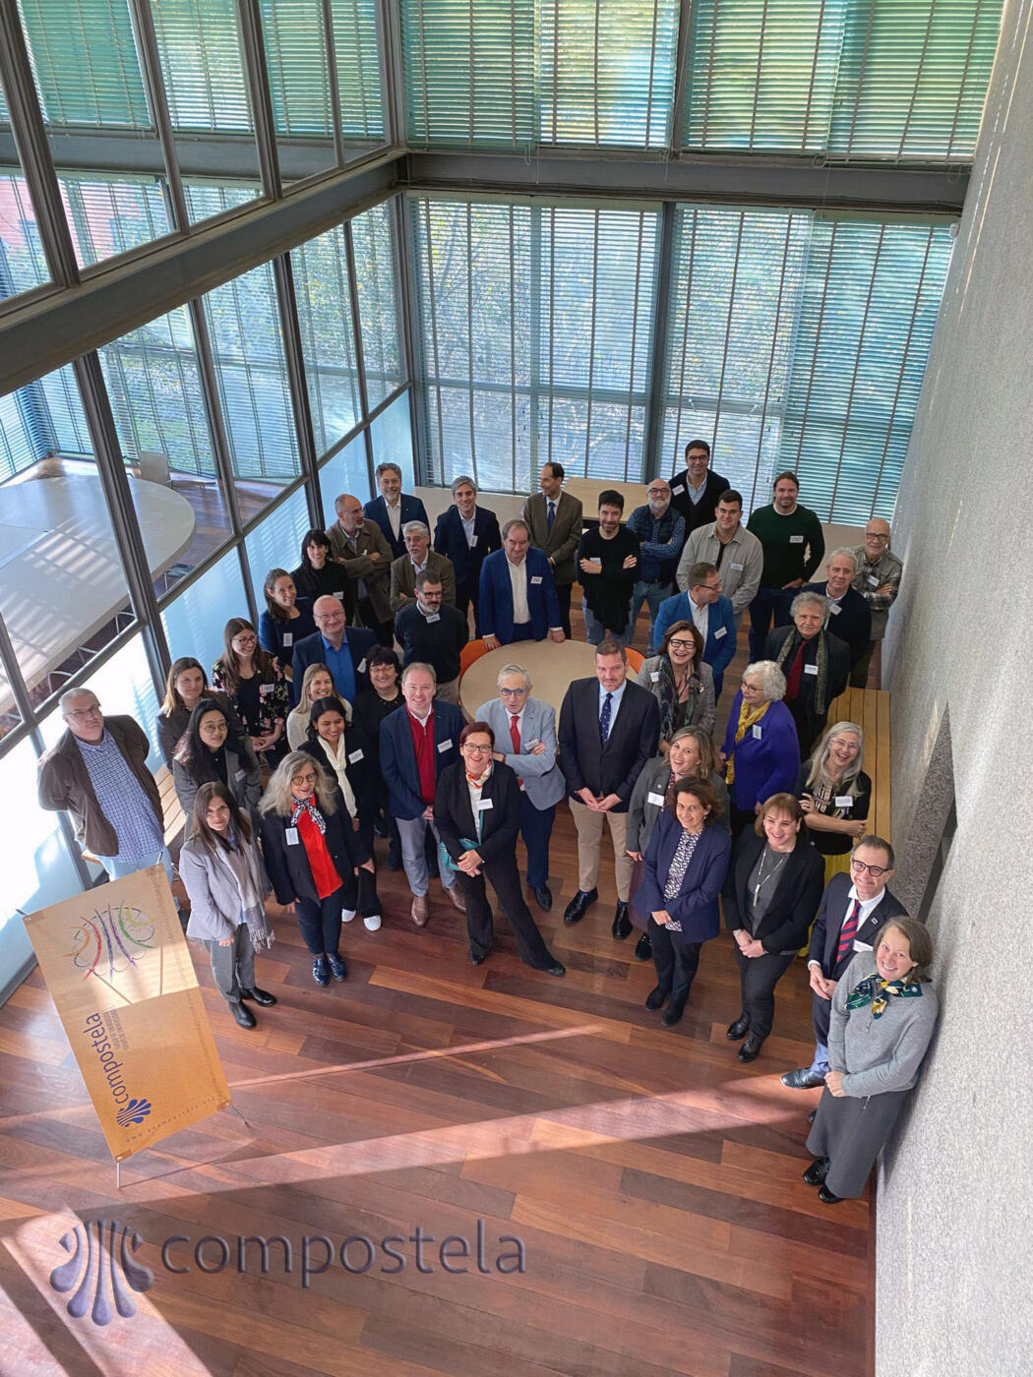
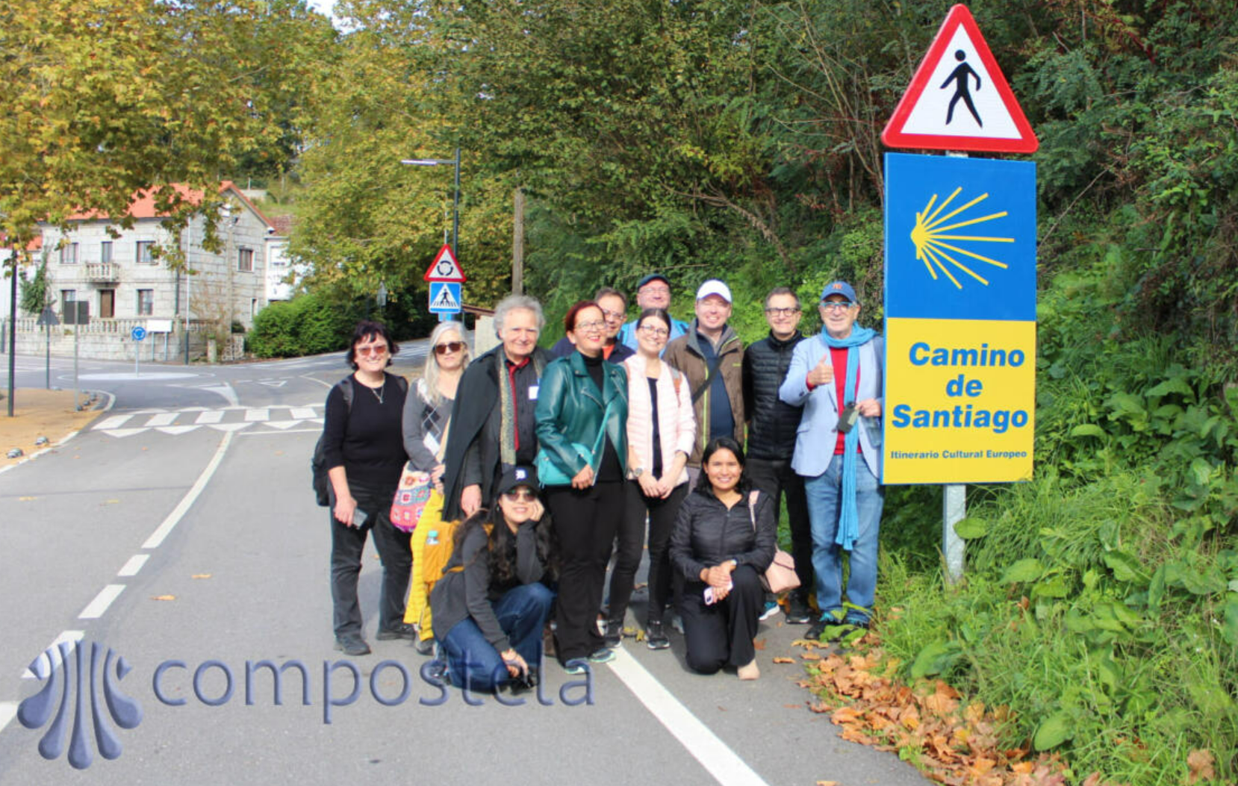
COLLABORATIONS AND AGREEMENTS
I International conference Universities and cultural routes
Santiago, 2024
CGU
XXXI
GA
REPORT OF THE EXECUTIVE SECRETARY

Slide 28


INITIATIVES
Promote relationships between Europe and America with a focus on students and ex alumnae and its professional careers.
CGU
XXXI
GA
REPORT OF THE EXECUTIVE SECRETARY

Slide 29



INITIATIVES
CGU
XXXI
GA
REPORT OF THE EXECUTIVE SECRETARY

Slide 30






INITIATIVES
Collaborator:
First prize 2023-2024:
Special mention 2023-2024:
CGU
XXXI
GA
REPORT OF THE EXECUTIVE SECRETARY

Slide 31
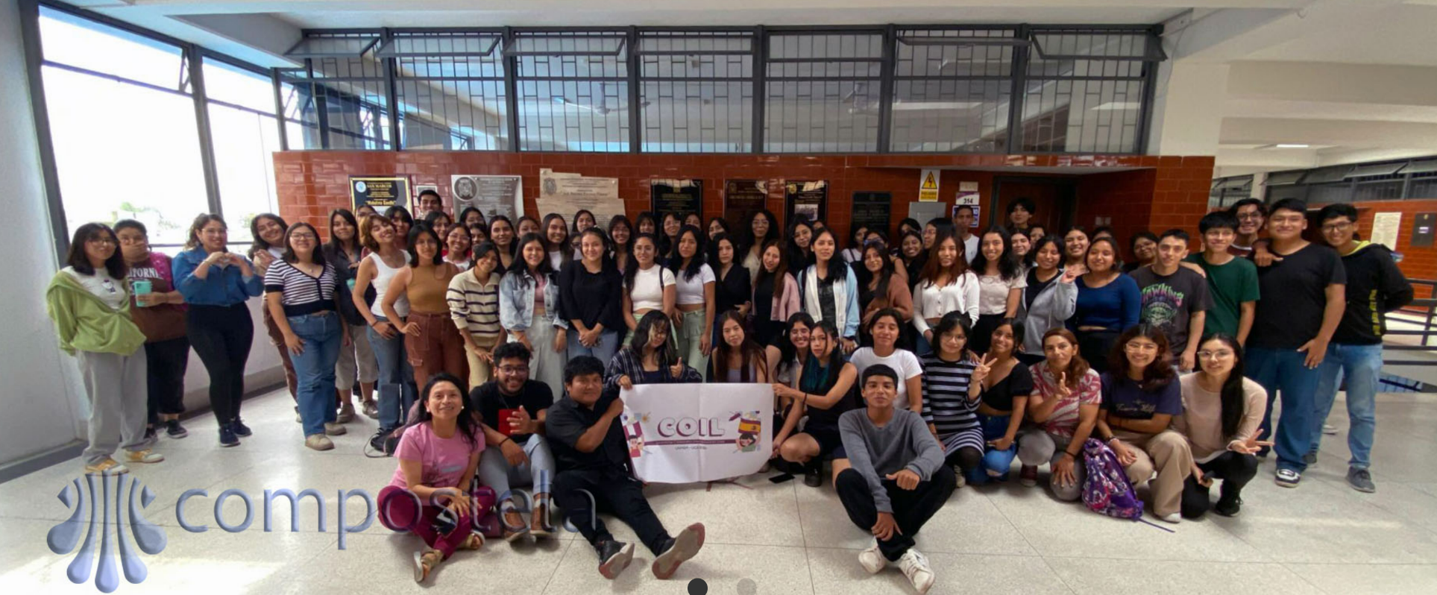
INITIATIVES
UCA & UNMSM Classroom
winner project
CGU
XXXI
GA
REPORT OF THE EXECUTIVE SECRETARY

Slide 32



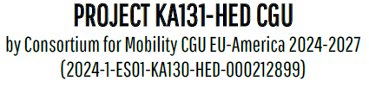
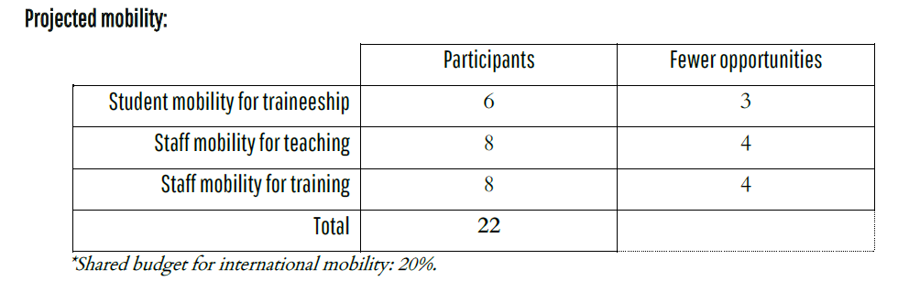
EUROPEAN PROJECTS
CGU as
coordinator
New granted Erasmus+
01/06/2025 - 31/07/2025
Target group:
recent graduates & doctorates
CGU
XXXI
GA
REPORT OF THE EXECUTIVE SECRETARY

Slide 33

EUROPEAN PROJECTS
KA130 - Consortium for Mobility CGU EU-America
CGU
XXXI
GA
REPORT OF THE EXECUTIVE SECRETARY

Slide 34

EUROPEAN PROJECTS
KA131 – Endorsed universities
CGU
XXXI
GA
REPORT OF THE EXECUTIVE SECRETARY

Slide 35

EUROPEAN PROJECTS
KA171
CGU
XXXI
GA
REPORT OF THE EXECUTIVE SECRETARY

Slide 36

EUROPEAN PROJECTS
CGU as a partner
Final report approved by the EC
Still ongoing!
CGU
XXXI
GA
REPORT OF THE EXECUTIVE SECRETARY

Slide 37
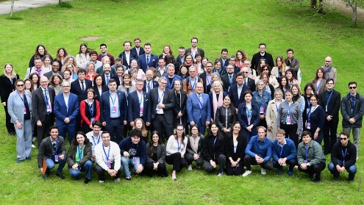

EUROPEAN PROJECTS
CGU as a partner
Partners meeting
University of Santiago de Compostela
May/2025
CGU
XXXI
GA
REPORT OF THE EXECUTIVE SECRETARY

Slide 38
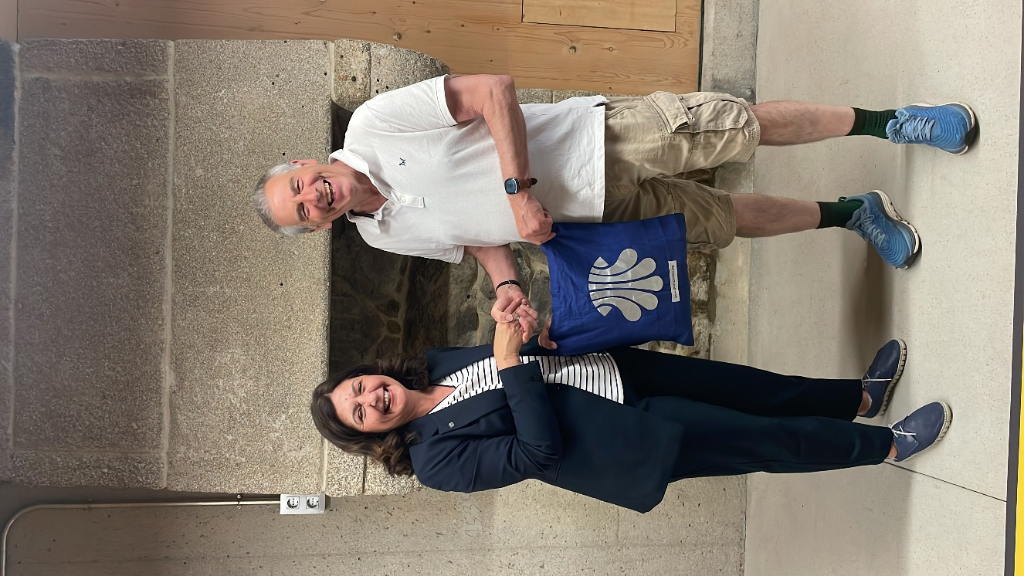
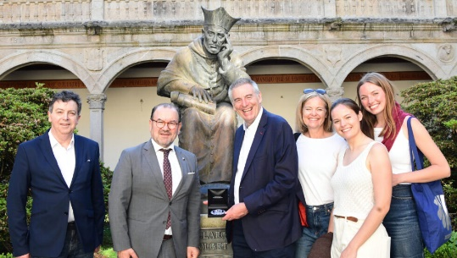
COMPOSTELA ACADEMY ON THE CAMINO
Meetings on the way
A charitable initiative fostered by the University of Worcester
CGU
XXXI
GA
REPORT OF THE EXECUTIVE SECRETARY

Slide 39

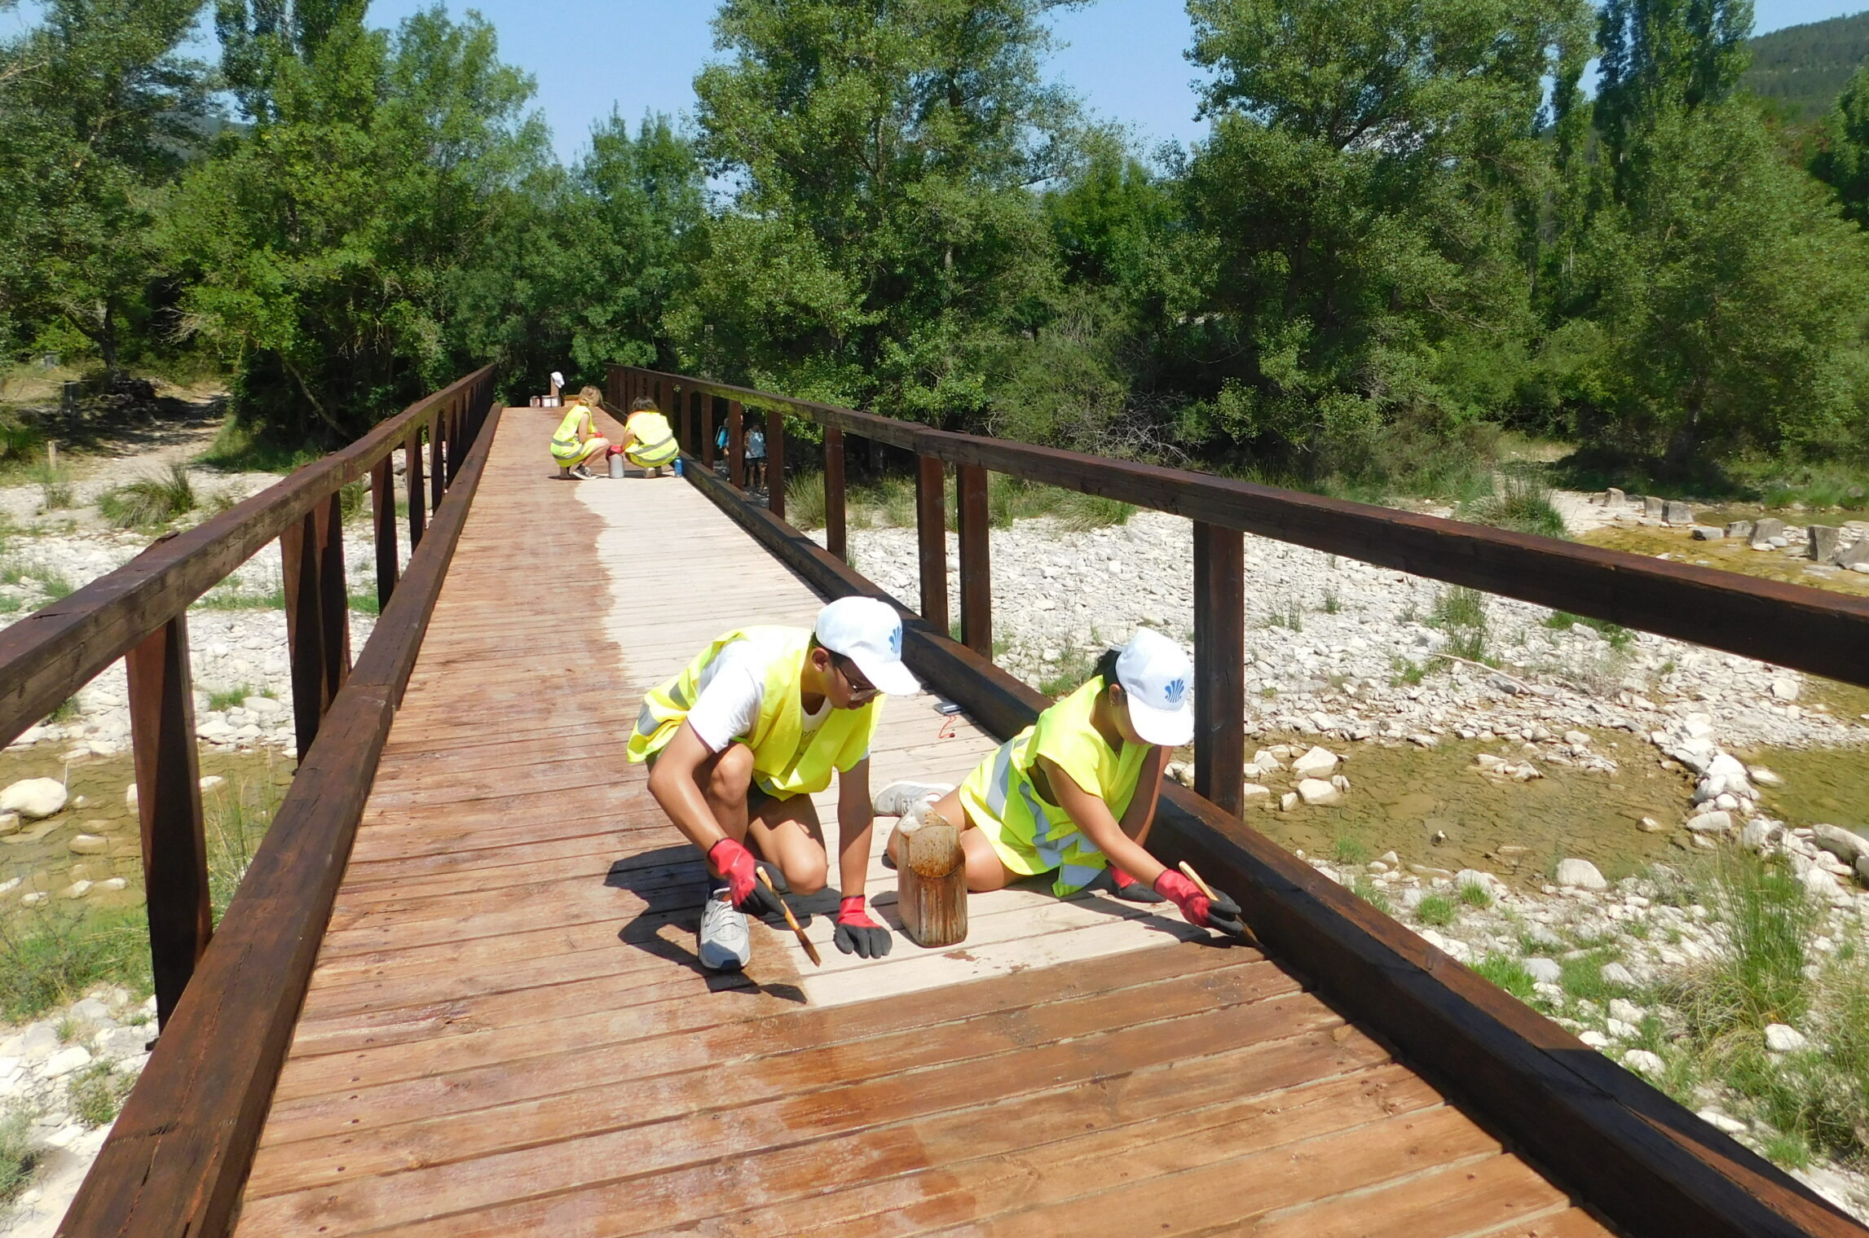
COMPOSTELA ACADEMY ON THE CAMINO
Autonomous Community of Aragon, 16-30/August/2025
Collaborator: Association of Municipalities of the Camino Francés de Santiago
Volunteer work.
Training (University of Zaragoza
and Instituto Cervantes).
Educational and cultural leisure.
CGU
XXXI
GA
REPORT OF THE EXECUTIVE SECRETARY

Slide 40
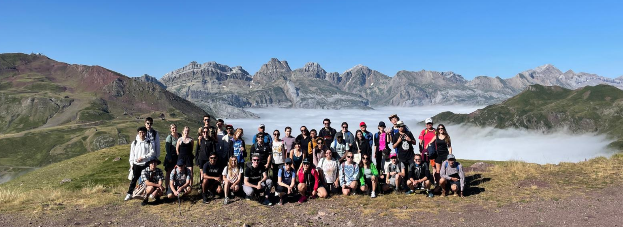
COMPOSTELA ACADEMY ON THE CAMINO
University Walking Community participants
and the incredible natural heritage of the Camino
CGU
XXXI
GA
REPORT OF THE EXECUTIVE SECRETARY

Slide 41
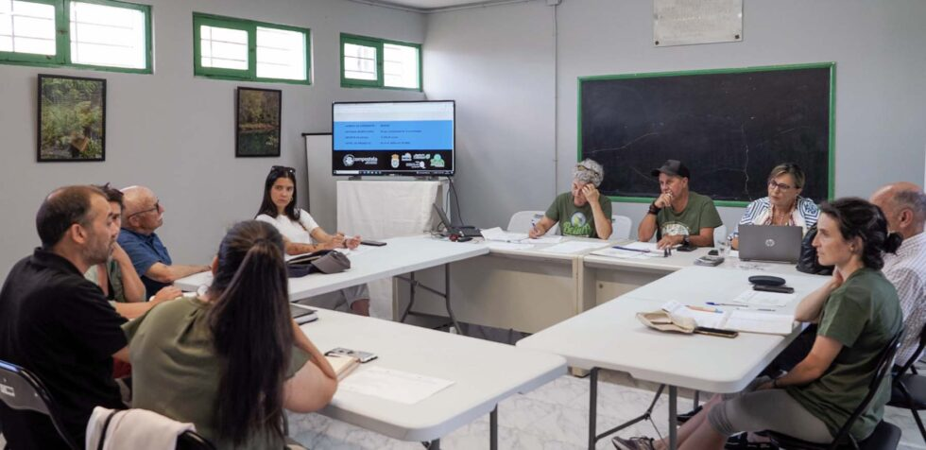
VOLUNTEERING
CGU Volunteering with Heritage in Forests GAL
CGU
XXXI
GA
REPORT OF THE EXECUTIVE SECRETARY

Slide 42
MOBILITY
Total budget: 13,200 €
11 individual exchanges
1,000 €/each mobility
Total budget: 10,800 €
10 individual exchanges:
7 intercontinental mobility: 1,200 €/each
3 national mobility: 600 €/each
CGU
XXXI
GA
REPORT OF THE EXECUTIVE SECRETARY

Slide 43

ATENEO CGU. SUPPORT THE MOBILITY
ATENEO GOLD:
ECONOMIC COMPLEMENT
AND SUBSISTANCE
ECONOMIC COMPLEMENT
ATENEO PREMIUM:
ACCOMODATION
ACCOMODATION
CGU
XXXI
GA
REPORT OF THE EXECUTIVE SECRETARY

Slide 44
MOBILITY
Activity open for
members to lead a chair
Leaders: any school from member universities.
Area of knowledge: to be proposed by the offering university.
Period of mobility: 2026.
Willing to submit an offer?
Just contact grupo.compostela@usc.esv
CGU
XXXI
GA
REPORT OF THE EXECUTIVE SECRETARY

Slide 45

TRAINING
CGU
XXXI
GA
REPORT OF THE EXECUTIVE SECRETARY

Slide 46

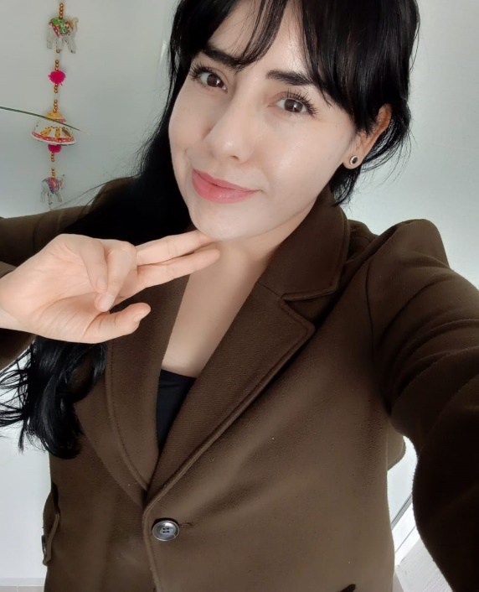
TRAINING
CGU-University of Pécs
3-7/November/2025
32 students maximum.
Deadline 5/October
Free training
“Participating in a debate at a foreign university, entirely in English, challenged me to step out of my comfort zone, broadening my academic and personal perspectives.”
Claudia Franco Núñez
University of Guadalajara
CGU
XXXI
GA
REPORT OF THE EXECUTIVE SECRETARY

Slide 47


RESEARCH
OBJECTIVES:
To valorize the communication abilities.
To give visibility to research
To help research groups
Prize: diplomas and
3,000 euros in prizes.
Biennial jury 2023-2025:
Universities of A Coruña & La Salle Bajío.
CGU
XXXI
GA
REPORT OF THE EXECUTIVE SECRETARY

Slide 48
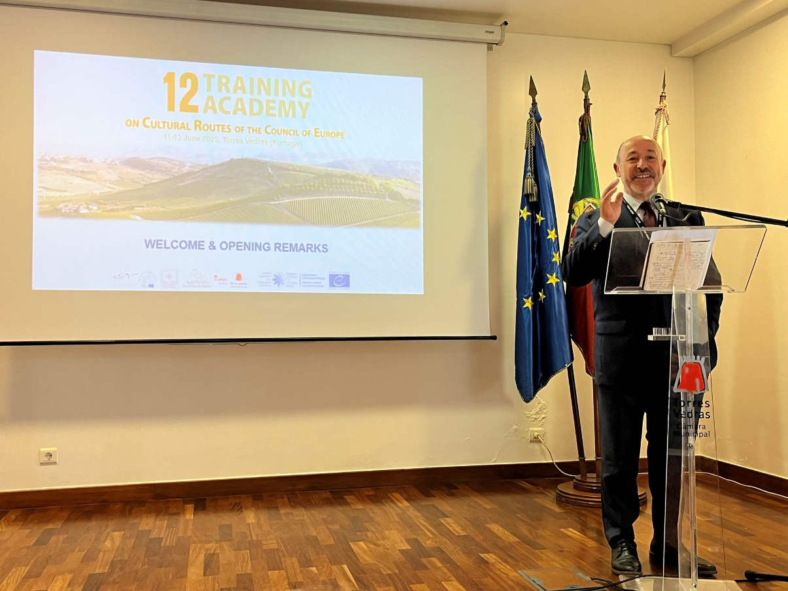

INTERNATIONAL PRIZE GRUPO COMPOSTELA-XUNTA DE GALICIA
CGU jury members:
University of Basque Country
University La Salle Bajío
University of Santiago de Compostela
Xunta de Galicia
CGU
Prize winner 2025:
European Institute
of Cultural Routes
CGU
XXXI
GA
REPORT OF THE EXECUTIVE SECRETARY

Slide 49


PUBLICATIONS
CGU
XXXI
GA
REPORT OF THE EXECUTIVE SECRETARY

Slide 50
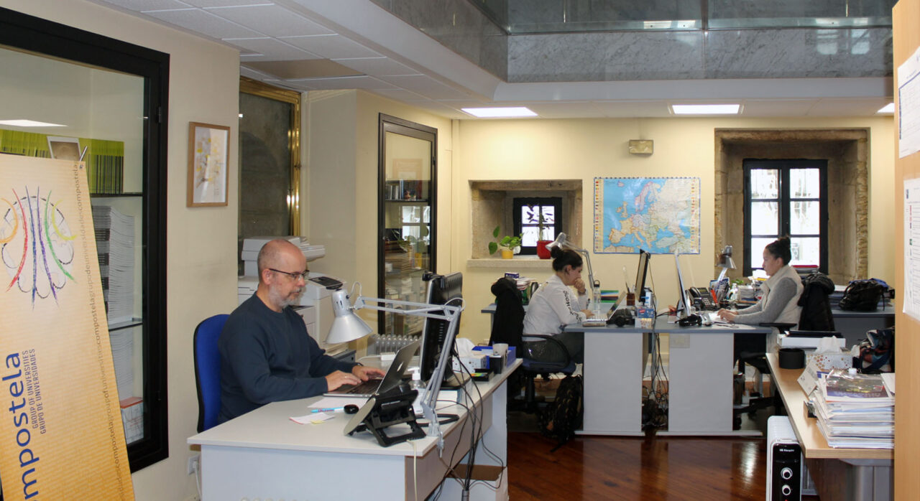
SECRETARIAT
Growth of office
and activity
CGU
XXXI
GA
REPORT OF THE EXECUTIVE SECRETARY

Slide 51
XXXII GENERAL ASSEMBLY
CGU
XXXI
GA

Slide 52
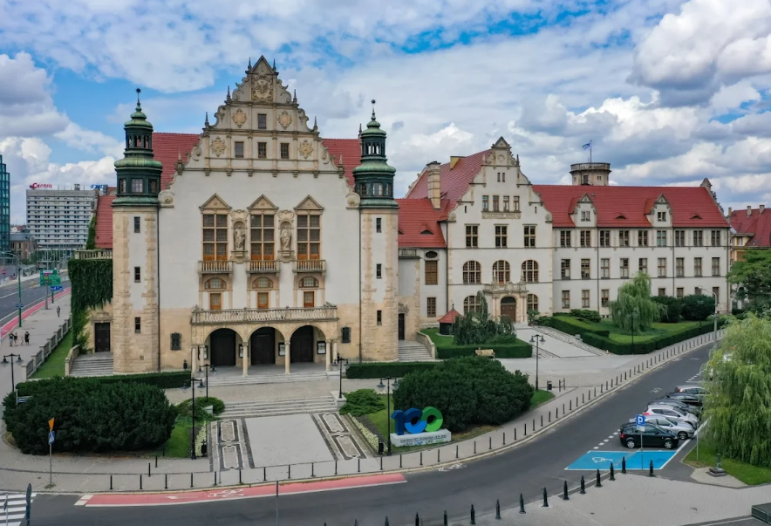
XXXII GENERAL ASSEMBLY
DATE:
14-16/September/2026
TOPIC:
University autonomy - funding and democracy
Pencil the date!
VENUES:
Adam Mickiewicz University in Poznan
(Wieniawskiego 1, 61-712 Poznań, Poland)
CGU
XXXI
GA
XXXII GENERAL ASSEMBLY

Slide 53
VOICES OF THE GROUP
CGU
XXXI
GA

Slide 54

CGU
XXXI
GA
VOICES OF THE GROUP

Slide 55

CGU
XXXI
GA
VOICES OF THE GROUP

Slide 56

CGU
XXXI
GA
VOICES OF THE GROUP

Slide 57

CGU
XXXI
GA
VOICES OF THE GROUP

Slide 58
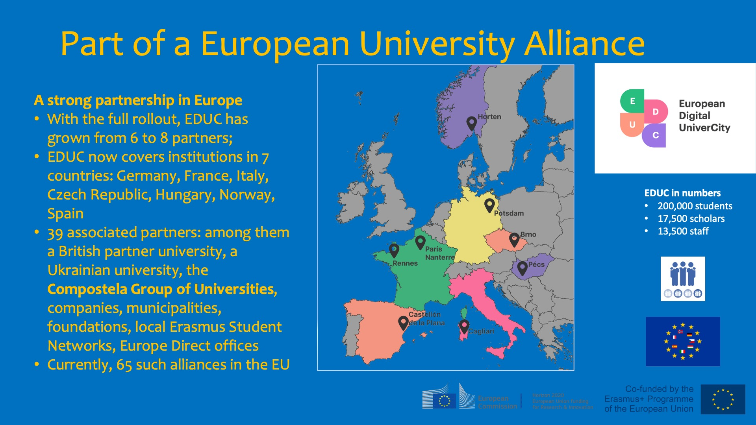
CGU
XXXI
GA
VOICES OF THE GROUP

Slide 59

CGU
XXXI
GA
VOICES OF THE GROUP

Slide 60
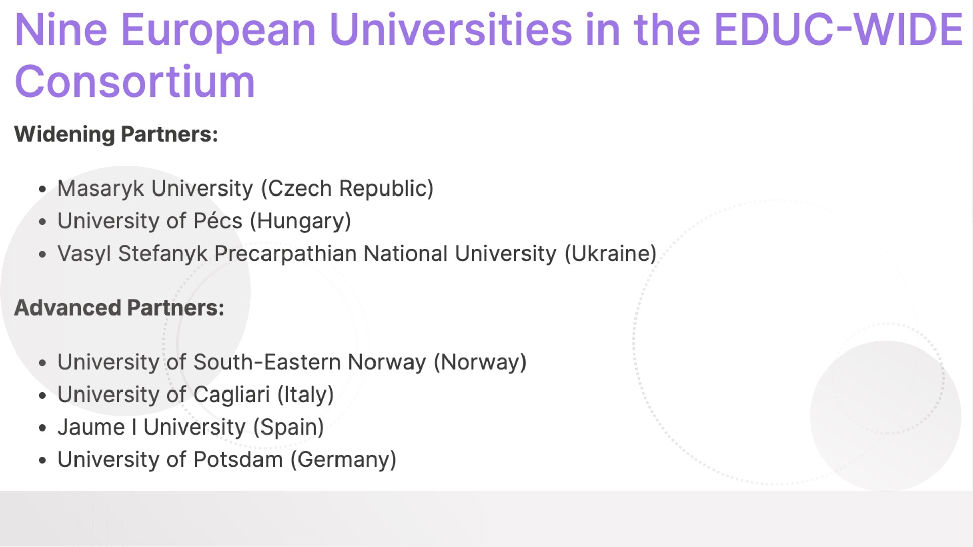
CGU
XXXI
GA
VOICES OF THE GROUP

Slide 61

CGU
XXXI
GA
VOICES OF THE GROUP

Slide 62
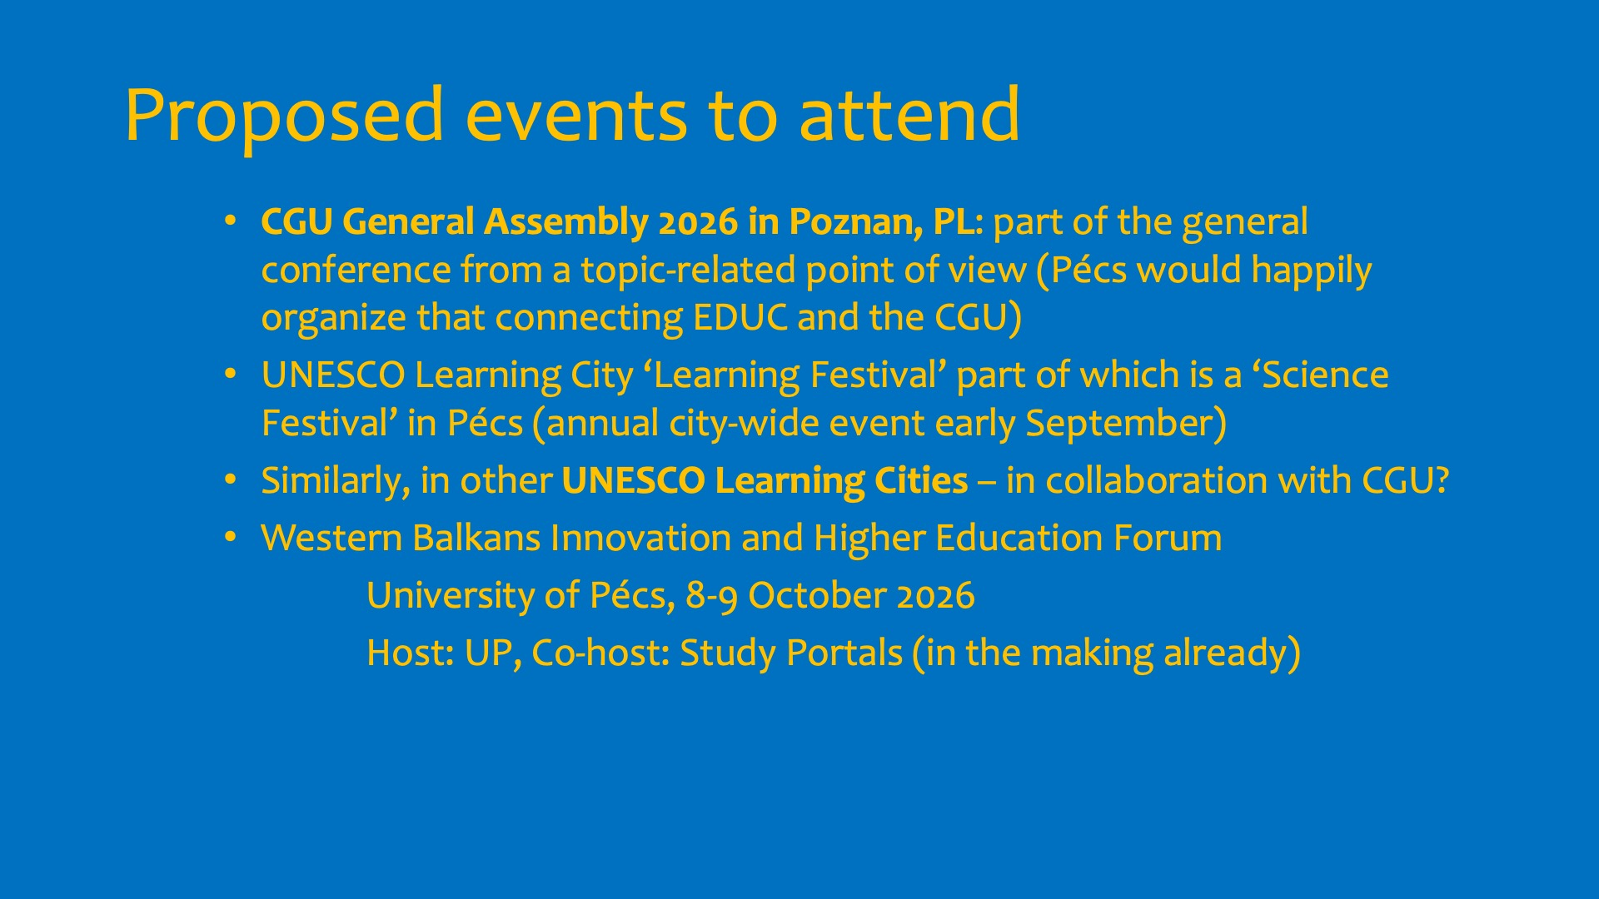
CGU
XXXI
GA
VOICES OF THE GROUP

Slide 63
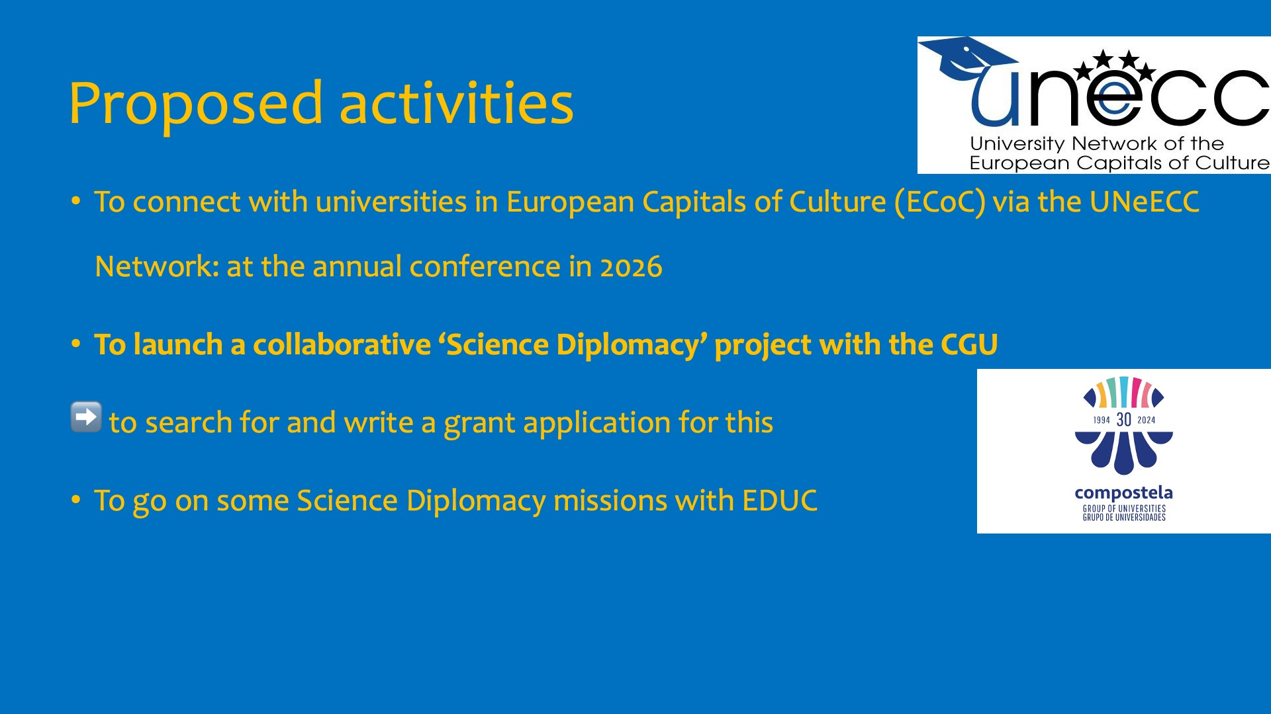
CGU
XXXI
GA
VOICES OF THE GROUP

Slide 64

CGU
XXXI
GA
VOICES OF THE GROUP

Slide 65
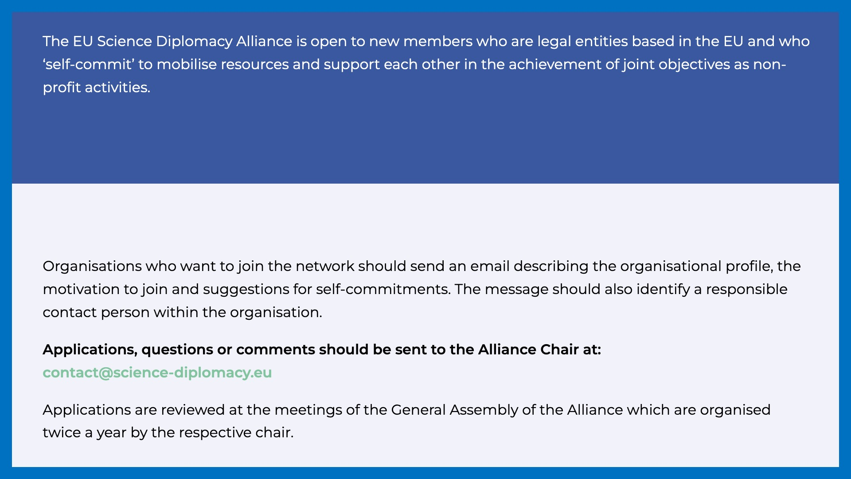
CGU
XXXI
GA
VOICES OF THE GROUP

Slide 66

CGU
XXXI
GA
VOICES OF THE GROUP

Slide 67

AWARD OF THE GOLDEN PIN
CGU
XXXI
GA

Slide 68

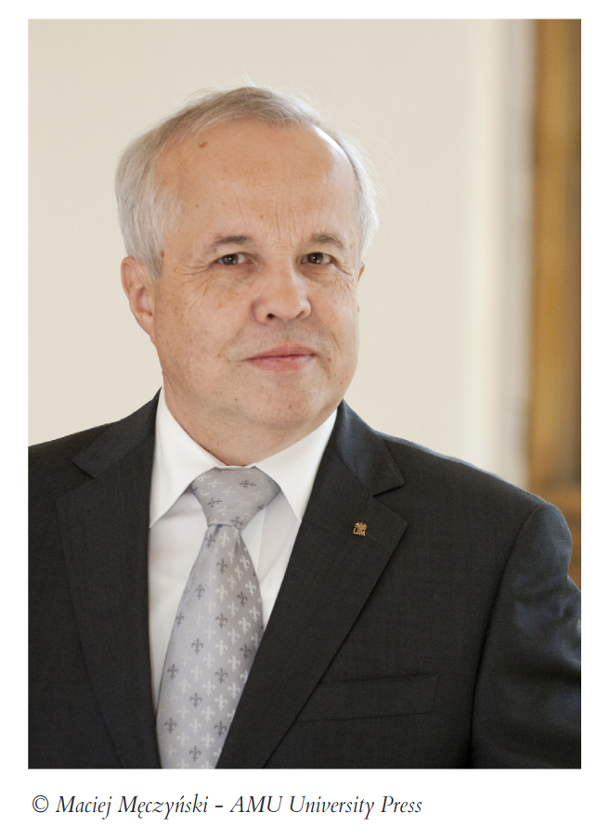
Marek Kręglewski
Professor at the Faculty of Chemistry
Adam Mickiewicz University in Poznan (Poland)

Slide 69
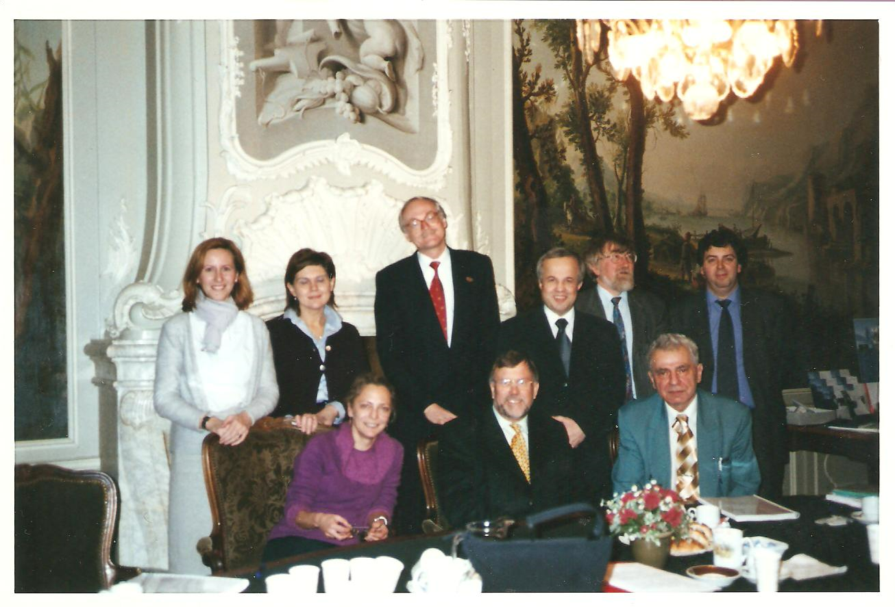
Marek Kręglewski
CGU Delegate at
Adam Mickiewicz University in Poznan
since the inception of the network.

Slide 70
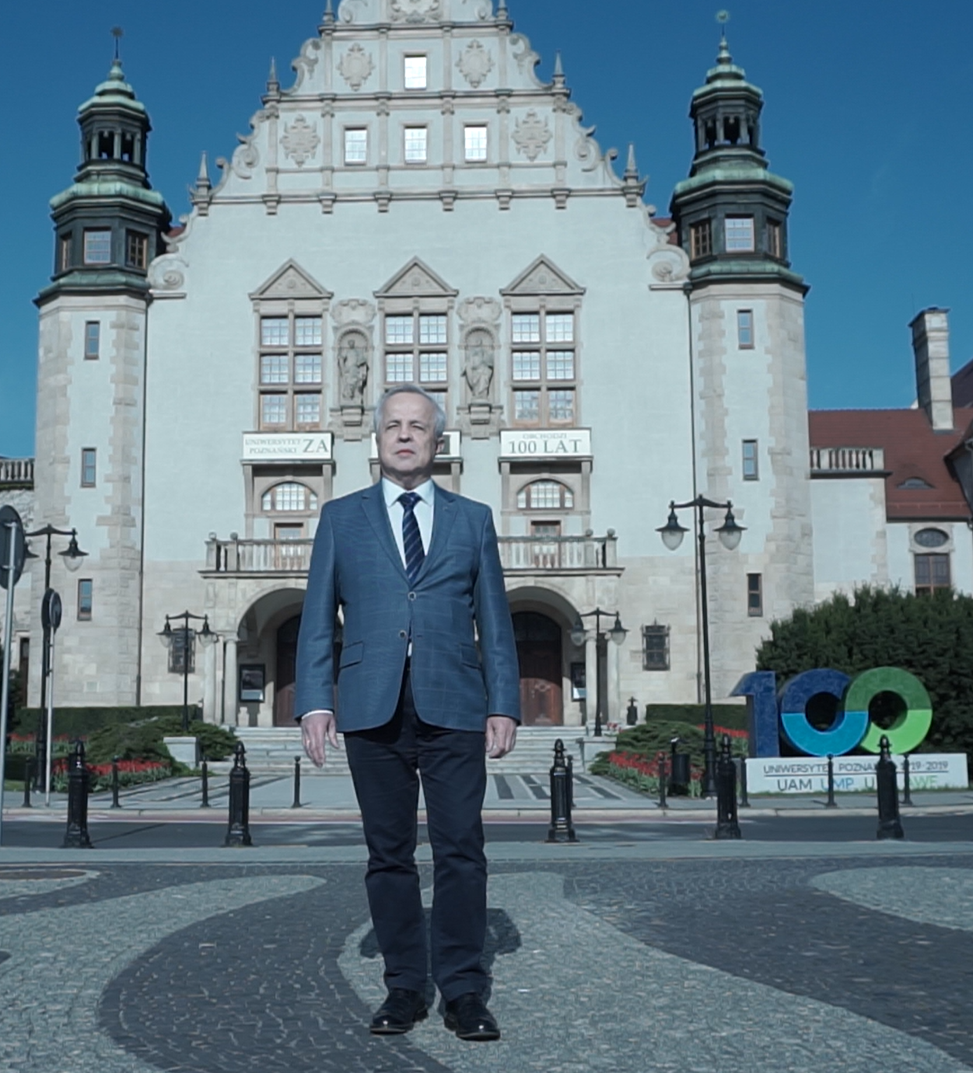
Marek Kręglewski
Representative of the University and the Group in numerous occasions.

Slide 71
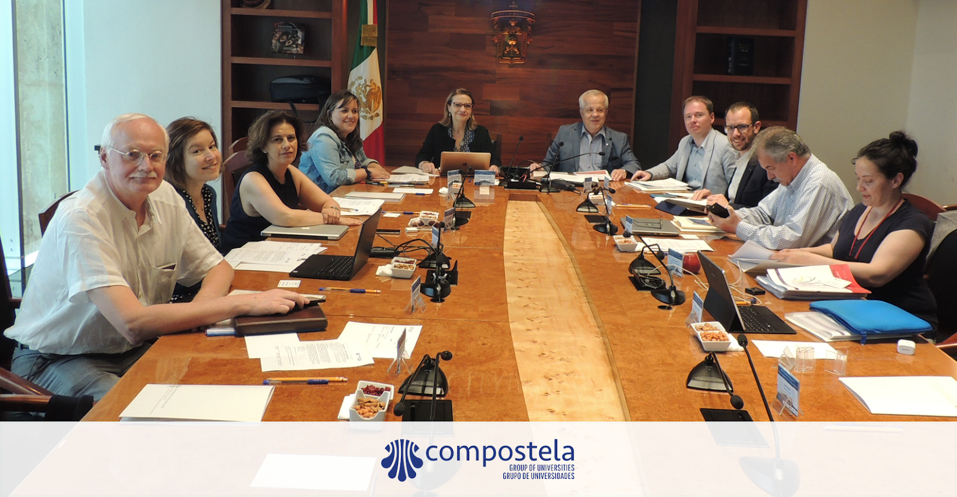
Marek Kręglewski
Active part
of the CGU executive committee,
as a member (1999-2007)
and as a treasurer (2007-2015).

Slide 72
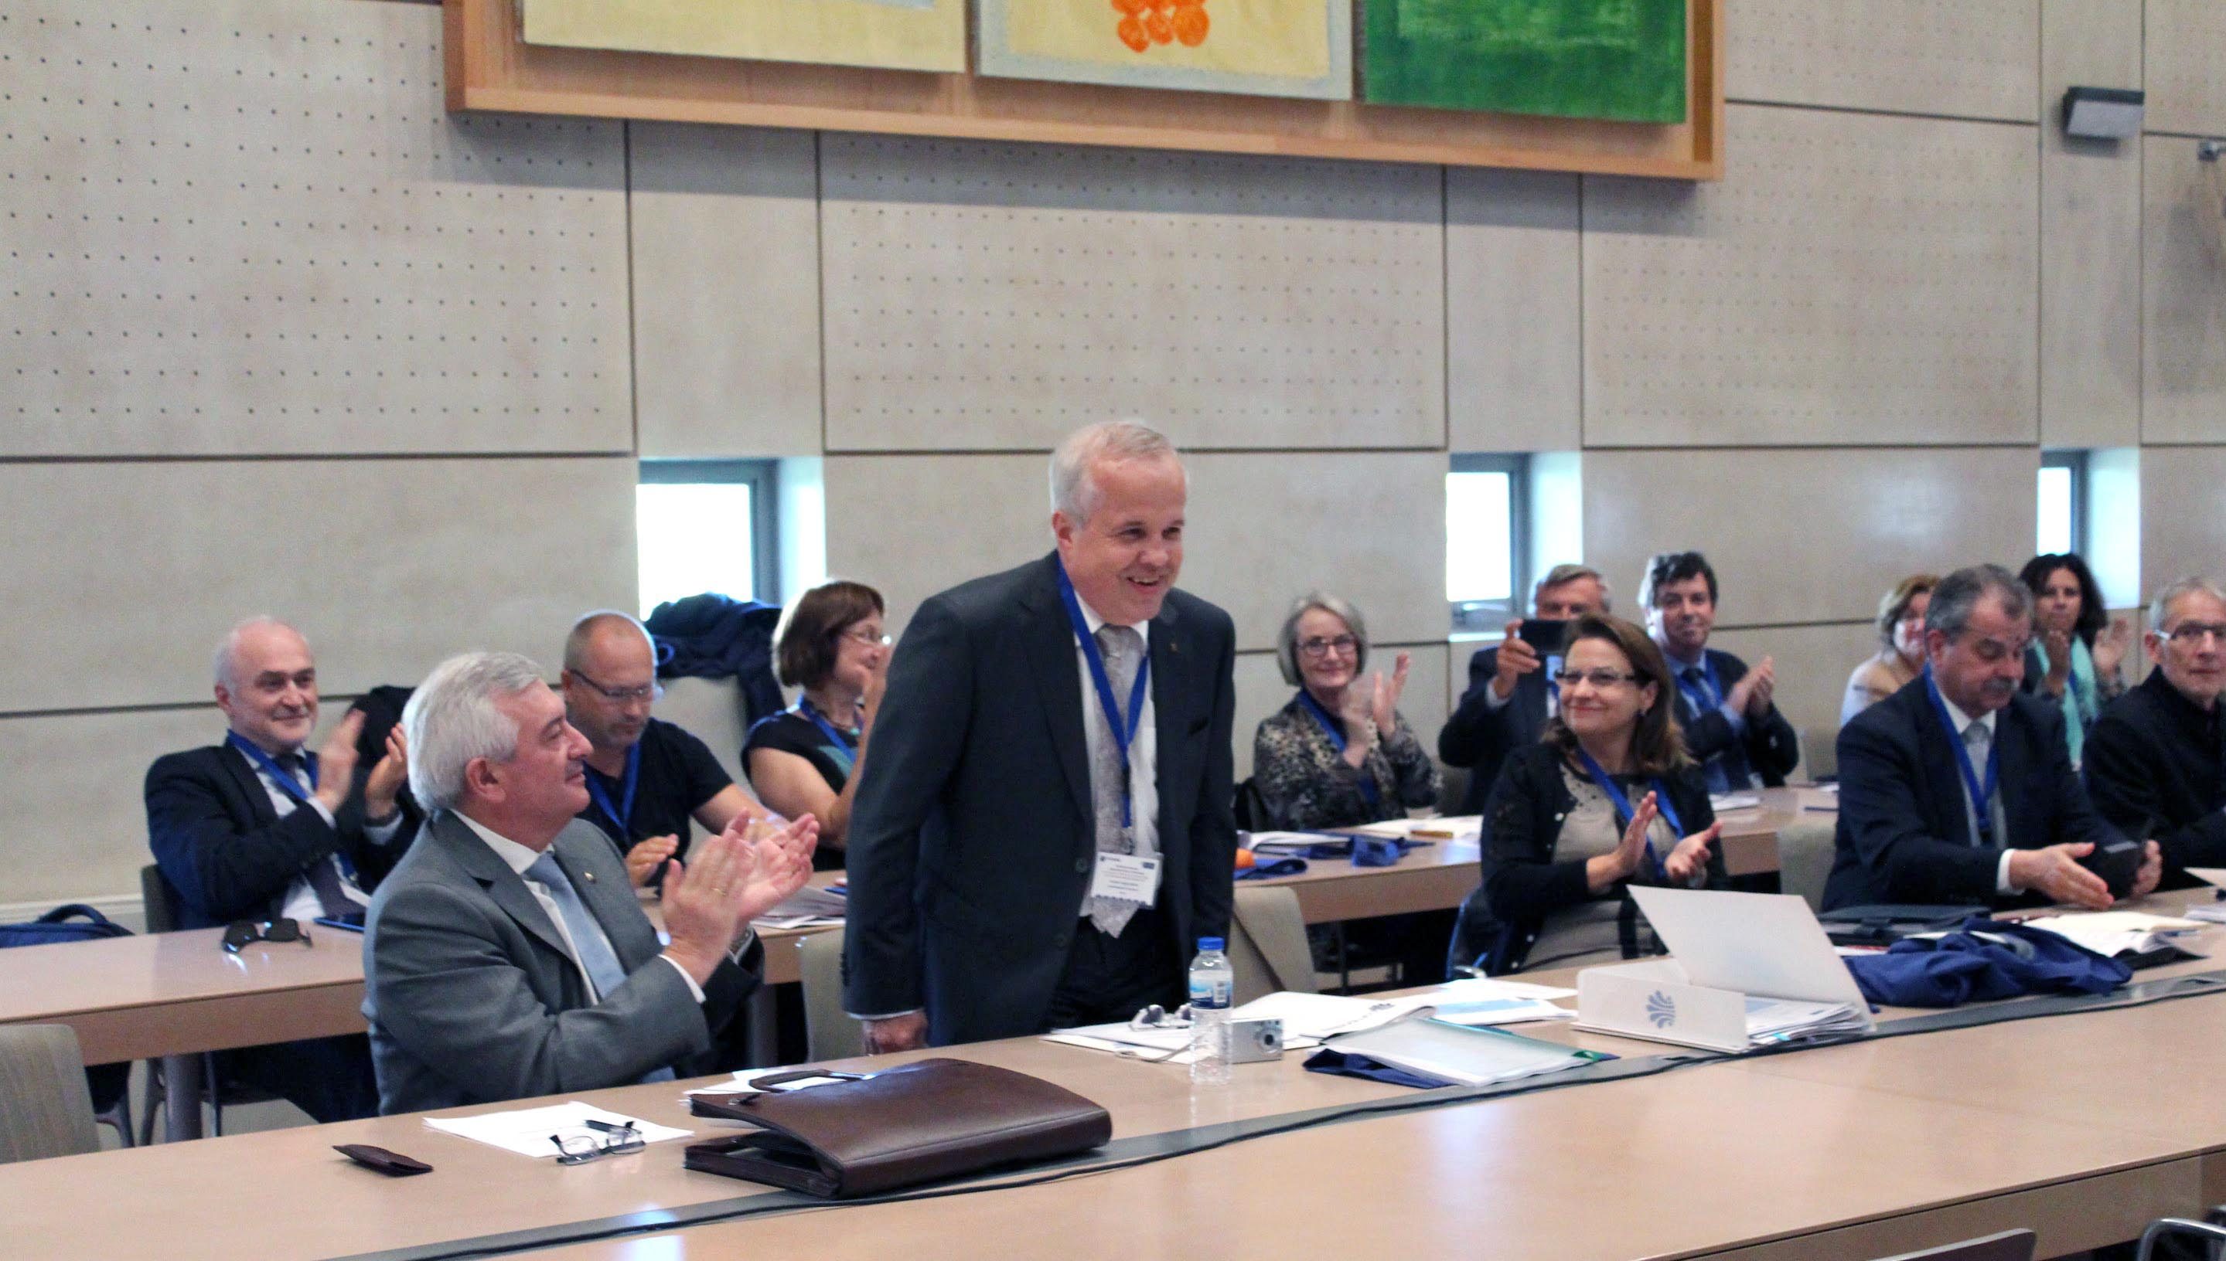
Marek Kręglewski
Elected President in first term (2015-2019)
at University of Santiago de Compostela (Spain).

Slide 73
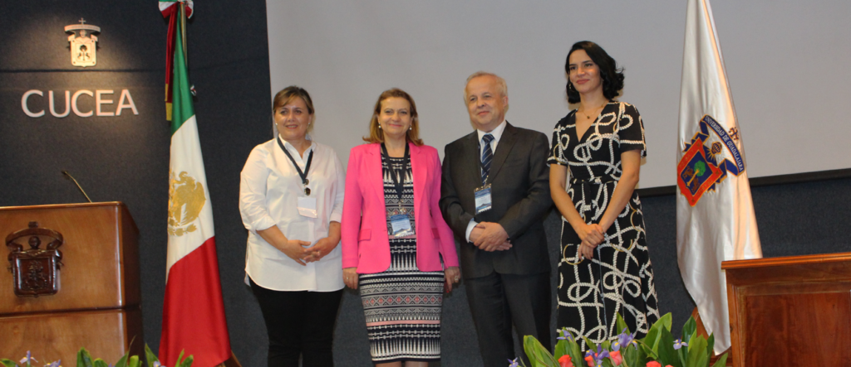
Marek Kręglewski
Reelected President in second term
(2019-2023) at University of Guadalajara (Mexico).

Slide 74
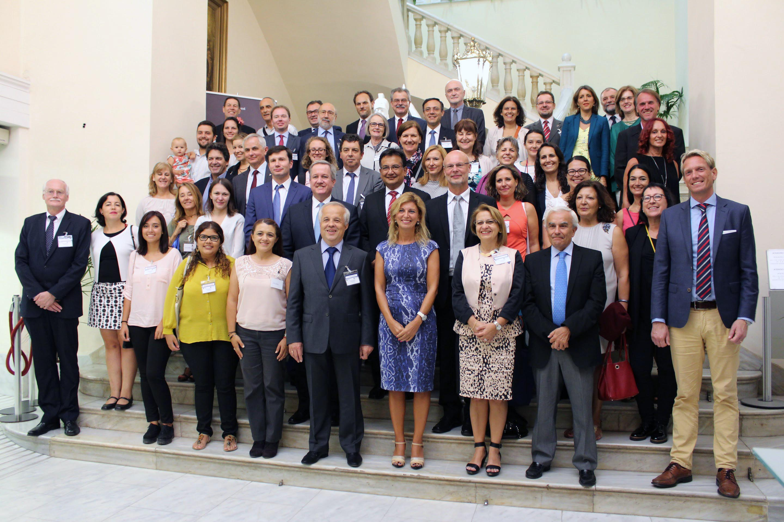
Marek Kręglewski
A leader with proven human qualities in social environments.

Slide 75
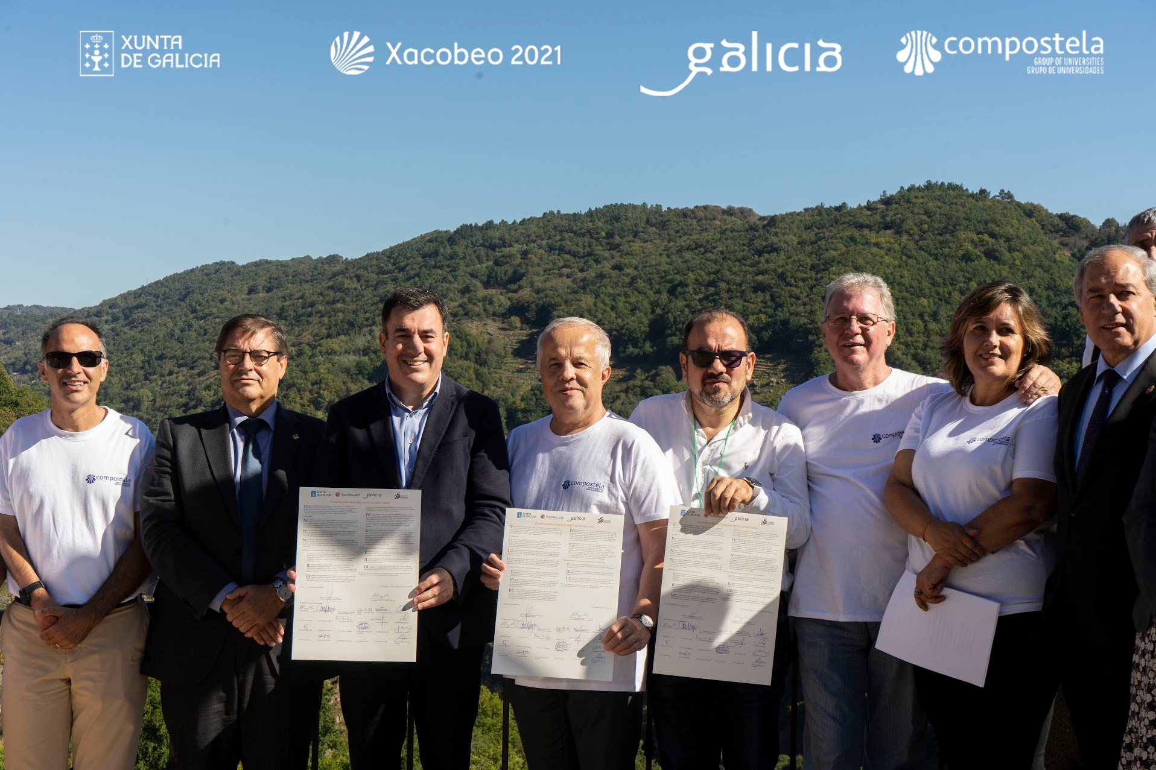
Marek Kręglewski
Passionate traveller
and good travelling companion
in every single event
of our beloved network.

Slide 76
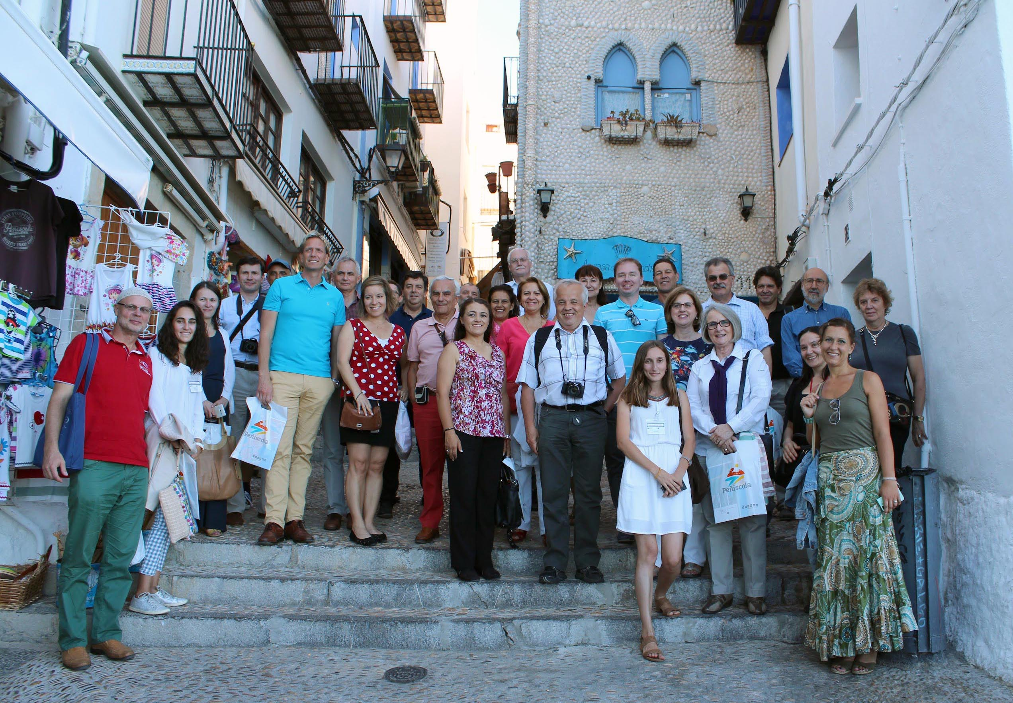
Marek Kręglewski
Passionate traveller
and good travelling companion
in every single event
of our beloved network.

Slide 77
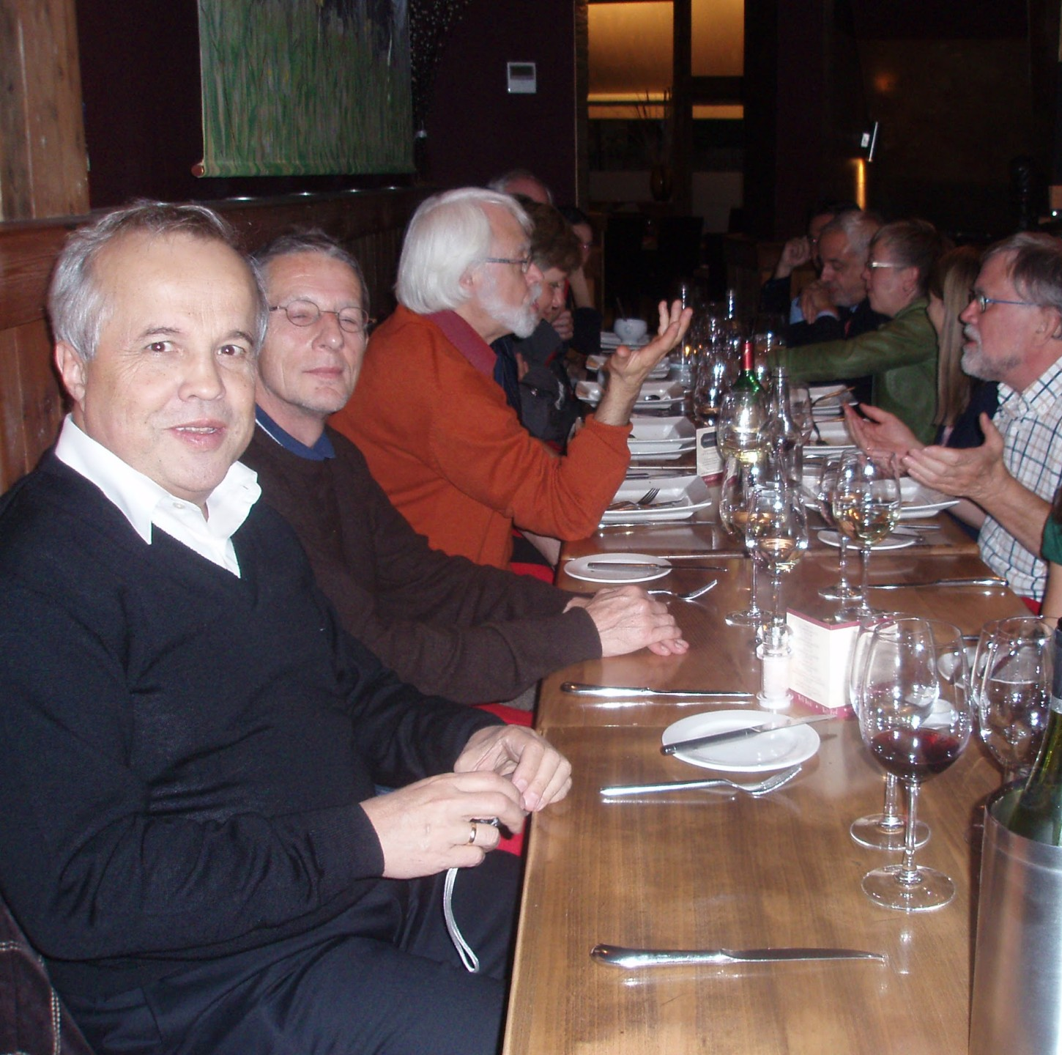
Marek Kręglewski
Passionate traveller
and good travelling companion
in every single event
of our beloved network.

Slide 78
Marek Kręglewski
Marek Kreglewski, awarded GCU Golden Pin 2025
for his generous and unwavering dedication
to the network and his valuable engagement
and leadership, a reflection of a profound vocation for service and excellence that deserves recognition.

