Slide 1


“Best practices of Sustainability at our CGU member universities”
Cristina Matos

Slide 2

“Best practices of Sustainability at our CGU member universities”
Best practices for university sustainability include:
- integrating environmental principles into the curriculum;
- implementing campus-wide resource efficiency programs for water and energy,
- promoting waste reduction and recycling;
- and fostering a culture of sustainability through student and staff engagement and research.

Slide 3
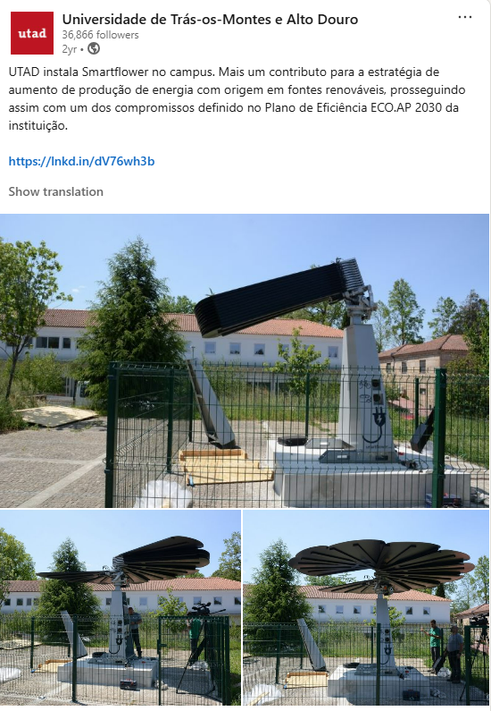
“Best practices of Sustainability at our CGU member universities”
🌱 Campus Operations (included in ISO 14001 and 50001 UTAD’s Certification)
Energy Efficiency: Transition to renewable energy (solar, wind, geothermal), improve building insulation, use LED lighting, and install smart energy management systems.
"Since fall 2022, we have been heating most of our buildings with biomass, significantly reducing natural gas consumption. As a result of these initiatives, combined with energy efficiency initiatives, we have already managed to reduce total CO2 emissions associated with energy consumption by approximately 20% compared to 2019 (the pre-COVID reference year)," emphasizes Ricardo Bento, Provost of Planning, Territory, and Heritage.
  One of the commitments defined in the institution's ECO.AP 2030 Efficiency Plan.
Currently, the Trás-os-Montes university has seven production units installed in campus buildings, two in university residences, and, most recently, a Smartflower, a pioneering photovoltaic energy production unit in the North region.
The total installed power is 221.3 kW, corresponding to a global production of nearly 900 MWh from 2020 to date.
Requested the Environmental Fund for three more power generation centers on the campus (with a total of 871 new modules), with an expected total production of 684 kWh/year and an estimated self-consumption percentage of 99.7%, which will result in greenhouse gas emissions equivalent to 58.63 toe/year," explains Ricardo Bento. If approved, UTAD will be able to benefit from a total power of over 470.34 kWp, which will triple its annual solar energy production.

Slide 4
“Best practices of Sustainability at our CGU member universities”
🌱 Campus Operations (included in ISO 14001 and 50001 UTAD’s Certification)
Water Conservation: Implement greywater recycling, low-flow fixtures, rainwater harvesting, and drought-tolerant landscaping.
UTAD has four duly licensed boreholes for irrigation of green spaces.
UTAD strives to follow national and international best practices and, to this end, plans to replace existing water sources with alternative sources, such as:
  installing rainwater harvesting systems for irrigation in new construction projects or in space renovations;
  using treated wastewater for irrigation;
Furthermore, UTAD is part of the AQUA+ Commitment Network, which will allow us to assess the campus's water efficiency, with a view to certification and improvement. With this commitment, UTAD will be a pioneer as a case study among higher education institutions in Portugal.

Slide 5
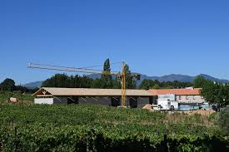
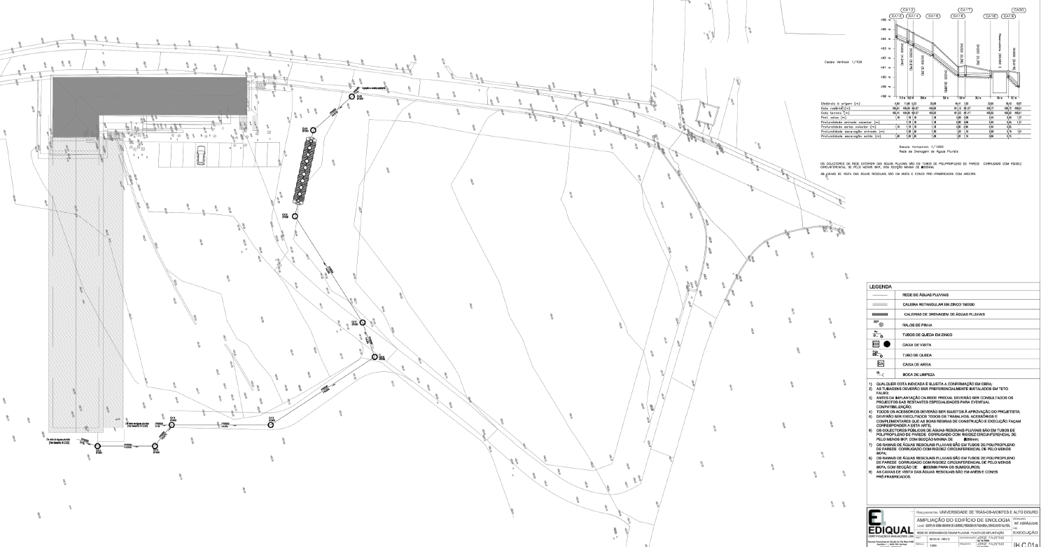
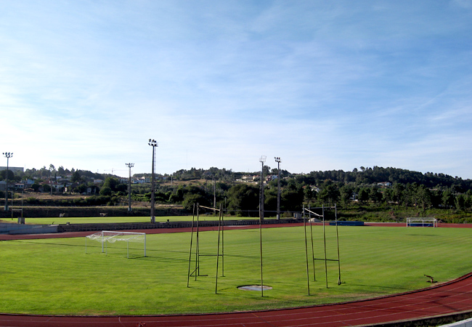
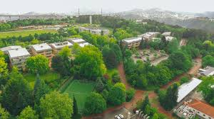
“Best practices of Sustainability at our CGU member universities”
🌱 Campus Operations (included in ISO 14001 and 50001 UTAD’s Certification)
Water Conservation examples implemented
Rainwater harvesting system (RWHS) from the winery rooftop for cleaning and irrigation
Rainwater harvesting system (RWHS) in the new residence for the greenroof irrigation
Rainwater harvesting system (RWHS) in the sports center for grass fields irrigation

Slide 6
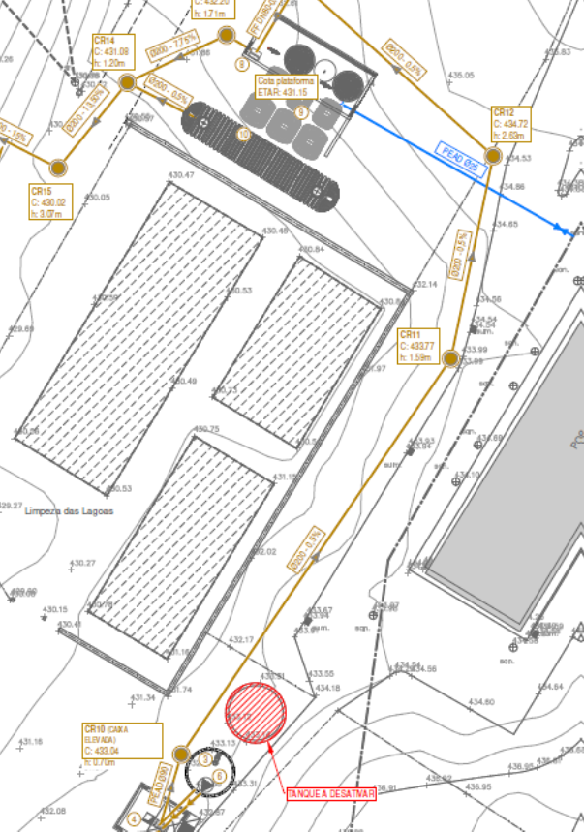
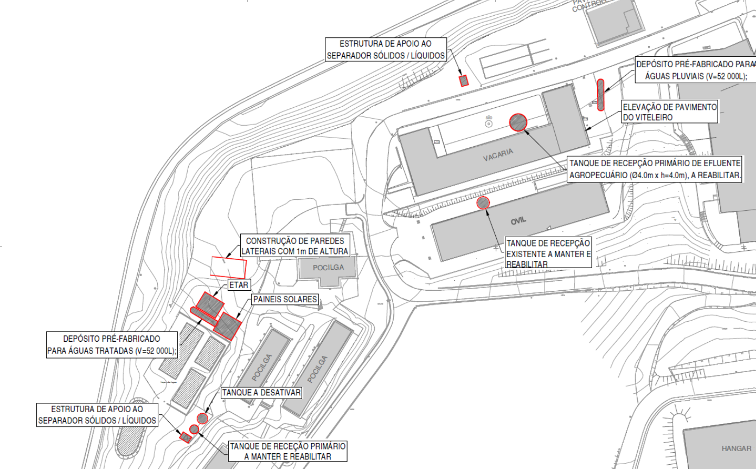
“Best practices of Sustainability at our CGU member universities”
🌱 Campus Operations (included in ISO 14001 and 50001 UTAD’s Certification)
Water Conservation examples implemented
this WWTP also has a system for harvesting rainwater from the farm's roofs;
the new WWTP, derived from the UTAD's environmental and water conservation project for agricultural effluents, will allow for the production of ApR, which will be used for irrigation and will simultaneously represent an added value for soil fertility (ENEAPAI, 2030).

Slide 7
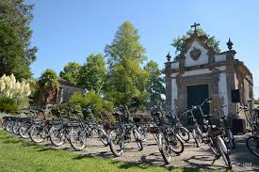

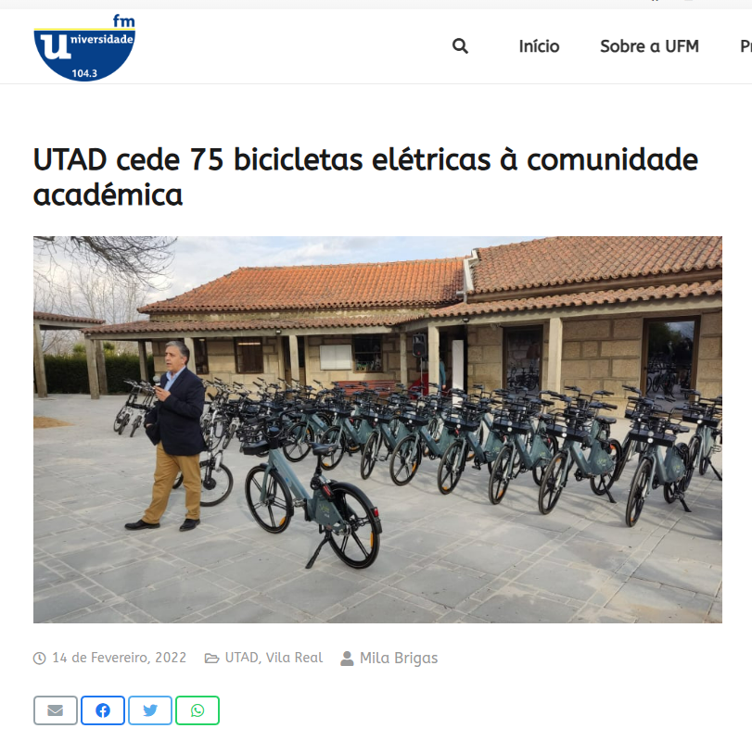
“Best practices of Sustainability at our CGU member universities”
🌱 Campus Operations (included in ISO 14001 and 50001 UTAD’s Certification)
🚲 Transportation
Encourage biking and walking with safe paths, bike racks, and repair stations.
Provide incentives for public transit or university shuttles (ideally electric).
Transition campus fleets to electric or hybrid vehicles.
Implement carpooling apps and limit single-occupancy vehicle parking.
“The University of Trás-os-Montes and Alto Douro (UTAD) provided 75 electric bicycles to the academic community, in a project in partnership with UBike.”

Slide 8
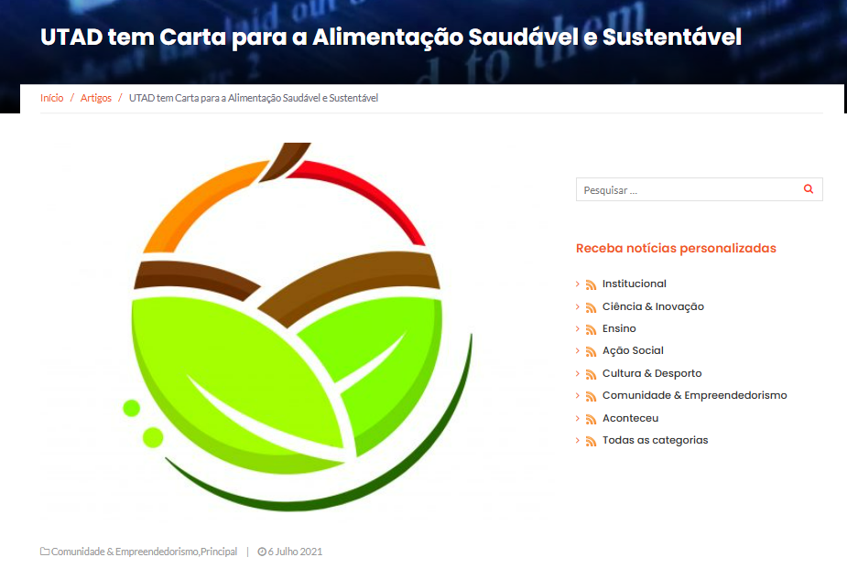
“Best practices of Sustainability at our CGU member universities”
🌱 Campus Operations (included in ISO 14001 and 50001 UTAD’s Certification)
🥗 Food & Dining
Source food locally and seasonally.
Offer plant-forward menus to reduce carbon impact.
Cut food waste via trayless dining, smaller portions, and food recovery programs.
Replace disposables with reusable containers and utensils.
The "Charter for Healthy and Sustainable Food of the University of Trás-os-Montes and Alto Douro" (UTAD) was created, integrated with the objectives of the University's Strategic Plan, which aims to create a campus where healthy and sustainable choices are easier.
It also aims to support the development of the 2030 Agenda, particularly in innovation and research processes (SDG 16), the European "Farm to Fork" strategy (SDG 17), the Defense of the Human Right to Adequate Food (SDGs 2 and 18), and Healthier and More Responsible Food Consumption (SDGs 3 and 12).
This Charter has five guiding principles: "Ensure access to a healthy, balanced, and varied diet, taking into account the needs of the individual and their situation in the life cycle"; "Ensure food security"; "Promote food sustainability and the reduction of food waste"; "Promote increased food literacy"; "Promote the training of different members of the academic community to promote healthy and sustainable eating habits";

Slide 9
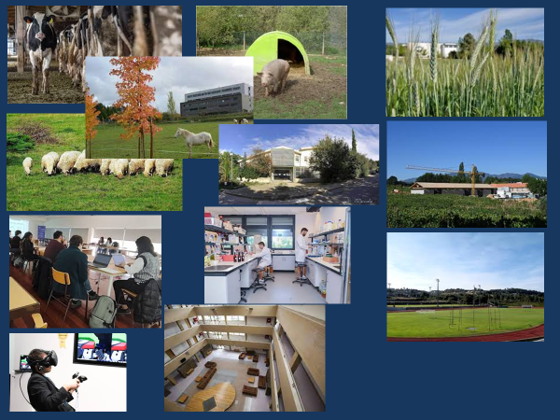
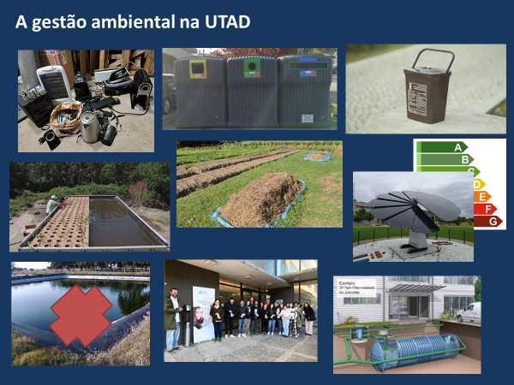
“Best practices of Sustainability at our CGU member universities”
🌱 Campus Operations (included in ISO 14001 and 50001 UTAD’s Certification)
📚 Teaching & Research
Integrate sustainability across the curriculum, not just in environmental sciences.
Support interdisciplinary research on climate, equity, and sustainable development.
Provide experiential learning (campus-as-living-lab, community projects).

Slide 10
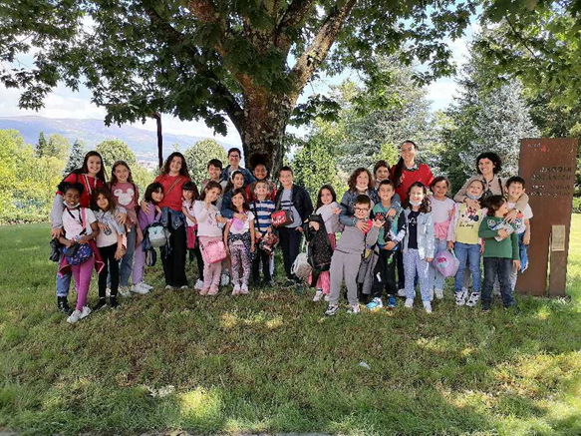
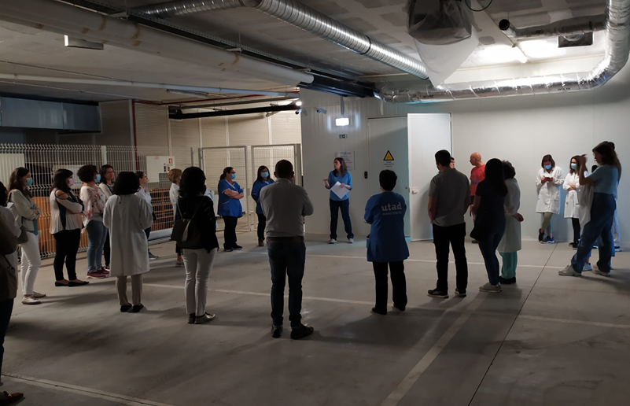
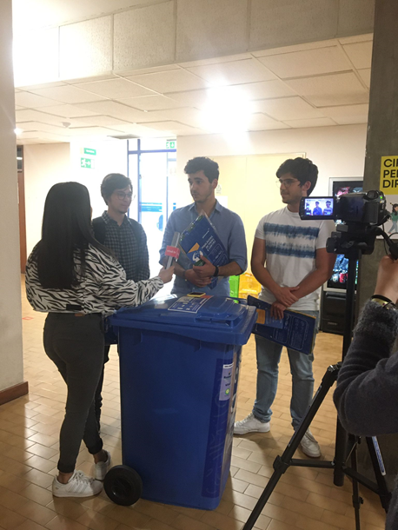
“Best practices of Sustainability at our CGU member universities”
🌱 Campus Operations (included in ISO 14001 and 50001 UTAD’s Certification)
🏫 Community & Engagement
Establish student-led green teams, eco-clubs, and ambassador programs.
Offer staff training and sustainability professional development.
Partner with local communities on sustainability projects (e.g., renewable energy co-ops, urban gardens).
Host events like Earth Week, repair fairs, and climate dialogues.

Slide 11
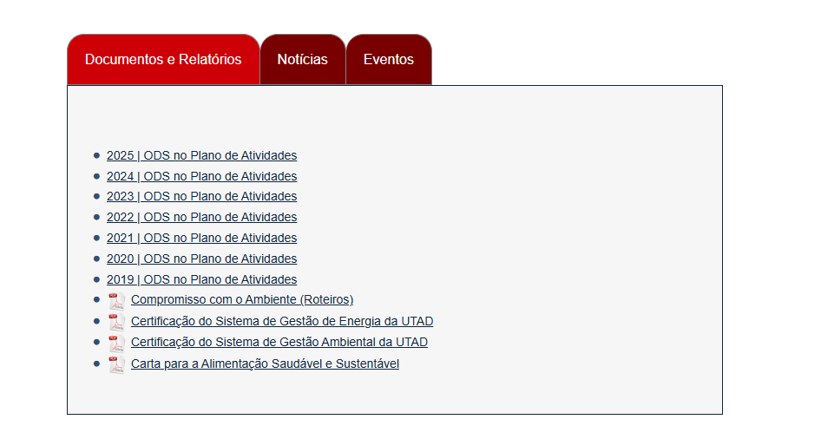

“Best practices of Sustainability at our CGU member universities”
🌱 Campus Operations (included in ISO 14001 and 50001 UTAD’s Certification)
📊 Governance & Policy
Set measurable sustainability goals aligned with frameworks like the UN SDGs, STARS (AASHE), or Carbon Neutrality commitments.
Publish annual sustainability reports with transparent progress data.
Create a dedicated sustainability office with student and faculty representation.
Incorporate equity, inclusion, and social justice into sustainability strategies.
https://www.utad.pt/ods/

Slide 12
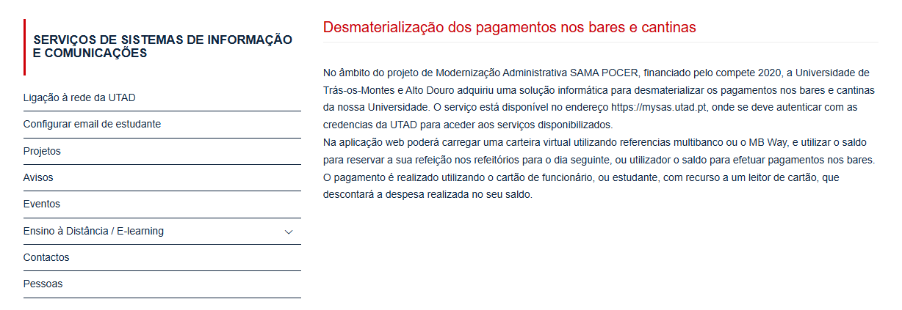
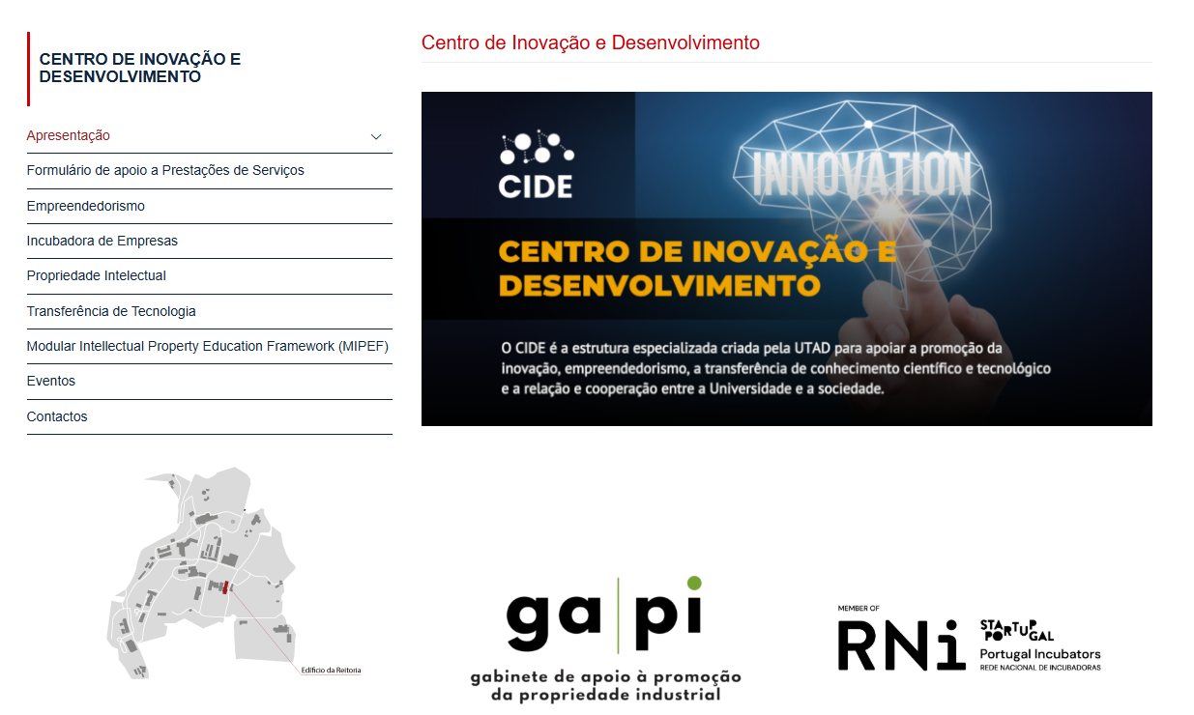
“Best practices of Sustainability at our CGU member universities”
🌱 Campus Operations (included in ISO 14001 and 50001 UTAD’s Certification)
💡 Technology & Innovation
Use digitalization to reduce paper use and optimize resources.
Implement smart grids, sensors, and AI for efficient energy and water management.
Support green startups and incubators on campus.

Slide 13


Slide 14
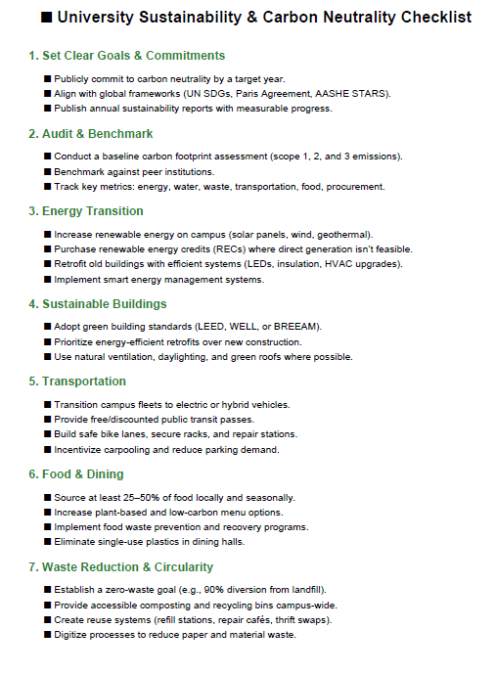
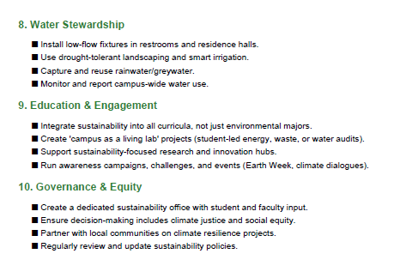
Practical checklist framework
“Top 10 Steps Universities Can Take.”

Slide 15

