Slide 1

Strong Sustainability and Higher Education

Slide 3


Hållbarhet i nivåer
AGENDA
Status check, where we are today
Research based illustration, where we need to be
Strong sustainability and HEI
Three take-aways
Notes:
CARINA
High and low
Ecocentric & technocentric
Sustainability 1.0, 2.0, 3.0
Natural capital substitutioinal or not?
The rationale of strong and weak sustainability
Different models
Corporations perspectives – inside out or outside in? Micro, Macro.

Slide 4
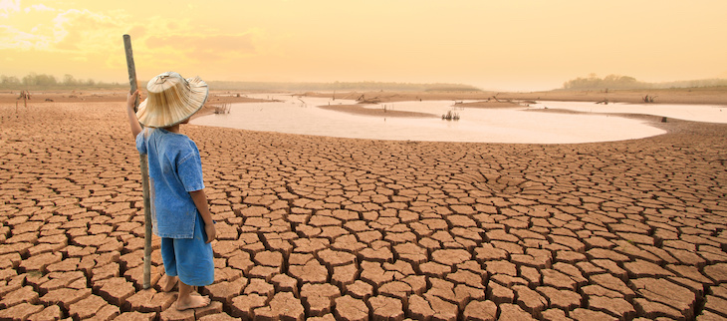
Source: IPCC-rapporten: Klimatkrisen är akut - Miljö & Utveckling
Status check, where we are today

Slide 5
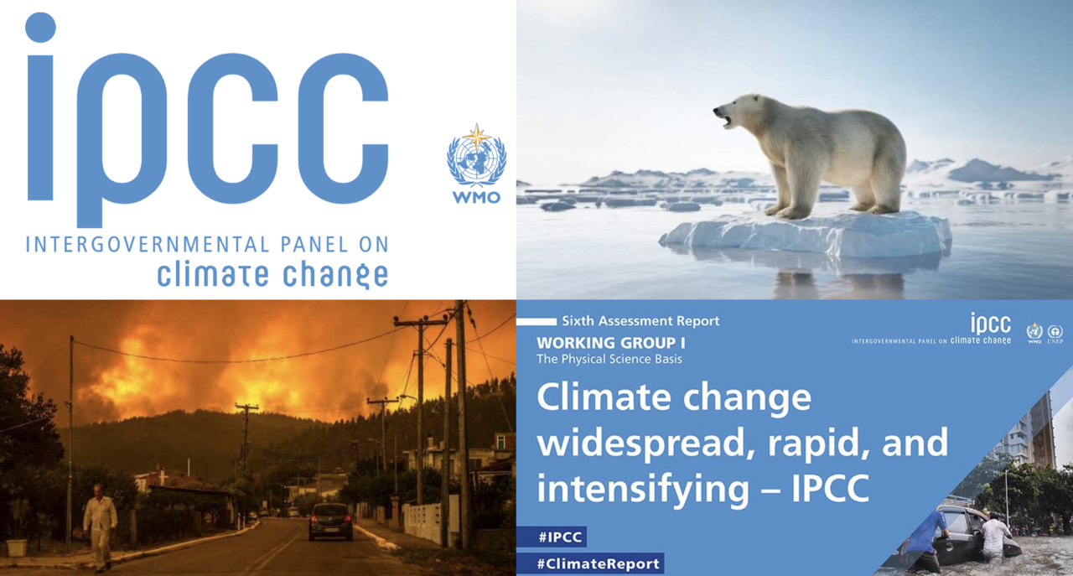
Status check, where we are today

Slide 6
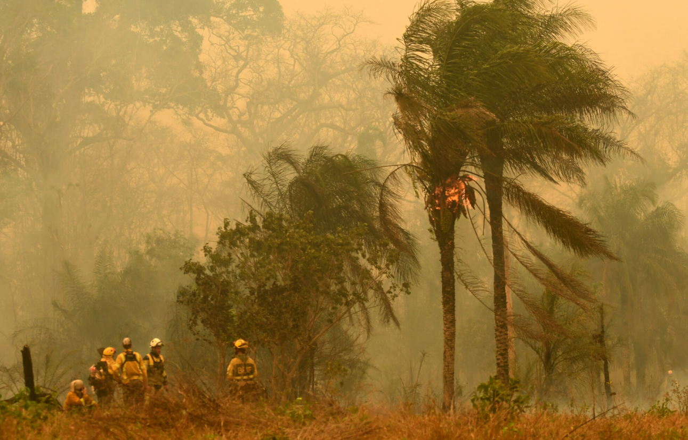
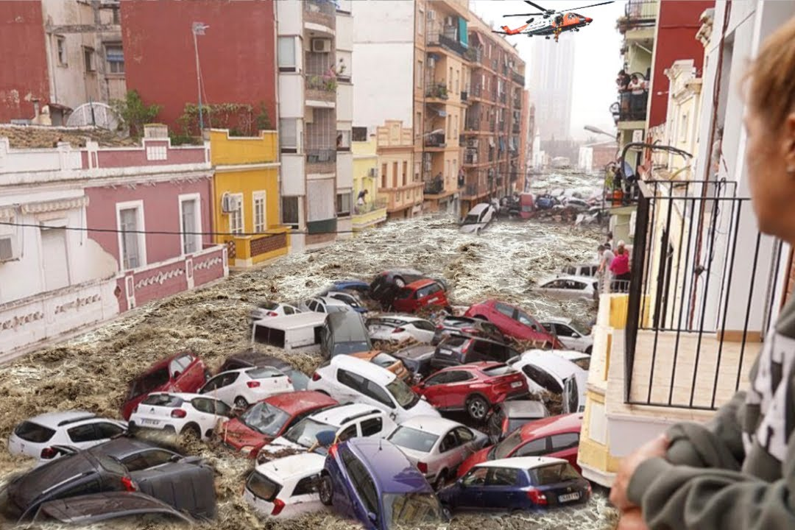
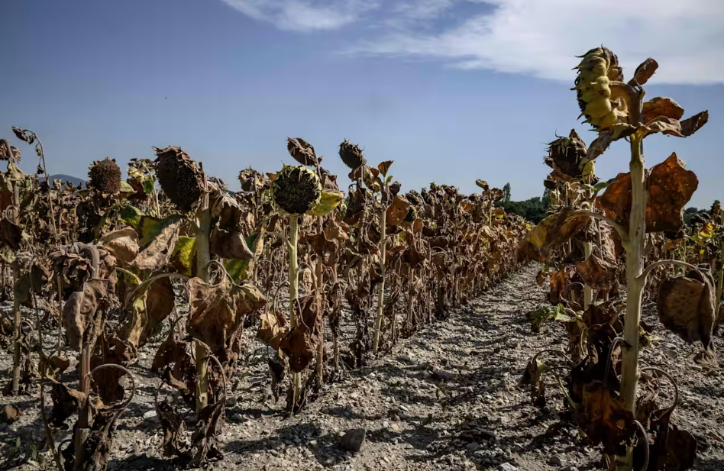
Wildfire in Bolivia, 2024
Flooding in Spain, Valencia, 2024
Dry sunflowerfield in France, 2023
Status check, where we are today
How can we still fail in our work?

Slide 7
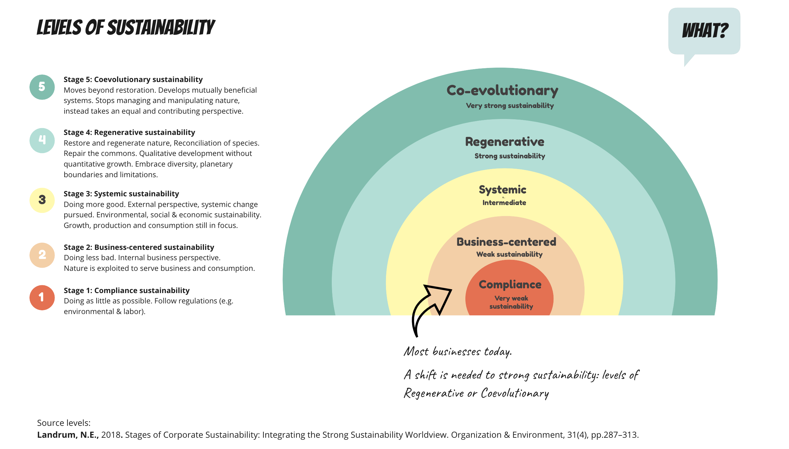
The Rainbow
Sustainability, what is it really?
Notes:
anna
De 5 nivåerna finns
De flesta är i business
Bäst i klassen nu är Systemic
Det finns två till nivåer och i de behöver vi vara.

Slide 8
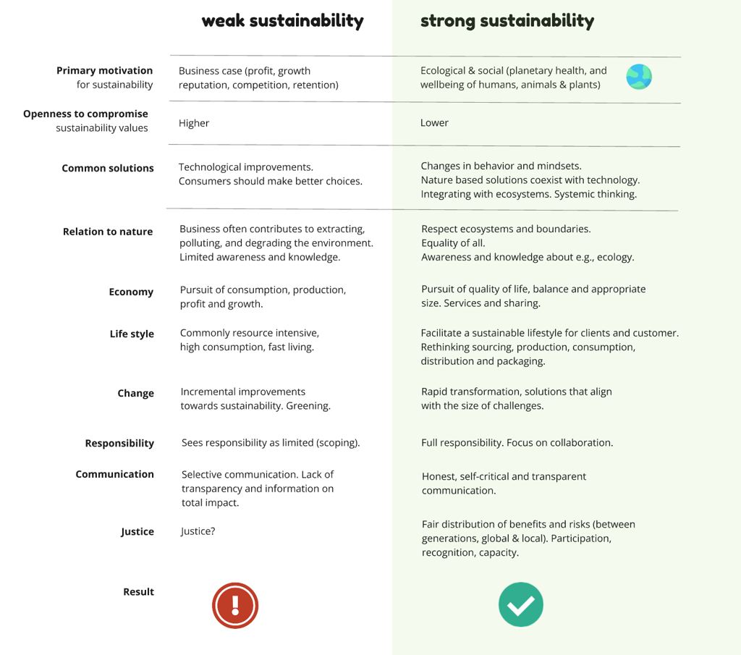
The Table

Slide 9
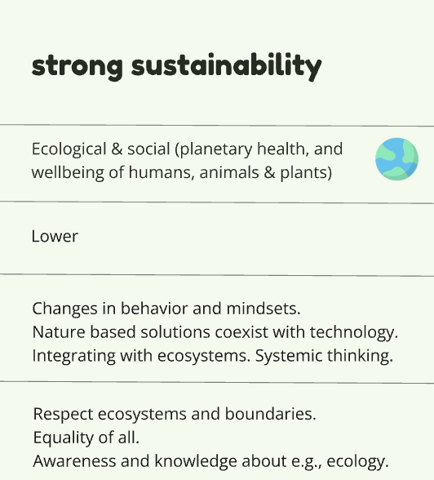

Slide 10
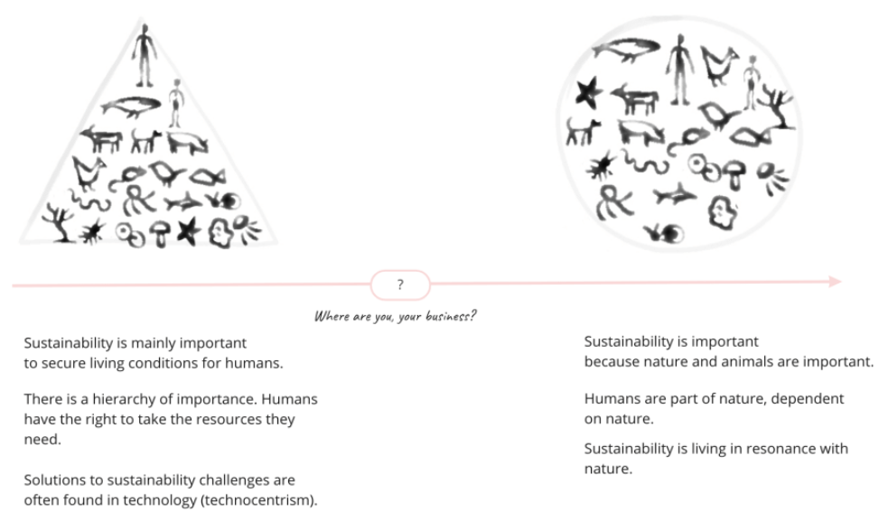
The Perspectives
Anthropocentric
perspective
Ecocentric perspective

Slide 11
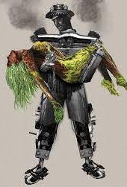
Technocentric
The Technocentric Perspective
Too high reliance in technology
Technological solutions that do not lead to the overexploitation of natural resources can be beneficial
Bild, källa: https://www.hongkiat.com/blog/beautiful-nature-inspired-artwork/

Slide 12
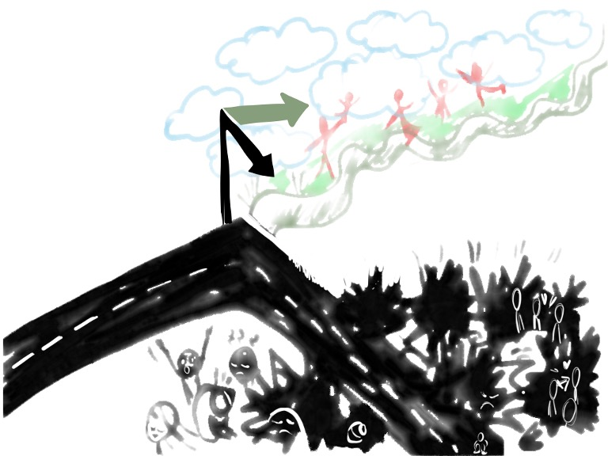
The Road

Slide 13

Higher Education´s role
Systemic thinking
Courage
Carina xx
Critical thinking
Hope & happiness
Acting fairly and ecologically
Wellbeing

Slide 14

Three take aways
Educate students with reference to strong sustainability. Curriculum for the future.
Lead by example: Your whole organisation is up to date and guided by a mindset towards strong sustainaibility and working with transformative actions.
Work together across boarders. Together we are stronger!
Notes:
ANNA
Problem
Current state:
Sustainability commitments in the corporate world is increasing
Still we see growing sustainability issues and an environmental degradation
Current way of addressing sustainability is not working
Demands:
Need for transformative actions
Need for sufficient engagement from the private sector and the citizens.
Need for understanding higher/stronger levels of sustainability.

Slide 15
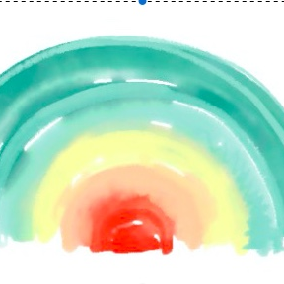
Thank you!
Be the change you want to see in the world.
Mahatma Gandhi
Carina Eriksson, Karlstad University, Sweden
carina.eriksson@kau.se

